Slide 1
Preparing 1st, 2nd and 3rd Generation Migrant Children for Vocational Education
Workshop 9
IO2 © 2023 by MaMLiSE is licensed under CC BY-NC-ND 4.0

Slide 2
The MaMLiSE project
Majority and Minority Languages in School Environment
an international project funded by Erasmus+ Programme under Action 2 – Strategic Partnerships, School Education;
running from 01.11.2020 to 31.07.2023;
main aim: supporting school teachers in delivering effective instruction in linguistically diverse classes. Although multilingualism has been present in EU schools for years, the range of in-service training courses and support materials on offer is still insufficient;
The project consortium has been able to prepare a book and materials on how to effectively support teachers and educational staff to teach successfully in linguistically diverse classes and to develop a whole-school inclusion policy, based on the premise that both newcomers and multilingual pupils who have lived in the country for a long time and were born there should be included.

Slide 3
Agenda
Getting to know each other
Introduction: Language and multilingualism in vocational education and training
Dealing with linguistic diversity in nursing education I
Raising awareness Changing sides
Linguistic challenges in nursing education
Language sensitive teaching in vocational education
Example

Slide 4
Getting to know each other

Slide 5
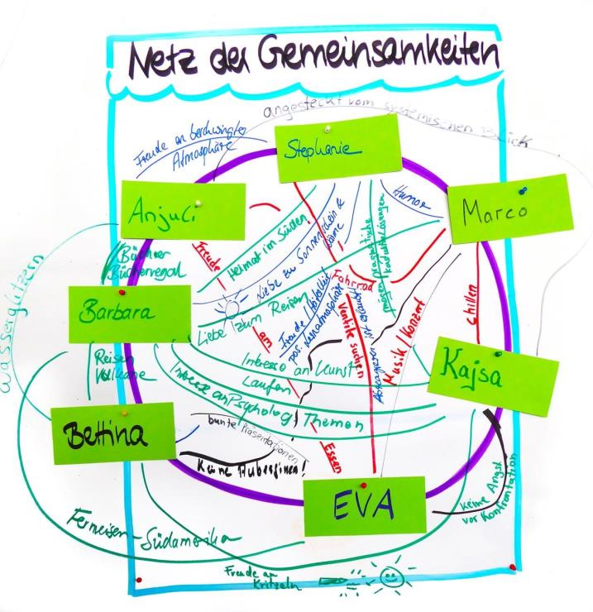
Network of commonalities
Find commonalities (place of birth, hobbies, favourite food, etc.) which every participant, but not directly related to your occupation, the subject of this workshop or your participation in it.
Write the commonality across a connecting line between your names.
You should not repeat the commonality with another person.
https://www.seminarmarkt.de/anbieterdocs/splendid_Methoden_Perle_das_Netz_der_Gemeinsamkeiten1_31554.pdf
Notes:
After the activity, there can be a short exchange with the participants about the advantages of this way of getting to know each other (practises asking questions, works even with little language knowledge, very interactive, a lot of fun) and whether they would also use this in their groups/classes.

Slide 6
Introduction I

Slide 7
Discussion
What experience have you gained with the topic of language and multilingualism in vocational training?
Why do you think the topic of language education in vocational training is still important for the second and third generation of migrants?
What sociocultural challenges may be crucial?
Find overarching aspects under which your experiences can be linked and write each of these down on a presentation card.
If questions about the topic remain open in the group, record these on cards as well.

Slide 8
Dealing with linguistic diversity in vocational education

Slide 9
Background
migration-related heterogeneity as the normal case
current numbers
migration background does not automatically indicate multilingualism
multilingualism does not automatically indicate that the national language has been acquired as a second language
people who have acquired the national language as a second language do not necessarily have linguistic difficulties in the national language
no statements about linguistic competence in German
but: linguistic diversity is increasing – often also due to socio-economic disparities
Notes:
This slide should explain the importance of the topic and can be extended (see also template schedule)

Slide 10
Handling and its effects
lLinguistic education in vocational education and training not yet a fixed integrated component
Either not provided for or as an introductory or additive offer
Trainees seen as responsible for ensuring sufficient language skills
The focus should not only be on the trainees, but also the system of nursing training should be critically reflected – not uncommon that trainees are already dismissed in the probationary period due to insufficient academic performance, without first taking supportive measures (Barth 2021: online).
Notes:
This slide should explain the importance of the topic and can be extended (see also template schedule)
The last point refers to nursing training in Germany but can be transferred to other countries and other vocational training

Slide 11
Interviews with trainees
“at the beginning of the training, you noticed how many people quit because of this language barrier“
“the TEACHERS [...] that it should be a bit easier to explain to us, [should] °hh that we also get in there, get in SLOWLY“
Notes:
This slide should explain the importance of the topic and can be extended (see also template schedule)
The last point refers to nursing training in Germany but can be transferred to other countries and other vocational training

Slide 12
Interviews with teachers in vocational education
We have courses where a WHOLE lot of people have started and also dropped out again
we can only teach the factual, the professional factual, we can NOT teach the language
Notes:
This slide should explain the importance of the topic and can be extended (see also template schedule)
The last point refers to nursing training in Germany but can be transferred to other countries and other vocational training

Slide 13
Raising awareness

Slide 14
Changing sides
You will receive instructions for making a paper aeroplane.
Familiarise yourself briefly with the instructions
Now guide your partner through these instructions using only language.
You must not show anything
The person doing the craft is not allowed to ask any comprehension questions.
After 7 minutes, swap roles

Slide 15
Reflection
How did you feel in the situation?
What percentage of your attention did you pay to the craft instructions and what percentage to the language?
What difficulties did you have?
How did you deal with the difficulties?
What tools would have helped you?
Notes:
This can first occur between the pairs that were working together and then in th whole group. The trainer should write Important aspects on the board.

Slide 16
Consequences for teachers
Teaching should be designed to create equal opportunities
Basic principle of non-discriminatory teaching: all learners should have the same opportunities to act and learn in the classroom, both professionally and linguistically
Providing opportunities for linguistic support
(Tajmel & Hägi-Mead 2017: 31)

Slide 17
Think – pair – share
What experiences/situations in your teaching practice do you now see in a different light?
What consequences do you draw from this?
Notes:
This slide should explain the importance of the topic and can be extended (see also template schedule)
The last point refers to nursing training in Germany but ca

Slide 18
Linguistic challenges in vocational education:
example from nursing training

Slide 19
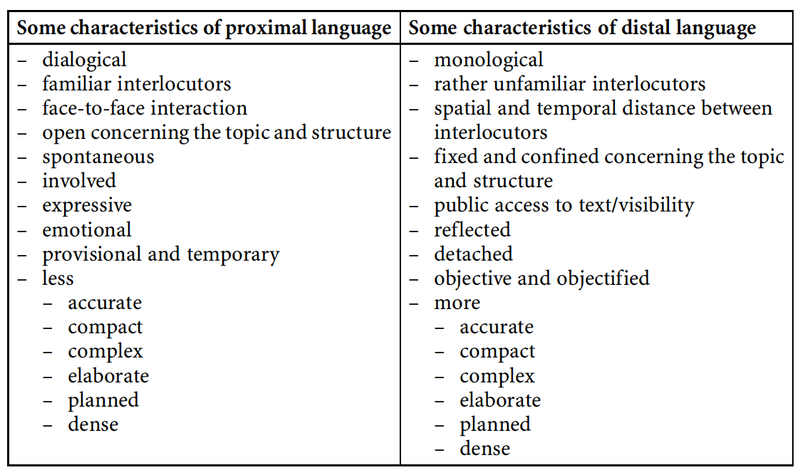
Features of proximal and distal language
(Szczepaniak-Kozak et al. 2023: 115)
Notes:
It is important to remind the participants that we talk about proximal and distal language, but that they are not clearly demarcated languages or linguistic varieties, but rather a continuum!

Slide 20
From proximal to distal language in nursing education
"As the parietal pleura is crossed by sensitive nerves, patients often report severe, stabbing and breath-dependent pain in the chest (thoracic pain). Therefore, they often involuntarily adopt a protective posture and breathing, which is easily recognisable by the shallow breaths and increased breathing rate."
"Mrs. XY is clearly showing signs of breathing, therefore the pain medication should be adjusted".
"Mrs. XY is clearly breathing easily. We need to ask about the pain medication again in a moment."
"I see that you are breathing very shallowly. Do you have any pain in your chest?"
Proximal language
Distal language:
Continuum
( Berendes et al. 2013: 25)

Slide 21
Acquisition
Proximal language
Can be acquired relatively quickly in the second language - in some cases possible within six months if the initial conditions are good.
Distal language
Acquisition takes several years → upstream offers not sufficient
Depends, among other things, on distal language skills in first and other languages
Possibilities of acquisition must be given – access to complex language structures in communication with language experts of the respective language who provide support and enable learning
Explicit teaching necessary

Slide 22
Reflexion and application
Get together in pairs or small groups that work in the same professional field.
Discuss the content of the last slides and link it to your experiences.
Collect examples from your field that illustrate the continuum from proximal language to distal language.
Note: The four examples are only meant to illustrate the continuum. There are many more differentiating situations and texts/utterances to be found in reality.

Slide 23
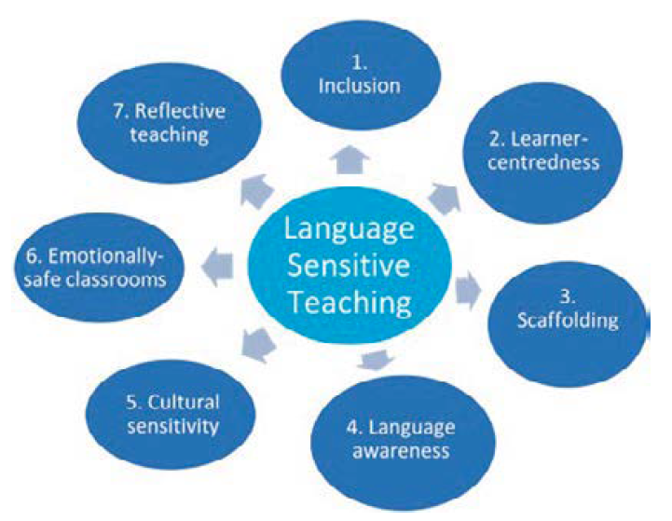
Language sensitive teaching in vocational education
(Szczepaniak-Kozak et al. 2023: 149)
Notes:
The graphic is taken from the project pulication. If you want to go into more detail on the individual points (the next slides are only an excerpt), chapter 6 of the book is recommended for preparatory reading.

Slide 24
Inclusive language development
Language development is constitutive for subject learning (Schmölzer-Eibinger 2013; Ohm 2017)
Content is primarily conveyed through language and learned by means of language (Schmölzer-Eibinger 2013: 25)
Interlocking of linguistic and subject-related learning
Functional view of language use: not only how (focus on form) and what (focus on meaning), but also what for (function of linguistic means) (Schleppegrell 2004; de Oliveira & Schleppegrell 2015)
important: situational embedding – contexts and language constitute each other (Hasan 2005)
Notes:
This slide should explain the importance of the topic and can be extended (see also template schedule)
The last point refers to nursing training in Germany but ca

Slide 25
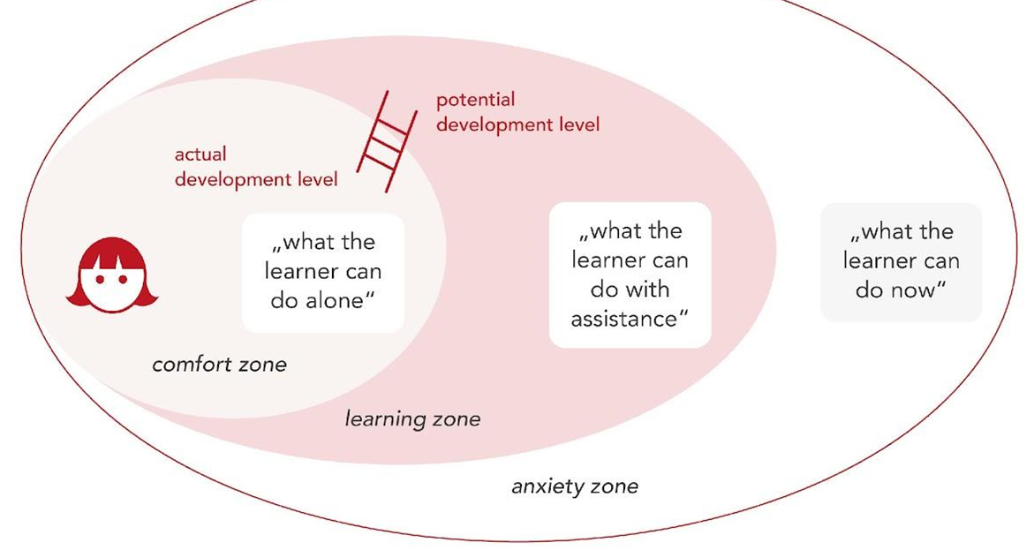
supporting and shaping language-sensitive teaching
→ SCAFFOLDING ←
high challenge and high support
(Mariani 1997)

Slide 26
Principle: Scaffolding
“Scaffolding, however, is not simply another word for help. It is a special kind of help that assists learners in moving toward new skills, concepts, or levels of understanding. Scaffolding is thus the temporary assistance by which a teacher helps a learner know how to do something so that the learner will later be able to complete a similar task alone. lt is future ­oriented and aimed at increasing a learner's autonomy. As Vygotsky has said, what a child can da with support today, she or he can do alone tomorrow.” (Gibbons 2015: 16)
Using language to construct knowledge together (= learning) through dialogue with the aim of solving problems

Slide 27
What do successful scaffolders
Focusing children's attention on task at hand
Keeping them motivated and working on the task
Dividing tasks into manageable components
Directing children’s attention to essential and relevant features
Demonstrating and modeling successful performance
Keeping tasks at an appropriate level of difficulty
(Hammond & Gibbons 2001: 14f.)

Slide 28
Designed-in Scaffolding
clarification and inclusion of prior knowledge and experience
forms of learning and tasks in which learners interact with each other and thus have to act linguistically
use of rich input, i.e. linguistic input
sequencing of learning tasks (e.g. from oral to written)
selection of appropriate (supplementary) material (e.g. films, own actions)
selection of/transition to different forms of presentation
use of mediational texts
planning of meta-linguistic and meta-cognitive phases
(Hammond & Gibbons 2005: 13; Kniffka 2012: 216–218)
Notes:
For more information on scaffolding that helps to illustrate the individual points, see the project publication, chapter 8, from page 218 onwards: https://www.vandenhoeck-ruprecht-verlage.com/themen-entdecken/literatur-sprach-und-kulturwissenschaften/interdisziplinaere-geisteswissenschaft/58207/promoting-multilingual-practices-in-school-and-home-environments

Slide 29
Interactional scaffolding
Slowing down the interaction between learners and teachers
More planning time for learner utterances
Variation of interaction patterns
Active listening by the teacher
Re-coding of learners' utterances by the teacher
Embedding learners' utterances in larger conceptual contexts
Making thought processes explicit
Handing over
(Gibbons 2002: 34ff.; Gibbons 2009: 136ff.)

Slide 30
Reflexion
What aspects of scaffolding are you already implementing without realising that you are?
What approaches do you see in your teaching?
Where is there still room for improvement?
What could you spontaneously integrate into your lessons?

Slide 31
Example from nursing training

Slide 32
Reflexion
Change of dressing for perifervenous vascular access
Task
Perform a simulated wound bandage change of a peripheral vascular access on your course mates. Describe in bullet points the materials required and the individual steps in the table below.
Notes:
If the group of participants is mixed according to the professional fields in which they teach, it does not really matter from which professional field an example is taken, as they are mostly transferable. However, the example can of course be exchanged. Especially if it is a homogeneous group with regard to the professional field, an example from this field should be taken.
===========
This is a teaching example from the first year of nursing training in Germany, which was observed as part of a research and development project. The picture shows a section of a worksheet.
The challenges observed: The work order was partly not understood, the table was partly not filled in or filled in incorrectly, there was no safeguarding of results
In addition, the task was unclear: Should the materials really be described or do they have to be named appropriately and then described what is done with them?

Slide 33
Supposed simplification
Didacticisation with bullet points is supposed to simplify
However, this makes the task more difficult, and the trainees cannot learn the full forms/sentences
Linguistic information is missing, unclear blanks
Selecting/formulating bullet points → complex (What is important? How long/short/precise?)
(What is important? How long/short/precise is the formulation?)
better: going the other way round: first enrich → then shorten

Slide 34
Alternative with scaffolding
Carry out a practical wound bandage change (concrete demonstration)
Oral exchange in partner work– recapitulating what they have done
Summarising in the plenary what has been done, teacher supports contributions linguistically, reformulates, secures central terms and phrases on the board
Groups: photos (action steps of changing the wound bandage) and word material (verbs, temporal adverbs: "first, then ...") + notes on blackboard from step 3

Slide 35
Alternative with scaffolding
Plenary: writing down the results in the form of complete sentences
Reading the corresponding textbook text
Pairs: marking important aspects that have to be written in the table
Plenary: Teachers shows formulation (shortening of sentences into bullet points) using an example, joint practising
Pairs: transferring the action steps to the table in bullet points
Notes:
After the presentation of the steps: Ask the participants about their impression: Is the teaching example comprehensible for them? Do you have any criticism or suggestions for improvement? Is the example transferable to other professional areas?

Slide 36
Task
Take a task from your lessons and try to design it step by step in such a way that it offers opportunities for integrated and demand-oriented Language learning.
You can do this on your own, but experience shows that it works better in dialogue with others at the beginning.
Notes:
If there is more time for the Workshop, you can integrate this tasks. It takes min. 90 minutes more (for group work and presentations/discussion).

Slide 37
Final reflexion
What insight do you take with you?
What do you want to work on?
What do you still need?
Write down short answers for each question on a presentation card.
Collect your cards in the whole group.
Have a look at the answers of the other participants.

Slide 38
Thank you for your attention! Dziękujemy za uwagę!
Ευχαριστώ για την προσοχή σας!

Slide 39
References
Barth, Judith Marlies (2021). Abbruch der Pflegeausbildung: Jede:r Dritte schmeißt die Lehre, at: https://medwing.com/DE/de/magazine/artikel/pflegeausbildung-abbruch/ (11.03.2023).
Gibbons, Pauline (2009).English Learners, Academic Literacy, and Thinking. Learning in the Challenge Zone. Portsmouth: Heinemann.
Gibbons, Pauline (2015). Scaffolding Language, Scaffolding Learning. Teaching English Language Learners in the Mainstream Classroom. 2nd Ed. Portsmouth: Heinemann.
Hammond, J. / Gibbons, P. (2001). What is scaffolding? In: Hammdond, J. (Ed.), Scaffolding: Teaching and Learning in Language and Literacy Education. Newton: PTA, pp. 13–26.
Kniffka, G. / Siebert-Ott, G. (2007/2009). Deutsch als Zweitsprache – Lehren und lernen. 2nd. Ed. Paderborn: Schöningh.
Kniffka, G. (2012). Scaffolding – Möglichkeiten im Fachunterricht sprachliche Komptenzen zu vermitteln. In: Michalak, Magdalena; Kuchenreuther, Michaela (eds.), Grundlagen der Sprachdidaktik Deutsch als Zweitsprache. Baltmannsweiler: Schneider Verlag Hohengehren, 208–225.
Mariani, L. (1997). Teacher support and teacher challenge in promoting learner autonomy. Perspectives, 23(2), 5–19.
Schmölzer-Eibinger, S. (2013), Sprache als Medium des Lernens im Fach. In: Becker-Mrotzek, Michael; Schramm, Karen; Thürmann, Eike; Vollmer, Helmut J. (eds.): Sprache im Fach. Sprachlichkeit und fachliches Lernen. Münster et al.: Waxmann, 25–40.
Szczepaniak-Kozak, A. / Farrell, A. / Ballweg, S. / Wąsikiewicz-Firlej, E. /Daase, A. / Masterson, M. (2023) Promoting multilingual practices in school and home environments (Interdisziplinäre Verortungen der Angewandten Linguistik, 8). Göttingen: V&R unipress.
Tajmel, Tanja; Hägi-Mead, Sara (2017). Sprachbewusste Unterrichtsplanung – Prinzipien, Methoden und Beispiele für die Umsetzung (FörMig Material,9). Münster: Waxmann.
Vygotsky, L, S. (1978): Mind in society. The development of higher psychological processes. Cambridge, Mass.: Harvard Univ. Press.
Wood, D. / Bruner J.S. / Ross, G. (1976). The Role of Tutoring in Problem Solving. Journal of Child Psychology and Psychiatry 17, 89–100.

Slide 40
CERTIFICATES
Thank you for your participation

