Slide 1
Psychological, emotional and cultural aspects of migrant experience and its impact on learning (focus on trauma)
Workshop 8
IO2 © 2023 by MaMLiSE is licensed under CC BY-NC-ND 4.0

Slide 2
The MaMLiSE project
Majority and Minority Languages in School Environment
an international project funded by Erasmus+ Programme under Action 2 – Strategic Partnerships, School Education;
running from 01.11.2020 to 31.07.2023;
main aim: supporting school teachers in delivering effective instruction in linguistically diverse classes. Although multilingualism has been present in EU schools for years, the range of in-service training courses and support materials on offer is still insufficient;
The project consortium has been able to prepare a book and materials on how to effectively support teachers and educational staff to teach successfully in linguistically diverse classes and to develop a whole-school inclusion policy, based on the premise that both newcomers and multilingual pupils who have lived in the country for a long time and were born there should be included.

Slide 3
Getting to know each other

Slide 4
Coming together by means of content
I am attending this workshop because …
Write your personal answers on presentation cards (one card for one answer).
Get together in a small group and share your reasons for attending this workshop – perhaps there will more reasons.
Collect your cards all together on the pinboard, they also can be clustered (putting similar responses together)
Which commonalities and differences

Slide 5
Outline
Getting to know each other
Perception of professional boundaries
Sequential traumatisation

Slide 6
Perception of professional boundaries

Slide 7
Starting point
Having to deal with (a larger) number of newly immigrated pupils, especially from war zones or with experiences of flight, without preparation (in terms of time and content) can lead to the following experiences and feelings:
Chaos and disorientation
Overstrain in the role as a teacher
Insecurity about own behaviour
Used languages in communication with the pupils
Topics allowed or to be avoided in contact with pupils
Dealing with my own emotions
Normal reaction in an extraordinary situation
Notes:
You can prepare yourself for this slide with the excerpt from the video by Verena Plutzar from 1:11 to 4:18 or play this excerpt to the participants.

Slide 8
Joint reflection
In small groups, discuss the following questions
What is my professional role?
What are my tasks and objectives?
Where can I find help and support?
Record the final results for each question on presentation cards.

Slide 9
Trauma and its impact

Slide 10
Challenge migration & migration crisis
not only flight, but also migration and the necessity of starting life and school in another country can be a very distressing situation (Plutzar 2019)
to bear in mind: even so-called voluntary migration is usually involuntary for children, as others (parents, caregivers) decide to migrate
trauma can also arise „from repeated experiences of discrimination, challenging or undignified conditions of living in a new environment or by leaving loved ones behind (Fanning 2018; Lyons 2010; Smyth et al. 2009)” (Szczepaniak-Kozak et al 2023: 179)
migration, for whatever reason, can always lead to a migration crisis, which can affect learning (Plutzar 2019)

Slide 11
Migration and trauma
Not every flight or migration inevitably triggers trauma
A potentially traumatising experience can lead to traumatisation in one person but not in another
Teacher should keep in mind that pupils might be traumatised without linking every different behaviour to trauma
Difficulty of children living with traumatised parents – Taking on tasks that are actually in the role of parents and the resulting overload
Important: no quick diagnoses, without an expert’s assistance
Notes:
Note to bullet point two:
Whether an event is traumatising for a person or not depends not only on external circumstances, but also on the inner experience, evaluation and handling of the event.
A number of factors play a role here:
Individual factors:
Previous experiences
processing strategies
Personality
cognitive coping abilities, age, etc.
Environmental factors:
Relationships and support through social networks
experience of safe places

Slide 12
Flight and admission as part of traumatisation – sequential traumatisation
from the beginning of persecution to flight
on the flight
transition 1 – the initial period at the place of arrival
chronification of the temporary
transition 2 – The return
after the persecution
(Becker 2006: 193f.; Plutzar 2016: 111ff.
Notes:
You can prepare yourself for this slide with the excerpt from the video by Verena Plutzar from minute 8:55 or play this excerpt to the participants.
https://odnpoznan-my.sharepoint.com/personal/malgorzata_dynowska_odnpoznan_edu_pl/_layouts/15/stream.aspx?id=%2Fpersonal%2Fmalgorzata%5Fdynowska%5Fodnpoznan%5Fedu%5Fpl%2FDocuments%2Funtitled%2Emp4&ga=1

Slide 13
Experiences of loss through migration/flight
family members
friends
status
property
taken-for-granted use of languages that are familiar to the pupils
reinforces the feeling of helplessness on the part of the pupils
unfavorable conditions for learning a new language or learning at all
(Plutzar 2019)
Notes:
You can prepare yourself for this slide with the excerpt from the video by Verena Plutzar from 1:11 to 4:18 or play this excerpt to the participants.

Slide 14
Impact on identity and learning
Pupils´ experience of pupils of speechlessness
reinforces the feeling of helplessness
supports the regressive states
unfavourable conditions for learning a new language or learning at all
(Plutzar 2019)
Notes:
You can prepare yourself for this slide with the excerpt from the video by Verena Plutzar from 1:11 to 4:18 or play this excerpt to the participants.

Slide 15
Possible manifestations of post-traumatic disorders
recurrent, intrusive memories
constantly repeating (repetitive) behaviours
fears
avoidance
dissociation
hypervigilance
regressive behaviour
physical feeling
Note: If these symptoms are observed for several weeks, post-traumatic stress disorder is probably present. Sometimes, however, they disappear again quickly - human capacity for resilience.
(Plutzar 2022)
Notes:
You can prepare yourself for this slide with the excerpt from the video by Verena Plutzar from 1:11 to 4:18 or play this excerpt to the participants.

Slide 16
The common experience of regression
“The feelings of insecurity experienced by newcomers are determined not only by the uncertainties and fears in the face of the unknown but also by the inevitable regression that is carried along by these fears. It is this regression that evokes in them a sense of helplessness and sometimes prevents them from making effective use of the resources they have at their disposal which are part of their 'luggage'." (Becker 2006: 84)
Notes:
You can prepare yourself for this slide with the excerpt from the video by Verena Plutzar from 1:11 to 4:18 or play this excerpt to the participants.

Slide 17
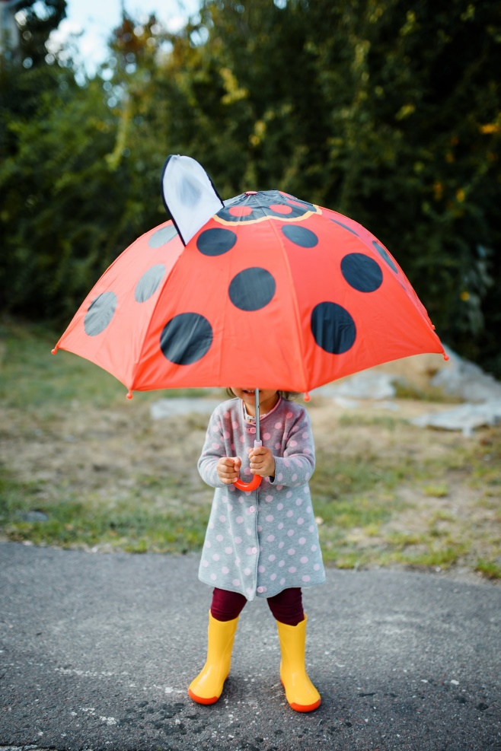
The classroom as a safe place

Slide 18
How to create a safe place
a focus on and promotion of pupils’ abilities so that they experience not only the inadequacy of their yet-to-be-acquired language but also self-efficacy, so that the entry into a new language and the new life is through something familiar
allowing all learners to include their languages in the learning process, so that the language being learned stands alongside the other languages and develops with their help so that pupils’ inability to communicate and feelings of inadequacy in terms of their expression in the new language are mitigated.
(Plutzar 2019: 225; Szczepaniak-Kozak et al. 2023: 181)

Slide 19
How to create a safe place
the use of all additional resources available to teachers and learners, such as dictionaries, translation programs, or digitally available texts in the first, or other known languages, in order to facilitate understanding and stimulate engagement with the language
enabling learners to experience something in the classroom and to connect language with it, so that emotions are handled and named in the languages known to the pupils and in the new language as well – the new language can be used to express an inner experience without displacing the known language if the learners so wish
teachers showing a willingness to learn from their pupils in order to respect and trust newcomers
(Plutzar 2019: 225; Szczepaniak-Kozak et al 2023: 181f.)

Slide 20
What you can do
Give the children a sense of normality
their behaviour is normal for what they have experienced and are still experiencing
Show them that they are now here and they are safe
Meet and treat them like the other pupils
Meet them openly
Talk to them in languages they are familiar with
If you do not know these languages, talk to the children anyway
Let them participate
Be aware of your emotions to keep them out as much as possible
Take care of yourself
Do not take on the role of a therapist
(Plutzar 2022: 15)

Slide 21
Reflection
What was new/surprising/relieving?
What of the proposed things are you already doing?
Which experience did you make?
What can you recommend?

Slide 22
Elaboration with case vignettes

Slide 23
Group work
Get together in small groups of three or four.
You might want to work with someone you haven't spoken to yet today to be able to expand your network.
Have a look at the case vignettes and think about which one you want to work with.
If one of you has a current case that fits the topic and that you want to discuss, this is also possible.
Discuss the cases and possible answers to the questions under the vignettes.

Slide 24
Closing session

Slide 25
Poster discussion: final reflection
What if I had not participated in today’s workshop?
How will my pupils notice that I did?

Slide 26
Final agreements
What can we do to ensure that the untreated aspects are not lost?
Who can be approached or invited?
Who will take care of it?
How can you network?

Slide 27
Thank you for your attention! Dziękujemy za uwagę!
Ευχαριστώ για την προσοχή σας!

Slide 28
References
Becker, D. (2006). Die Erfindung des Traumas – Verflochtene Geschichten. Freiburg: edition Freitag.
Plutzar, V. (2016). Sprachenlernen nach der Flucht. Überlegungen zu Implikationen der Folgen von Trauma und Flucht für den Deutschunterricht Erwachsener. In: OBST (Osnabrücker Beiträge zur Sprachtheorie) Heft 89, Flucht. Punkt. Sprache, 109–132.
Plutzar, V. (2019). Sprachenlernen im Kontext von Flucht und Migration. Psychologische Aspekte und ihre Implikationen für den Deutschunterricht. In: S. Schmölzer-Eibinger / M. Akbulut / B. Bushati (eds.), Mit Sprachen Grenzen überwinden. Sprachenlernen und Wertebildung im Kontext von Flucht und Migration (pp. 215–228). Münster: Waxmann.
Plutzar, V. (2022). War and displacement in the neighbouring country What does it mean to my work as a teacher? Presentation in a MaMLise webinar. http://mamlise.home.amu.edu.pl/?page_id=350.
Szczepaniak-Kozak, A. / Farrell, A. / Ballweg, S. / Wąsikiewicz-Firlej, E. /Daase, A. / Masterson, M. (2023). Promoting multilingual practices in school and home environments (Interdisziplinäre Verortungen der Angewandten Linguistik, 8). Göttingen: V&R unipress

Slide 29
CERTIFICATES
Thank you for your participation

