Slide 1
Multilingual school development -
Whole school development
Workshop 7
IO2 © 2023 by MaMLiSE is licensed under CC BY-NC-ND 4.0

Slide 2
The MaMLiSE project
Majority and Minority Languages in School Environment
an international project funded by Erasmus+ Programme under Action 2 – Strategic Partnerships, School Education;
running from 01.11.2020 to 31.07.2023;
main aim: supporting school teachers in delivering effective instruction in linguistically diverse classes. Although multilingualism has been present in EU schools for years, the range of in-service training courses and support materials on offer is still insufficient;
The project consortium has been able to prepare a book and materials on how to effectively support teachers and educational staff to teach successfully in linguistically diverse classes and to develop a whole-school inclusion policy, based on the premise that both newcomers and multilingual pupils who have lived in the country for a long time and were born there should be included.

Slide 3
Contents
The axes of the term multilingual school development and whole school development.
Examples from schools, especially multilingual schools.
Participants create a whole school development plan by completing the template.
Debate in plenary.

Slide 4
Icebreakers
About
age,etc
why they do this workshop
what they want to learn
their beliefs about education
about their experience in multilingual classes
10’

Slide 5
1st part: The axes of the term multilingual school development and whole school development.
20’
Brainstorming
What multilingual school development is?
What whole school development is?

Slide 6
Multilingual school development (M.S.D) means
Multilingual school development aims to provide a safe, diversity-friendly environment for all pupils in which they can develop their individual linguistic repertoire.
Chapter 5, pg 26.

Slide 7
Who participates in it?
Multilingual school development involves
all stakeholders - school leaders,
administrators,
educators,
pupils,
parents and others - is now needed in order to provide a safe, diversity-friendly learning environment for all pupils to allow them to develop their individual linguistic repertoire
and thrive cognitively, socially, and emotionally.
Chapter 5, p 26.

Slide 8
How can M.S.D be achieved?

Slide 9
Whole school development (WSD)
Whole-school approach addresses development on
an individual level,
a classroom level and
an organizational level.
These should be the levels to consider in evaluating the resources and needs on each level.
Chapter 9, p. 3

Slide 10
Individual level:
Basic guidelines include:
not to prohibit, discourage or punish the use of other languages at school,
not to prohibit or discourage parents from using their own languages at school,
not to advise parents to use a different language at home with their children,
to nominate a coordinator for multilingual school development,
to jointly develop a plan for school development.
https://languagefriendlyschool.org/welcoming-all-languages/how-to-become-a-language-friendly-school/

Slide 11
In the classroom
to make room for pupils’ home languages as part of the learning process,
to make each of the pupils’ languages visible in the classroom,
to offer regular training and professional development to improve language friendly classroom strategies,
to encourage pupils to develop their whole language repertoire, including dialects and accents,
to find ways to provide instruction in various languages present in the school and by using other semiotic resources,
to promote written, oral, gestural, and graphic communication, for the educators to reflect on their own norms, values and attitudes towards language, cultural and ethnic diversity,
to share and regularly update approaches and the used materials, for educators,
to learn about the role of home languages in learning additional languages.
Chapter 9, p. 5

Slide 12
In the school
to discover all the languages spoken within the school community,
to inform the whole school community about the role of home languages,
to foster teacher-parent collaboration to support pupils’ learning and well-being,
to create awareness of multilingual language acquisition and development,
to make all school languages visible,
to encourage pupils to become language ambassadors,
to draft an anti-bullying plan that includes languages, dialects and accents,
to facilitate communication in different languages with parents,
to facilitate after-school language activities,
to create a language friendly library.

Slide 13
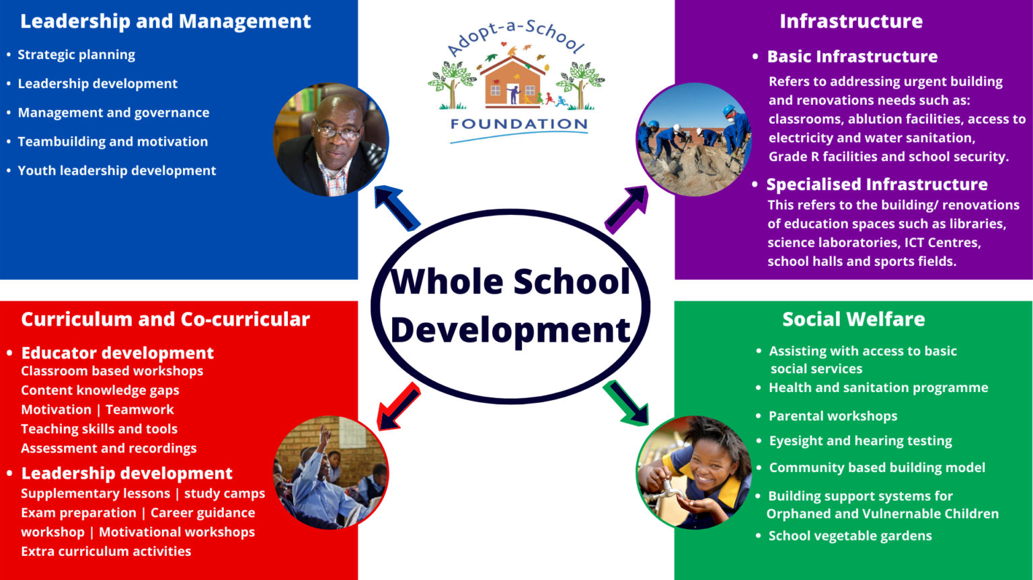
1st part: The axes of the multilingual school development and whole school development.
Whole School Development – Adopt-a-School Foundation (adoptaschool.org.za)

Slide 14
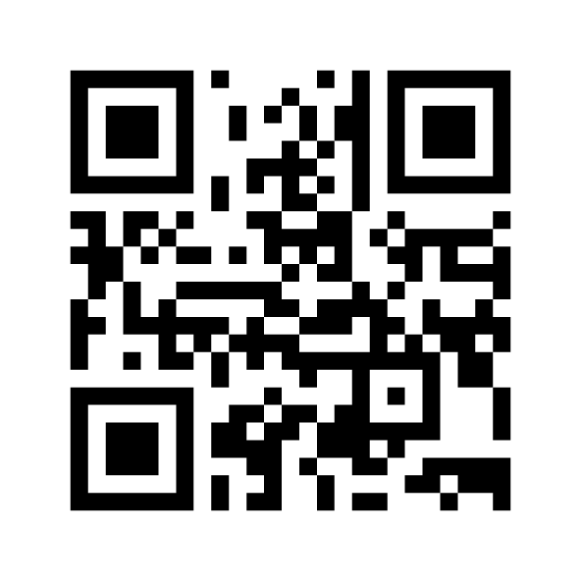
1st part: The axes of themultilingual school development and whole school development.
Brainstorming
Vote: https://www.menti.com/g5ik386yh1
Answers: https://www.mentimeter.com/app/presentation/0373006d5528f7bf6050811ac6acee65/228d3e25d571

Slide 15
1st part: The axes of multilingual school development and whole school development.
15’
Multiligualism
We must be aware that a student's repertoire does not always consist of one mother tongue, one new language of the host country and perhaps one or two foreign languages. In many cases, students grow up with more than one mother tongue or may have had other languages ​​of instruction in the past. Other varieties are probably involved. Furthermore, especially for refugees and highly mobile families, the new host country may not be the first host country after leaving the home country, so that a student may have had different languages ​​of instruction in the past.
It is essential to let multilingual students define their own multilingualism and not to label them and their languages.
Chapter 9

Slide 16
1st part: The axes of multilingual school development and whole school development.
The multilingual development of the school is not limited to encouraging and supporting the learning of the language of instruction but it aims to provide a safe, diversity-friendly environment for all pupils in which they can develop their individual language repertoire.
Meeting the challenges and making the most of the opportunities offered by a high degree of diversity requires a whole-school approach and the contribution and cooperation of all stakeholders - school managers, teachers, pupils, parents and others.
Chapter 9, p. 5

Slide 17
1st part: The axes of the term multilingual school development and whole school development.
Whole School Development – Adopt-a-School Foundation (adoptaschool.org.za)

Slide 18
1st part: The axes of multilingual school development and whole school development.
Leadership - Management
Well-developed, accountable and supportive leadership with an established and clear vision for the future of the school
Good relationships and coordinated interventions with different stakeholders.
Strategic planning, leadership, management and governance

Slide 19
1st part: The axes of multilingual school development and whole school development.
Infrastructure - physical environment of the school
Clean and well-maintained surroundings and facilities with all necessary resources.
The school premises create a positive learning environment for students.
Library or learning resources adequately support delivery of the curriculum.

Slide 20
1st part: The axes of multilingual school development and whole school development.
Quality of teaching and learning
Dedicated and committed educators
Extra and co-curricular activities
Educator development, including knowledge and implementation of curriculum,

Slide 21
1st part: The axes of multilingual school development and whole school development.
Social welfare
Safe, healthy and happy environment which promotes human dignity.
Social welfare of learners
Dedicated, committed and accountable school community which promotes the long-term sustainability of the school.
School safety, security and discipline

Slide 22
Break!
End of 1st part!
10’

Slide 23
2nd part: Examples from schools, especially multilingual schools.
Work groups discuss and point out the main axes of multilingual school development (case studies)
20’
Case study group1 - Worksheet_1a
Case study group 2 - Worksheet_1b
Case study group 3 - Worksheet_1c

Slide 24
2nd part: Examples from schools, especially multilingual schools.
Presentations by the groups Debate Conclusions
20’
More examples of schools
Language Friendly Schools in action

Slide 25
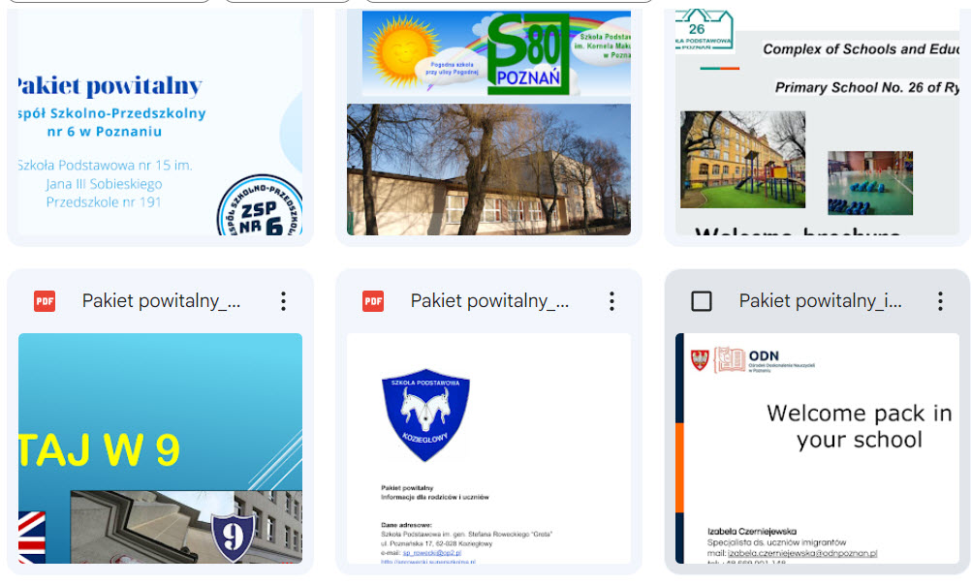
2nd part: Examples from schools, especially multilingual schools - welcome packages
Greek school
https://drive.google.com/file/d/1yt5KrSr8qjPoSu3QEdtjS0s_LQkPysR2/view?usp=sharing
Polish schools
https://drive.google.com/drive/folders/1dGTfGsbqOsyKiW17BmcaKxqJ1SYjs0QF?usp=sharing

Slide 26
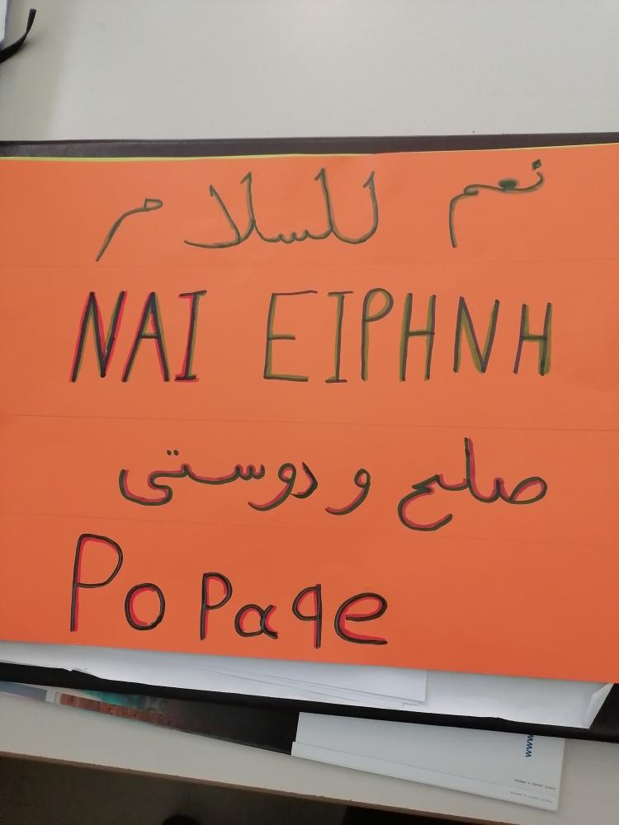
2nd part: Examples from schools, especially multilingual schools - multilingual signs

Slide 27
Break!
End of 2nd part!
10’

Slide 28
3rd part: Participants create a whole school development plan by completing the template.
work groups template of Whole school development
30’
School development plan template - Worksheet_2

Slide 29
3rd part: Participants create a whole school development plan by completing the template.
Presentations by the groups Debate Conclusions
15’

Slide 30
Break!
End of 3rd part!
10’

Slide 31
4rd part: Discussion in the plenary. Conclusions
Alternatively
We can use this video from youtube
https://www.youtube.com/watch?v=6Vc-OYEjImw
(24’-31’)
where Dr Deirdre Kirwan speaks
Dr Deirdre Kirwan
Former Principal Scoil Bhride
(Cailini)
Blanchardstown
“Plurilingual Education: Benefitsfor all learners”
David Little
14 minute for 3 minutes

Slide 32
4rd part: Discussion in plenary. Conclusions
Panel discussion about: What were the main goals of the workshop? How did we achieved these? Why is it necessary to change the conventional school to whole school development? What are the results?
30’

Slide 33
4rd part: Discussion in plenary. Conclusions
15’

Slide 34
References
Mattheoudakis, M.; Chatzidaki, A.; Maligkoudi, C. (2017). Greek teachers’ views on
linguistic and cultural diversity. In: Agathopoulou, E. / Danavassi, T. / Efstathiadi,
L. (eds.), 22rd International Symposium papers on theoretical and applied linguistics
- Selected papers (pp. 358–371). Thessaloniki: Aristotle University of Thessaloniki.
Oller, D. K. / Pearson, B. (2002). Assessing the effects of bilingualism: A back-
ground. In: Oller, D. K. / Eilers, R. (eds.), Language and literacy in bilingual
children (pp. 3–21). Clevedon: Multilingual Matters.
Polinsky, M. (2015). Heritage languages and their speakers: State of the field,
challenges, perspectives of future work, and methodologies. Zeitschrift für
Fremdsprachenforschung 26 (1), 7–27.
Rolff, H.-G. (2013). Schulentwicklung kompakt. Modelle, Instrumente, Perspektiven.
Weinheim/Basel: Beltz.
Skutnabb-Kangas, T. (2012). Indigenousness, human rights, ethnicity, language and
power. International Journal of the Sociology of Language 213, 87–104.
Slade, S. / Griffith, D. (2013). A whole child approach to student success. KEDI
Journal of Educational Policy, Special issue, 21–35.

Slide 35
CERTIFICATES
Thank you for your participation

