Slide 1
Workshop 6.2
Subject-Oriented Language Teaching
IO2 © 2023 by MaMLiSE is licensed under CC BY-NC-ND 4.0

Slide 2
The MaMLiSE project
Majority and Minority Languages in School Environment
an international project funded by Erasmus+ Programme under Action 2 – Strategic Partnerships, School Education;
running from 01.11.2020 to 31.07.2023;
main aim: supporting school teachers in delivering effective instruction in linguistically diverse classes. Although multilingualism has been present in EU schools for years, the range of in-service training courses and support materials on offer is still insufficient;
The project consortium has been able to prepare a book and materials on how to effectively support teachers and educational staff to teach successfully in linguistically diverse classes and to develop a whole-school inclusion policy, based on the premise that both newcomers and multilingual pupils who have lived in the country for a long time and were born there should be included.

Slide 3
Let's try to describe the process
.
Most of the subject content conveyed in texts is often accompanied by many instructions and comments. Misunderstanding or insufficient understanding of the message and /or accompanying commands inhibits the learning process (Seretny, A., 2019: 18).
Effective reading and understanding of the text in this situation is not possible
without strategies, as they are effective methods of solving difficulties and
problems (Kugiel-Abuhasna, 2019: 9).

Slide 4
Please, underline in the text below those words that the student will learn while working with the second language textbook. (Worksheet 06_W_05_WS)
Please, complete the table with reference to the geography text on Glacial Valleys and U-shaped Valleys in worksheet 06_W_05_WS. (Worksheet 06_W_06_WS)

Slide 5
Please, make a list of what might be an obstacle for a foreign student in understanding the text? (Worksheet 06_W_07_WS)

Slide 6
Strategy examples
Inference | Definition | Example
Formal | Reaching the meaning on the basis of the analysis of the words’ structure as well as searching for analogies to already known forms and grammatical information | We were talking for a long time but it was not a nice conversation. Talking – conversation (in Polish the noun derives from the verb)
 | Reaching the meaning on the basis of syntactic or semantic connectivity of words in the vicinity of the unknown | He has committed an offense. If the learner knows that the verb to commit collocates with nouns referring to a reprehensible act, he/she knows that such an act was committed, although he/she does not quite know what kind.
Contextual | Reaching the meaning based on the analysis of the content of the context in which it appears. | I am asking you for a legible signature. I need to know who took the letter. The context indicates that it is a signature that can be read, in other words – it is clear.
Thematic/content-related | Reaching the meaning on the basis of your knowledge. | The color of a canary is yellow. If the learner has some basic knowledge about a canary, it is highly likely that he/she will guess the meaning of the word yellow.
Table 1. Types of lexical inference (Seretny, A. 2019: 20), own elaboration.

Slide 7
This short text below is about why French people travel to live and work in Montréal, which is the largest city in Canada's Québec province.
What strategies will you use to understand these words? (Worksheet 06_W_08_WS)

Slide 8
.
Which factors related to the student have an impact on the process of understanding the meaning of words? (Worksheet 06_W_09_WS)
The results of this task differs among the workshop participants. What do you think this is the case?

Slide 9
Factors
.
Cognitive factors | Linguistic factors
The ability to focus on details | Lexical resource (quantitative and qualitative)
The ability to reason | Level of knowledge of Language 2
Being willing to make a cognitive effort | Linguistic knowledge
General knowledge (also a linguistic factor) | Linguistic biography
Reading skills in Language 1 (also the linguistic factor) | Ability to use context (also a cognitive factor)
 | Ability to find analogies in Language 2 (also a cognitive factor)
More on this topic: Seretny, A. (2019: 21).

Slide 10
.
Underline word concreteness in the text. Assess the degree of difficulty of the text based on the proportions of word concreteness and word abstractness. (Worksheet 06_W_10_WS)
Concrete words refer to tangible objects, experiential features and activities. They say about the here and now. Imaginable units, on the other hand, are those who semeaning "can be seen" in the form of an image. Imagination and specificity are similar concepts - the image of a concrete thing, e.g. a flower pot, is easily evoked in our minds. However, they are not identical, because sometimes it is easy to imagine abstract beings, for example, "see" the blue or "feel" that it hurts or stinks. Imagination is therefore a feature with a much broader meaning than specificity (Seretny, A., 2016: 22).

Slide 11
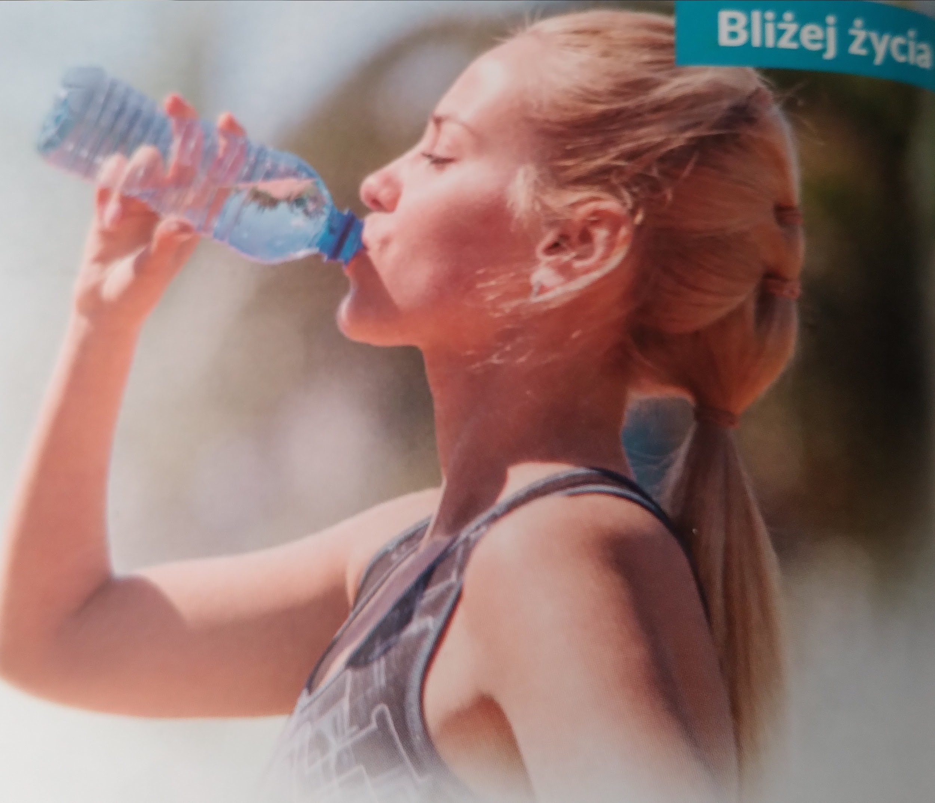
Pictures
A picture was attached to the fragment of text about water in the previous slide. How can students be taught to support themselves with graphics in order to better understand the text?

Slide 12
.
Read the text about the 2011 earthquake and tsunami in Japan. Complete the gaps in the text with the words below. (Worksheet 06_W_11_WS)

Slide 13
.
What may a foreign student miss while learning language and history? (Worksheet 06_W_12_WS)

Slide 14
Functional grammar
The meaning of colors:
red - participants - realised by nouns, noun phrases and nominal groups
green - processes - verbs and nominalizations
blue - circumstances - prepositional phrases, adverbial adjuncts, and other resources for information about time, place, manner, etc.
yellow - connections - realised by resources for making logical relationships by conjunctions, adverbs, prepositions etc.
Stands out immediately as being different to traditional grammatical analysis in the sense that it not the word level that is the focus, but the units of meaning within a sentence.
Start by specifying the phenomenon to be explained.

Slide 15
.
Analyse the following ten sentences with functional grammar using this colour scheme. (Worksheet 06_W_13_WS)

Slide 16
Understanding word formation and syntax rules
Pattern 1: The procedure of lexical inference
Step 1 What part of speech is a word you don`t understand? Can it be broken down by
distinguishing the subject, affix and ending? What is its basic form?
Step 2 If the unknown word is a noun, is it determined by any adjectives? What verb does it come
with, what does the noun ‘do’, what ‘happens’ to it? If it is a verb, what noun is it connected with?
Step 3 How does a sentence relate to the unknown word with other sentences before or after it?
Step 4 Are you capable of guessing the meaning of the word?
Step 5 Check if you guessed correctly:
- is the part of speech correct?
- does the meaning of individual parts correspond to the guessed meaning, after dividing the word into morphemes?
- does the sentence, in which this word is, make sense now?
Step 6 Make sure you correctly guessed the meaning: check it tup in the dictionary, ask the teacher, etc.
Source: Seretny, A. (2019: 24), own elaboration
.

Slide 17
Maths
According to Ellerton and Clarkson (1996), mathematics can be seen as a language unto itself, complete with its own vocabulary, grammar, symbols, and punctuation. Language enables math students to communicate their understanding, ask and respond to questions, and share their solutions with others. In addition, it has a big impact on how questions are understood and how mathematical language is processed (Hoosain, 1991).
With the advent of Project Maths in Ireland, where there is a much larger emphasis on answering word problems and applications, this is currently especially pertinent. Students are expected to translate common difficulties into mathematical formulas, work out the problems, and then explain their solutions in light of the original issue.
According to many teachers, students with poor literacy skills and, in particular, international students for whom English is a second language have difficulty understanding this content and some of the questions since they are wordy (Cosgrove et al., 2012). ‘The language used when phrasing a question poses a major problem for students whose literacy skills would be weak, they can therefore not answer a question they are mathematically capable of doing! This is a major issue!’ (Cosgrove et al., 2012:72)
According to Prendergast et al's (2016: 3) study, more must be done to accommodate international students for whom English is not their first language and make sure Project Maths does not penalize them. The ability of students to solve practical and application-based problems as well as to read and understand questions with a focus on helping students read questions and understand what is being asked as well as help them explain their answers in English are some potential solutions.
Prendergast, M. et al. (2016: 1-8).

Slide 18
.
The following text relates to the United Irishmen who rebelled against English rule in Ireland in 1798. Please, find elements of the scientific language in the text and complete the table at the end. (Worksheet 06_W_14_WS)

Slide 19
Well-demonstrated grammar
One way to learn is to use observation and comparison
strategies to spot differences and similarities.
First of all, well-demonstrated grammar can speed up language
acquisition while developing the student's analytical abilities,
creating opportunities to synthesize knowledge and skills, and
improve the processes related to inference (Pamuła-Behrens,
M. and Szymańska, M. (2018: 42-43).

Slide 20
Good practice
While teaching a second language, the teacher should go beyond the language of everyday communication and take advantage of the opportunities for teaching the language of school education.
Please, read the material and indicate the places where the language of school education was included in the didactic process.
https://www.scoilnet.ie/fileadmin/user_upload/PressPass19Lesson18.pdf

Slide 21
.
While developing your work with the chapter of the textbook, please complete the table. (Worksheet 06_W_15_WS)

Slide 22
How the language of school education can be introduced
page number | issue | subject / universal language | content | type of the input material
32 | writing genres | English | mind map of writing genres i.e., newspaper report, movie/book review, biography, fiction, etc. | lexical
33 | country sport | geography | popular sport in different countries | lexical
33 | presentation | journalism | elements of a news article i.e., headline, byline, lead, body, photos, caption, etc. | lexical / word formation / sentence structure
34 | interview skills | universal | communication skills, questioning, recording applications, etc. | lexical / word formation / sentence structure / social context / technology
35 | presentation | history | historical figures | lexical
35 | basic phrases - structure | universal | analysis of news article i.e., quotations, passive voice, reported speech, etc. | grammatical
35 | basic phrases | Irish (Gaelic) | analysis of the use of Irish Gaelic phrases i.e., grá | lexical

Slide 23
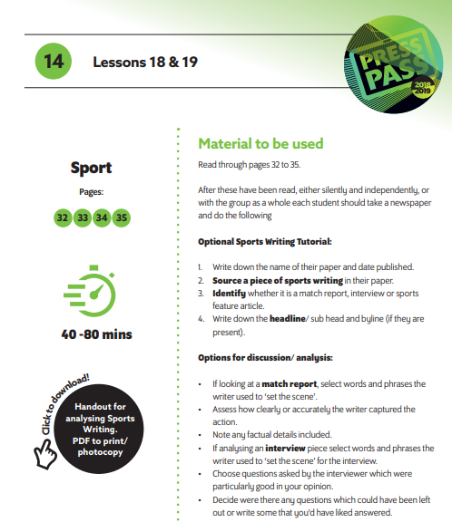
https://www.scoilnet.ie/fileadmin/user_upload/PressPass19Lesson18.pdf
.

Slide 24
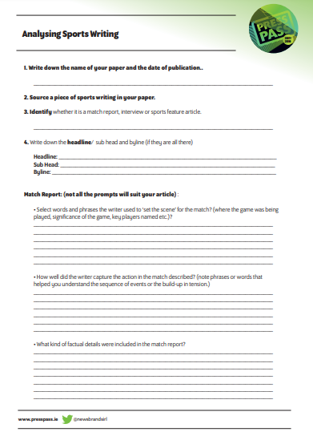
.
>

Slide 25
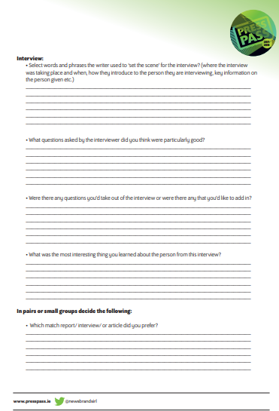
.
.

Slide 26
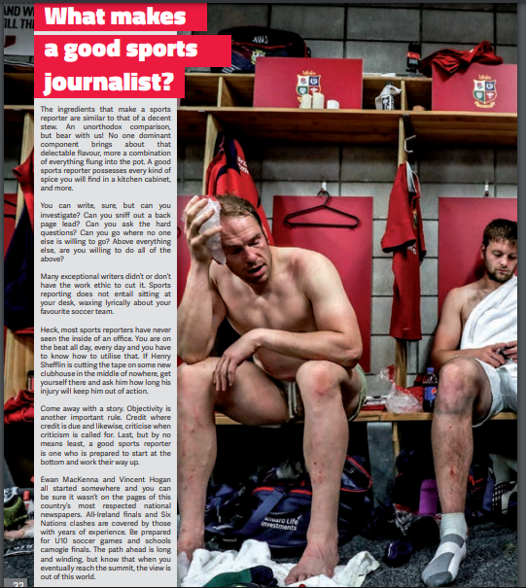
.
.

Slide 27
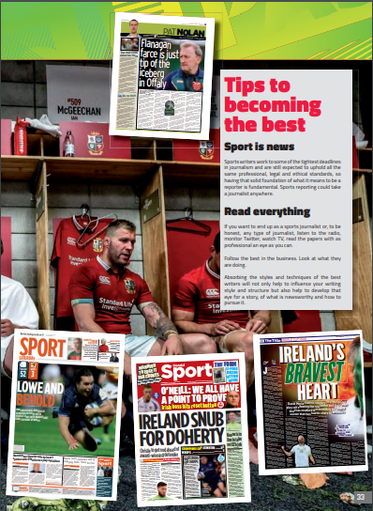
.
>

Slide 28
.
.

Slide 29
Summary
.
What is important?
Pupils’ prior knowledge and experience
Selection of tasks
Sequencing of tasks
Participant structures – Determining forms of learning and working
Use of additional semiotic systems for “message abundancy”
Use of mediational texts and mediational artefacts
Metalinguistic and metacognitive awareness

Slide 30
Sources of pictures
Willi Heidelbach (Pixabay) https://pixabay.com/pl/photos/puzzle-pasuje-zgodzi%c4%87-si%c4%99-brakuje-693870/
Alexa (Pixabay) https://pixabay.com/pl/photos/puzzle-ostatnia-cz%c4%99%c5%9b%c4%87-3223941/
Hebi B. (Pixabay) https://pixabay.com/pl/photos/puzzle-wyznaczenie-654962/
Mike Foster (Pixabay) https://pixabay.com/pl/photos/biegacz-przeszkoda-uruchomi%c4%87-sport-555074/
Helmin A., Holeczek, J. (2019). Biologia na czasie 1. Podręcznik dla liceum ogólnokształcącego i technikum, p. 38.

Slide 31
Referencesin Polish
Kugiel-Abuhasna, I. (2019). Studiologia. Podręcznik polskiego języka naukowego dla cudzoziemców na poziomie B1. Kraków.
Seretny, A. (2019). Inferencja leksykalna – ważna strategia czytelnicza w języku obcym. [in:] "Polonicum" 2019, 31/32, p. 18, 20, 21, 24. Available online at: http://polonicum.uw.edu.pl/wp-content/uploads/2020/06/Polonicum31-32-korekta-2.pdf accessed August 16th 2022.
Seretny, A. (2016). Stopień trudności słowa w perspektywie glottodydaktycznej. [in:] "Języki Obce w Szkole" 1, p. 22. Available online at: https://jows.pl/artykuly/stopien-trudnosci-slowa-w-perspektywie-glottodydaktycznej accessed June 22th 2023.

Slide 32
References in English
Britannica Education (2023). Sustainability, Junior Cycle Geography and CSPE. , Scoilnet: Ireland. Available online at https://www.scoilnet.ie/uploads/resources/39149/39002.pdf accessed June 10th 2023.
Council of Europe (2023). ‘Les Français à Montréal’, CIEP French Reading. Available online at: https://rm.coe.int/CoERMPublicCommonSearchServices/DisplayDCTMContent?documentId=090000168069a119 accessed June 23rd, 2023.
Cosgrove, J., Perkins, R., Shiel, G., Fish, R., & McGuinness, L. (2012). Teaching and Learning in Project Maths: Insights from Teachers who Participated in PISA 2012. Dublin: Educational Research Centre.
Ellerton, N.F. and Clarkson, P.C. (1996). Language factors in mathematics teaching and learning. [in] A.J. Bishop et al (Eds.), International handbook of mathematics education (pp. 987-1033). Leiden: Kluwer Academic Publishers.
Hoosain, R. (1991). Psycholinguistic Implications for Linguistic Relativity: A Case Study of Chinese. Hillsdale, NJ: Lawrence Erlbaum.
Junior Cycle Final Examination (2022). ‘Pre-twentieth century revolutions/rebellions’, Junior Cycle History Common Level, Question 4, p. 14. Available online at: https://www.juniorcyclehistory.ie/uploads/1/0/0/4/10049804/jc_history_2022.pdf, accessed June 11th 2023.

Slide 33
Junior Cycle History (2020). Archaeological Discoveries, Junior Cycle Final Examination, Sample Paper History, Common Level, Question 2, p. 6-7. Available online at: https://www.juniorcyclehistory.ie/uploads/1/0/0/4/10049804/jc_history_sample_exam_paper_2020.pdf, accessed June 24th 2023.
Kennedy, D. Lawlor, R. and Finn, S. (2021). ‘The Circulatory System’, Junior Cycle Science, Essential Science, 2nd ed., Chapter 5, 5.1, p. 37, Folens: Dublin. Available online at: https://www.folens.ie/sites/default/files/bulk_upload/EssentialScience2ndEd/ES_TB_EBOOK/index.html, accessed June 24th 2023.
Kenny, S. and Horan, A. (2018). Cyclone, Complete Junior Cycle Geography, Teacher’s Resource Book, Chapter 1, question 8, p. 23. Gill Education: Dublin. Available online at: http://www.gillexplore.ie/AcuCustom/Sitename/DAM/124/GILL-JC%20Geography-TRB-sampler-FINALwCover.pdf, accessed June 25th 2023.
Kirwan, F. (2019). News Brands Ireland ‘Analysing Sports Writing’. Available online at: PressPass19Lesson18.pdf (scoilnet.ie), accessed June 10th 2023.
Latham-Koenig, C. and Oxenden, C. (2018). English File 4th Edition, intermediate Student Book; Paperback, Unit 1, p. 2, Oxford University Press, Oxford University Press.
Lucey, D. and Condon, J. (2018). Erosion, Transportation and Deposition: Glacial valleys – U-shaped valleys. Geography for Junior Cycle Living Geography, p. 14. CJ Fallon, Dublin. Available online at: https://cjfallon.ie/downloads/LivingGeography%E2%80%93SampleMaterial-(25511).pdf, accessed June 11th 2023.
Prendergast, M., Faulkner, F. and Clare, O.H., (2016). The effect of high literacy demands in mathematics on international students. International Journal of Educational Studies in Mathematics, 3(2), pp.1-8.

Slide 34
CERTIFICATES
Thank you for your participation

