Slide 1
Subject-Oriented Language Teaching
Workshop 6
IO2 © 2023 by MaMLiSE is licensed under CC BY-NC-ND 4.0

Slide 2
The MaMLiSE project
Majority and Minority Languages in School Environment
an international project funded by Erasmus+ Programme under Action 2 – Strategic Partnerships, School Education;
running from 01.11.2020 to 31.07.2023;
main aim: supporting school teachers in delivering effective instruction in linguistically diverse classes. Although multilingualism has been present in EU schools for years, the range of in-service training courses and support materials on offer is still insufficient;
The project consortium has been able to prepare a book and materials on how to effectively support teachers and educational staff to teach successfully in linguistically diverse classes and to develop a whole-school inclusion policy, based on the premise that both newcomers and multilingual pupils who have lived in the country for a long time and were born there should be included.

Slide 3
Workshop 6
Outline in 2 minutes a typical situation of your subject class. Your sketch is only for you, it doesn't have to be perfect.
What is the third best language you can speak? (just think about it for yourself)
Write down embroidery points on your sketch for one minute
Form groups according to the third best languages. Design a poster with important aspects of this workshop in 5 minutes. Only communicate in your third best language.
Present your result in this language
Notes:
this task is planned for 15 minutes - the participants need paper and pencil - so make sure before that this will be available - or bring it for them
the tasks should be giving step by step so that they first can sketch without thinking about the language and worrying too much. So, keep the slide animated or get sure that they still are after having downloaded the file so that the participants can´t see als the tasks at once-
Before doing this activity, you have to have an idea over the group. What languages might be there? Perhaps you should change the first activity and ask for the second best language or just leave out the word “best” and ask for another language they know a bit. The groups will differ from country to country, from town to town and from school to school - so a small adjustment of this task will always be necessary to make the task work.. If there won´t be a group for a language, one person hast chosen, she can join any other group and language she wants.

Slide 4
Flashlight
What did this exercise teach you about teachers and learners in the context of immigration and education?
Please keep it short and put your new knowledge in one sentence.

Slide 5
Rationale

Slide 6
Why subject oriented language teaching?
time aspect: in a very short time pupils have to
acquire everyday language skills
find their way into the new school system, sometimes even into the institution of school itself in general
acquire academic language skills as well as the corresponding subject content - contradiction to research results
Pupils have to catch up with a moving target
School development: language-sensitive subject teaching is not yet comprehensively established – it happens randomly as it highly depends on teachers (and their education)
possible and necessary to teach subject content from the beginning of second language acquisition
Notes:
research results in point 3: According to research, 5 to 7 years are necessary to acquire educational language.

Slide 7
Aims of language learning classes
Development of second language skills
Integration into/participation in regular subject classes as quickly as possible
Prior subject knowledge
Experience with academic expressions of the language in school contexts

Slide 8
Challenges
special materials for subject content and language oriented learning for newly arrived pupils in many countries still at early stage of development
Use of additional materials: often simplified by teachers - helpful to introduce new topics
Linguistic simplification often goes hand in hand with subject simplification - access to concepts not possible
unclear or imprecise expressions hinder acquisition of subject-specific content and competencies, including competent use of specific language (cf. Grießhaber 2010: 42; Kniffka 2012: 215)
Notes:
introducing new topics also possible by pictures, videos, hands-on activities

Slide 9
conclusion
pupils need the opportunity to access and be supported in their acquisition of the registers of schooling
important to provide texts, in terms of students' reading and writing skills
Possibility to access the school's registers and to be supported in their development

Slide 10
Aims of subject oriented language classes
building linguistic competencies in subject-relevant contexts (Wulff & Nessler 2019: 99)
first access to subject-specific lexis, non-fiction texts and forms of subject-oriented writing (ibid.)
pupils have different experiences with schooling - strategies should be teached from the very beginning of second language learning
Theoretical foundation: orientation towards discourse functions (Vollmer & Thürmann 2017) or genres (Rose 2011)

Slide 11
Important discourse functions in school
naming
describing
explaining
arguing
evaluating
negotiating
narrating
Notes:
at this point you can ask the participants of examples of these discourse functions in special tasks in the subjects lessons, you can also ask them, in what kind of tasks in language classes these discourse functions are sued.
IMportant: we will come back to this later on

Slide 12
Needs and possibilities of combining language teaching with subject relevant teaching

Slide 13
Taks for the groups
Group 1: Reading strategies, test-formats, expectations of behaviour … What content would a propaedeutic course need to prepare for diverse requirements in school? Make a detailed offer.
Group 2: What points of contact can be developed from the textbooks in the subjects you teach (e.g. topic food and drinks in the language book: healthy nutrition (housekeeping), world trade in food (politics), digestion (biology), weights and measures (mathematics), ...
Group 3: Task formats require skills. (How) does the language course prepare you for the relevant requirements?
You have 30 minutes. Please record your work at the end on flipchart paper to visualize for the rest of the group. Decide who will present it.
Notes:
The aim of the second part of the workshop is to work out in three groups how language lessons can be designed in a subject-sensitive manner right from the start.
Group distribution: The groups should be randomized. For this purpose, it is a good idea to distribute small chocolate bars or other sweets in different colors or similar (everyone grabs something from a bag so that it is not possible to choose). The groups then get together according to color. Postcards can also be cut apart and the participants have to find their remaining puzzle pieces.
For workshops in Poland reference in commentary to contents of slides by Julia, as references shown in selected pages.

Slide 14
Presentation of results in plenary
Please present your group results in about 5 minutes each.

Slide 15
Approaching texts in a subject textbook

Slide 16
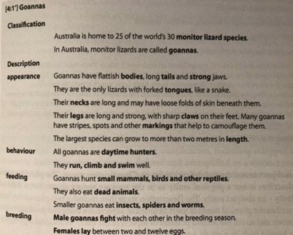
classifying and describing
Notes:
example of an typical classification and description of animals, other phases of genres can be found with very good explictions in Rose 2011 (you can find the text in the folder Google Drive folder of workshop 6). Working with the pupils at the structure and the phases of an genre (imagining an order, talking about similar texts they know from their country and their structure, comparing texts (here of different animals) of an genre helps them getting access to these texts without understanding everything from the beginning. You can then work in a special phase of the genre (e.g. the behavior) and deal with the vocabulary and language structures they need.

Slide 17
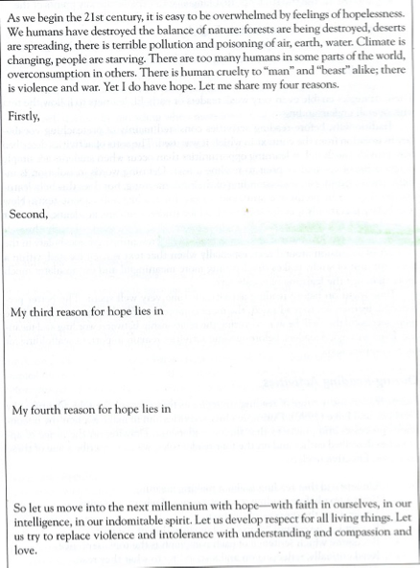
Support on text macrostructure
Introduction to the structure of the text
A text (here a narrative) can be cut in the different parts and the pupils try to put them together, followed by a discussion about the logic of the structure and the names and functions of the different parts-
A text skeleton contains the outline of a text with beginning, end and structuring signal words.
The main part with the central information is omitted.
Pupils should predict (oral, in small groups) the main part based on the introduction and conclusion before reading the text.
Notes:
example of an typical classification and description of animals. Working with the pupils at thes phases of an genre helps them, to get access to these texts without understanding everything from the beginning

Slide 18
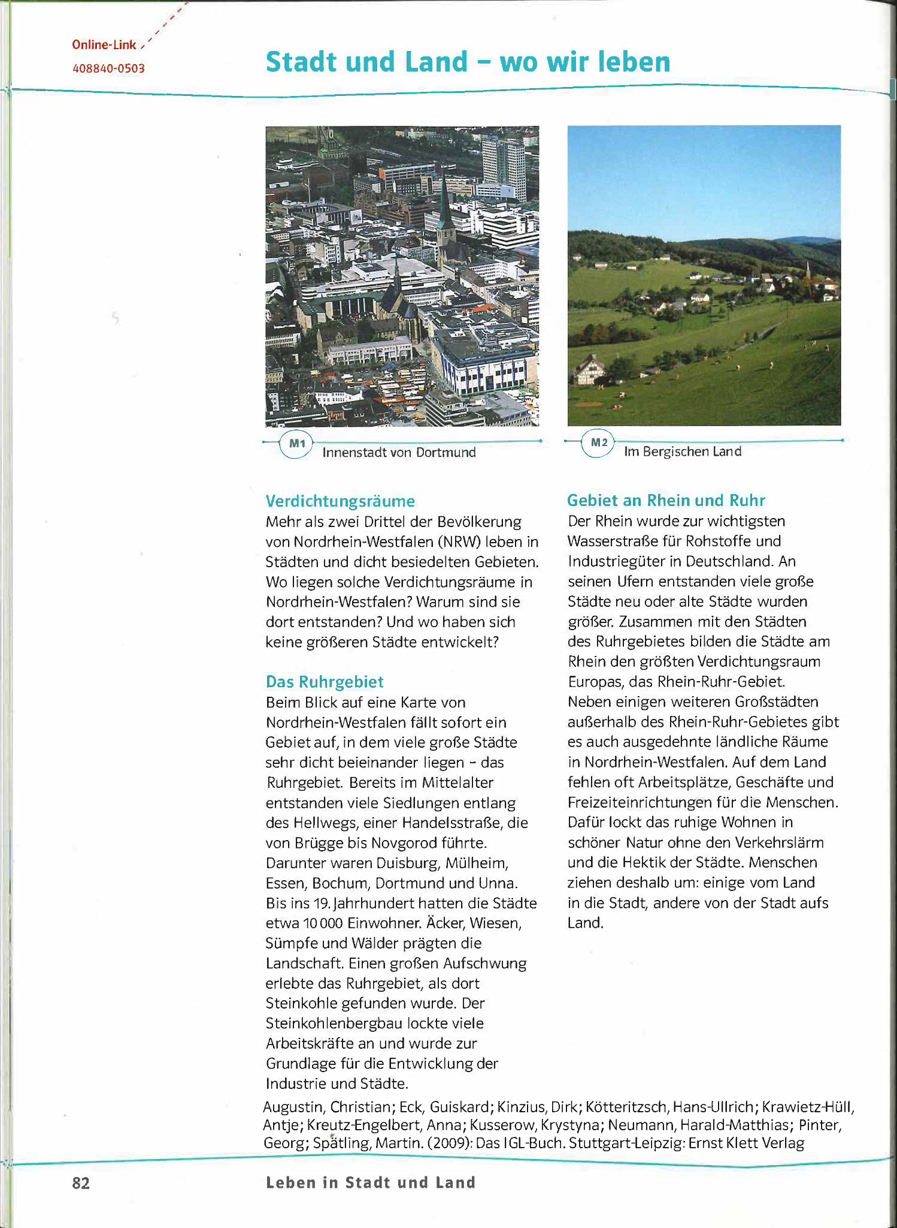
Approaching a textbook
Notes:
We will now work together through the page of a geography book used in Germany (but not start with it at this point). In this workshop we will not try to work out the text completely, but create first accesses. How a deeper elaboration can be done is the topic of workshop 5.
(How) would the teachers approach the task in German? Google translator? If so, what? And which of the collected strategies do they allow their students to use in class? With what justifications?

Slide 19
Beschreibe M1 und M2: Nenne Merkmale einer Stadt und Merkmale eines ländlichen Raumes.
Augustin, Christian: Das IGL-Buch. Stuttgart 2009: Klett
Notes:
The decision to work with a German book has been made consciously in order to enable the participants to comprehend better, quasi as a self-experience - for Germany another language has to be chosen.
To the participants: We will do now an example

Slide 20
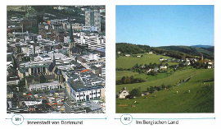
Using textual and visual resources
Augustin, Ch. (2009). Das IGL-Buch. Stuttgart: Klett
Notes:
This is the textbook page without the main text. What do you think the theme of the page is? How do you come up with your hypothesis?

Slide 21
Step 1: Focusing on visual resources
Finding out the topic of the text
Images, headings, tables, graphs and highlighted terms provide information on the topic of a text and help to find an introduction to the text, therefore they are visual supports which we can use in approaching the text before reading it

Slide 22
Step 2: Look closely at the visual resources
What clues do the
images and headings
add to the potential
text content?
Notes:
They represent two landscapes, possibly a comparison. The markings M1/M2 underline this assumption. Maybe it is about the comparison city/country, maybe it is about the development of a landscape: Where there is a city today, there was country in former times. Perhaps the city of Dortmund is known.

Slide 23
On the power(lessness) of words
The title of the textbook page is:
“Stadt und Land”
"Land" can be an "island of understanding" and equated with the English term "land". In German “Land” also means “State”, “Country”, “agricultural area”, “farmland” or “rural region”. The contrast of town and country shown through the images leads to meaning.
Notes:
Question to the participants: What hint would be needed to get the right meaning in this context? This reference should not be understood as a counter-argument to the previous steps, but it must be observed and taken into account in the didactics, the support of the students.

Slide 24
Lexical store
How is foreign language vocabulary stored in memory?
Psycholinguists mention the lexical store being a complex network of
associations. It contains semantic traces along with the words-labels of
the languages ​​we know. Words are remembered primarily by their
meaning and to a lesser extent by their phonological structure (as a
combination of sounds). Therefore, it is easier to learn words that are
semantically close, combined into semantic fields (semantic fields are
built of synonyms, antonyms, homonyms, collocations, etc. - e.g. plant,
vegetable = vegetable, beetroot, as red as a beet) or word families
(words create a family based on structural similarities - e.g. to learn,
university, teacher, student) (Kugiel-Abuhasna 2019: 54)

Slide 25
Step 4: Work on solving the task
Read the assignment carefully: Beschreibe M1 und M2: Nenne Merkmale einer Stadt und Merkmale eines ländlichen Raumes.
What should you do? What are you looking for to get the information?
Task formats are defined by verbs that have a specific meaning in school contexts
Beschreiben = Describe
Nennen = Name
The task is: Describe M1 and M2: Name characteristics of a city and characteristics of a rural area.
What is exactly to do?
Which answers would you expect from your pupils? How do you define "describe" and "name" for your pupils?

Slide 26
Integrate language and technical skills
The subheadings on the page include “Verdichtungsräume”, “Das Ruhrgebiet”, Gebiet an Rhein und Ruhr”.
What do you find in a digital dictionary of a language you are familiar with about “Verdichtungsräume” and "Ruhrgebiet"?
Notes:
Here there could be a short exchange about using mobile phones as ressource in class

Slide 27
Step 5: Read the text and get an awareness of the reading strategy
With the help of steps 1-4, an expectation of the text content was established. With the help of a text expectation, individual elements of the textbook page can often be decoded even with little knowledge of German.
The goal is not a complete understanding of the text but
to teach reading strategies first to enable learners to access subject teaching in a new language
to stabilize the self-concept of the students in such a way that they do not primarily perceive themselves as deficient language learners, but rather become aware of their existing language and technical skills
Task 1: Now read the whole text and mark everything you understand. Compare your key points with those of your seat neighbour. Choose together the 3 most important key points. Collect your key points in plenary and sort them by topic. Write important new words in your vocabulary notebook.
Notes:
If you have more time, the participants can do this task to experiment the proces. Otherwise it is enough to show the steps.

Slide 28
Read the text and get an awareness of the reading strategy
Task 2 could be:
You have now worked very intensively with the textbook page. Mark with a cross what was helpful for you.
 | Helped me a lot | Helped me | Helped me a bit | Did not help
My prior knowledge
Visual ressources
Texts in a language that I know better than German
Sharing with my classmates

Slide 29
Approaching subject-oriented language teaching

Slide 30
Working in groups
Task 1 (5 minutes):
What is your second language teaching about? Have a look on the presentation of content in your language textbooks.
Task 2 (5 minutes):
What should language lessons be about or lead to?
Task 3 (5 minutes):
What is the most important aspect for your work? How can you implement it in your daily work? Focus on possibilities, not on constraints (although there are a lot …)
Record the key points of the last question on presentation cards (2 minutes).

Slide 31
Application Tasks

Slide 32
start into subject oriented language teaching
… with the help and power of your group …
Search in a subject course book one aspect to combine it with language aspects. Develop a small unit for a subject-oriented language lesson on the basis of the aspects developed until now. In the table you will find examples of some aspects from which you can select and which you can add. For further inspiration have a look in Chapter 7 of the MaMLiSE Handbook.
Activate prior knowledge | … | Integration of the whole language repertoire | Develop discourse function competence
Word development strategies | Reading strategies for continuous and discontinuous texts | Subject-specific symbols | Create peer group learning opportunities
Formulas | Spaces for reflection on one's own way of working | Enable digital research | Subject-specific ways of thinking and working
Notes:
For this application task, the groups should be mixed again. This time the participants should get the possibility to choose with whom they want to work. A good suggestion can be: Think about who else you have not worked with in this workshop or who you would like to work with.

Slide 33
Conclusion
Reflect on your own situation, taking into account structural conditions for success, without allowing these to render one incapable of action
Reflect on the checklist on Worksheet 4
Have a little chat about it with your neighbour

Slide 34
Portfolio-Task on Moodle
Have a look on your notes you put on moodle about why you attended the workshop.
What do you think now about your notes?
Where your expectations met?
Have expectations been met that you were not aware of before?
What have you learnt?
What would you like to learn in another workshop?

Slide 35
Feedback
Please express in one sentence how you feel now after the workshop.
We just listen to one another without commenting or discussing.

Slide 36
Thank you for your attention! Dziękujemy za uwagę!
Ευχαριστώ για την προσοχή σας!

Slide 37
References
Augustin, C. (2009). Das IGL-Buch. Stuttgart:Klett.
Grießhaber, W. (2010). (Fach-)Sprache im zweitsprachlichen Fachunterricht. In: B. Ahrenholz (Ed.), Fachunterricht und Deutsch als Zweitsprache (2nd ed.) (pp. 37–53). Tübingen: Narr Verlag.
Kniffka, G. (2012). Scaffolding - Möglichkeiten, im Fachunterricht sprachliche Kompetenzen zu vermitteln. In: M. Michalak/ M. Kuchenreuther (Hrsg.). Grundlagen der Sprachdidaktik Deutsch als Zweitsprache. Baltmannweiler: Schneider Verlag Hohengehren, 208-225.
Kugiel-Abuhasna, I. (2019). Studiologia. Podręcznik polskiego języka naukowego dla cudzoziemców na poziomie B1, p. 54. Kraków.
Martin, J.R.; Rose, D. (2008/2009). Genre Relations. Mapping Culture. Nachdr. London & Oakville: Equinox.
Rose, D. (2011). Genre in the Sydney School. In: Gee, J./Handford, M. (Eds), The Routledge Handbook of Discourse Analysis. London: Routledge, 2011, 209-225.
Vollmer, H./Thürmann, E. (2017).Zur Sprachlichkeit des Fachlernens: Modellierung eines Referenzrahmens für Deutsch als Zweitsprache. In: Ahrenholz, B. (Ed.), Fachunterricht und Deutsch als Zweitsprache. 2., durchg. u. akt. Aufl. Tübingen: Narr, 107–132.
Wulff, N.; Nessler, S. H. (2019). Fachsensibler Sprachunterricht – den Übergang in den Fachunterricht erfolgreich gestalten. In: Schmölzer-Eibinger, S.; Akbulut, M.; Bushati, B. (Eds.), Mit Sprachen Grenzen überwinden. Sprachlernen und Weiterbildung im Kontext von Flucht und Migration. Münster: Waxmann, 97–115.
Wulff, N.; Nessler, S. (2020). Fachsensibler Sprachunterricht in der Vorbereitungsklasse – auf dem Weg zur erfolgreichen Integration in den Fachunterricht. In: Ahrenholz, B.; Jeuk, S.; Lütke, B.; Paetsch, J.; Roll, H. (Eds.): Fachunterricht, Sprachbildung und Sprachkompetenzen. Berlin: De Gruyter, 279–299.

Slide 38
CERTIFICATES
Thank you for your participation

