Slide 1
Subject Specific Language-Sensitive Teaching
Workshop 5
IO2 © 2023 by MaMLiSE is licensed under CC BY-NC-ND 4.0

Slide 2
The MaMLiSE project
Majority and Minority Languages in School Environment
an international project funded by Erasmus+ Programme under Action 2 – Strategic Partnerships, School Education;
running from 01.11.2020 to 31.07.2023;
main aim: supporting school teachers in delivering effective instruction in linguistically diverse classes. Although multilingualism has been present in EU schools for years, the range of in-service training courses and support materials on offer is still insufficient;
The project consortium has been able to prepare a book and materials on how to effectively support teachers and educational staff to teach successfully in linguistically diverse classes and to develop a whole-school inclusion policy, based on the premise that both newcomers and multilingual pupils who have lived in the country for a long time and were born there should be included.

Slide 3
(Re-)Activation
Watch the first part of the movie with a part of a science lesson (topic: “How rain is made”)!
Recognise the most important principles of language sensitive teaching.

Slide 4
(Re-)Activation
THINK: Note 5 key points from workshop 2 (or if you have not worked on workshop 2 from worksheet 1) which are implemented in the movie.
→ 5 minutes

Slide 5
(Re-)Activation
THINK: Note 5 key points from workshop 2 which are implemented in the movie or on worksheet 1.
→ 5 minutes
PAIR: Compare your key points with those of your seat neighbour. Choose together the 3 most important key points.
→ 5 minutes

Slide 6
(Re-)Activation
THINK: Note 5 key points from workshop 2 which are implemented in the movie or on worksheet 1).
→ 5 minutes
PAIR: Compare your key points with those of your seat neighbour. Choose together the 3 most important key points.
→ 5 minutes
SHARE: Collect your key points in the group and sort them by topics.
→ 5 minutes

Slide 7
Language learning in class
Language is a fundamental element of every class
Language competencies of pupils are very important because they are condition for:
their success in school (understanding of texts and tasks in textbooks, teachers and peers)
their participation in class of all subjects (taking active part in classroom discussions, talking with teachers and other students)

Slide 8
Which language?
We are NOT talking about
teaching grammar
teaching language basic skills (e.g. plural, genus, articles, tenses)
→ that is the task of language teaching
We are talking about
subject specific language and its functions
which is interwoven with content
→ that can NOT be the task of language teaching, because it can only be taught in combination with the subject content

Slide 9
Which language?
We are talking about subject specific language which is interwoven with content
→ that can NOT be the task of language teaching, because it can only be taught in combination with the subject content
→ What is that kind of language?
Exercise:
Screen your subject-specific schoolbooks and find some specific expression/sentence for your own subject (hint: Make sure to focus not only on vocabulary!)

Slide 10
Language sensitive teaching
Language Sensitive Teaching is…
an important and supporting element for ALL pupils
not only relevant for pupils with migration background
Learning a second language acquisition features specific needs for support (e.g. grammar and vocabulary)
(see Jeuk 2015: 54, 73)

Slide 11
In this workshop…
we learn to analyse the functions of the specific language of texts in school books
we apply strategies to handle language-based challenges in school books and to prepare a part of a lesson based on a text from science schoolbooks

Slide 12
In this workshop…
Functional view on language as a tool for raising awareness of linguistic challenges in texts
we learn to analyse the functions of the specific language of texts in school books
we apply strategies to handle language-based challenges in school books and to prepare a part of a lesson based on a text from science schoolbooks

Slide 13
The functions of language and what can be challenging for pupils
language is used in subject lessons to
communicate and transfer knowledge
reproduce content to show that pupils understand
think through abstract and complex phenomena
→ the language which needs to be received and produced by pupils can differ from the language which they are used to in everyday context
(following Halliday 1978, 1985; Morek & Heller 2012)

Slide 14
The functions of language and what can be challenging for pupils
examples: You use (and pupils need to use) different language
to describe the process of photosynthesis or what happens on a birthday party last weekend
to explain the process of photosynthesis in a test or in a learning situation with other pupils (or in a conversation with a friend on a birthday party)
to acquire knowledge about the process of photosynthesis or to summarize the acquired knowledge

Slide 15
The functions of language and what can be challenging for pupils
=> language differs depending on
the content
the participants in the communication situation and their intention
the medium in which communication takes place

Slide 16
The functions of language and what can be challenging for pupils
=> language differs depending on
the content
the participants of the communication situation and their intention
the medium in which communication takes place
… but what exactly can be challenging for pupils considering the language in subject lessons?

Slide 17
The functions of language and what can be challenging for pupils
language-based challenges for pupils can occur if they are not familiar with
specific forms (which can fulfill different functions)
specific functions (which can be fulfilled by different forms)
the specific connection of form in function
Notes:
RAUS?

Slide 18
Introductory small-step tasks (learning maths tasks)
Guide to task solution through questions and small-step task completion.
What should be calculated/solved?
(operator/question words)
What relevant information is given in the task text?
What mathematical concepts are signaled in the task?
What difficult language-based structures (grammatical phenomena) are important to understand the task?
(Huang; Normandia 2011: 66-67)
Notes:
vlt besser den Fokus auf Genres legen

Slide 19
Cracking text tasks
What should be calculated/solved? (operator/question words)
"How much euro interest": Calculate amount; Interest calculation; Caution: not the total amount, but only the interest amount.
What relevant information is given in the task text?
What difficult grammatical structures important for maths do you see in the text?
Notes:
vlt besser den Fokus auf Genres legen

Slide 20
Group work: Analysis of language
Form working groups by finding participants with the same picture (worksheet 2) on your card or join participants of your taught subject(s).

Slide 21
Group work: Analysis of language
In every group:
Choose a short abstract from a schoolbook of your subject in your language (approximately 2-4 sentences).
Describe the language-based challenge for your pupils in this abstract (e.g. in German language Passive, Nominalization or Compound nouns belong to language based-challenges in science texts and tasks).
Why is the content expressed in exactly these constructions?
→ 20 minutes

Slide 22
Presentation of the results
Form working groups by finding participants with the same number on your card or participants teaching your subject(s) at school.

Slide 23
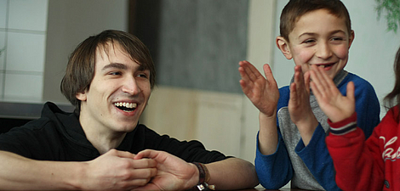
Discussion
How can we use the results of the analysis to shape and support language-sensitive teaching?
Collect your ideas and try to sort them in a mind-map.

Slide 24
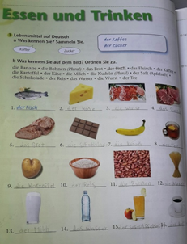
Break
Haben Sie eine schöne Pause!
Have a nice break!
Miłej przerwy!
Καλό διάλειμμα!

Slide 25
In this workshop…
Functional view on language as a tool for raising awareness of linguistic challenges in texts
we learn to analyse the functions of the specific language of texts in school books
we apply strategies to handle language-based challenges in school books and to prepare a part of a lesson based on a text from science schoolbooks
Scaffolding as a tool for supporting and shaping language-sensitive teaching

Slide 26
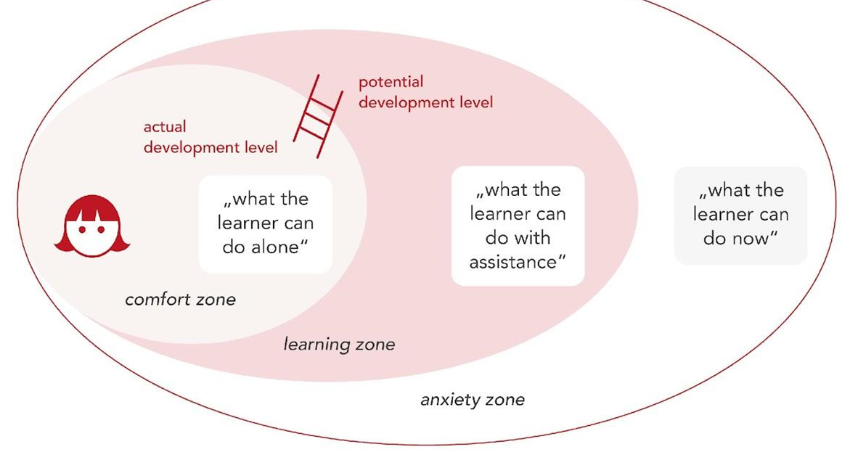
supporting and shaping language-sensitive teaching
→ SCAFFOLDING ←
high challenge and high support
(Mariani 1997)

Slide 27
supporting and shaping language-sensitive teaching – definition of scaffolding

Slide 28
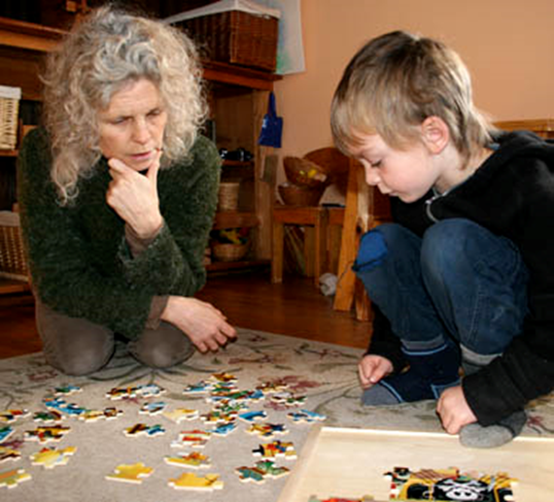
supporting and shaping language-sensitive teaching - giving scaffolding
Notes:
This refers to both linguistic and technical goals and content

Slide 29
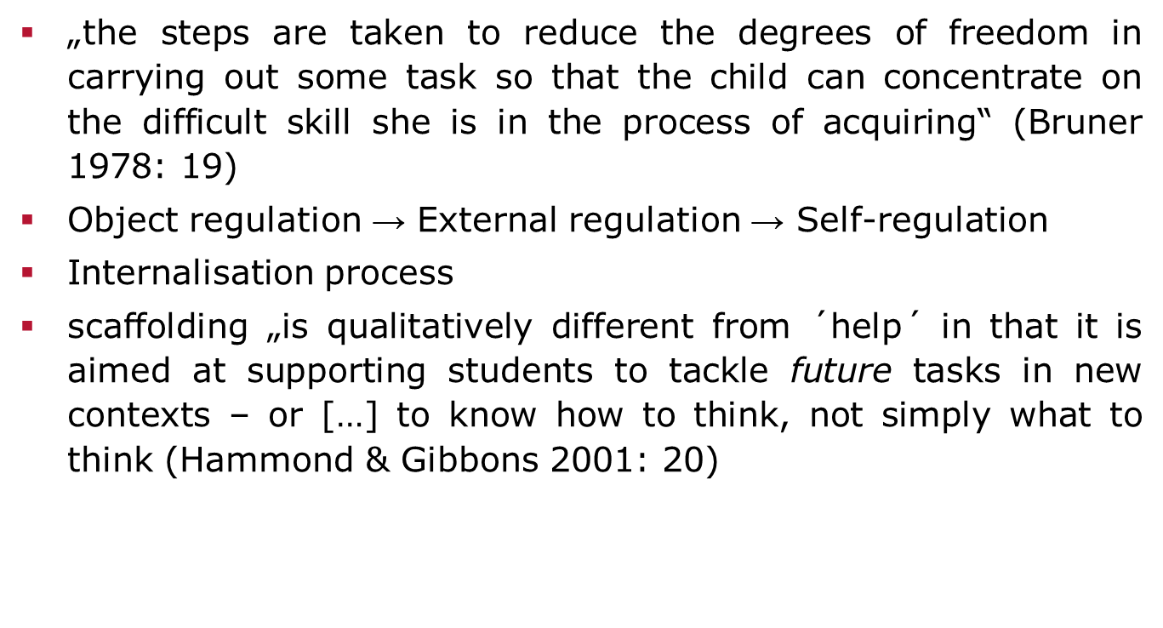
supporting and shaping language-sensitive teaching: scaffolding - more than help

Slide 30
supporting and shaping language-sensitive teaching: selection of levels and features
→ SCAFFOLDING ←
Improving of normal intellectual capacities of individuals through additional supports under adult guidance, or in collaboration with more capable peers’, by means of dialogue and interaction leading to mediated/assisted content internalization (compare with workshop 2).
Scaffolding focuses on student’s learning potential, and not simply on their current abilities, it is located at both the micro and the micro levels of teaching (Hammon&Gibbons 2005).

Slide 31
supporting and shaping language-sensitive teaching: selection of macro and micro levels of scaffolding
→ SCAFFOLDING ←
Scaffolding at the macro-designed-in level → can be found in the ways in which classroom goals are identified and classrooms are organised, it enables:
scaffolding at the micro-level → interactional scaffolding

Slide 32
supporting and shaping language-sensitive teaching: levels and features of scaffolding
Macro-Scaffolding
(e.g. for teaching preparation)
Micro-Scaffolding
(ie.g. for nteraction in classroom)
locating new learning in student’s prior knowledge and experience
linking t to background knowledge and prior experience, recapping
the use of semiotic systems
apropriating and recasting student contributions (wordings,ideas)
attention to selection and sequencing of tasks
using verbal and gestural hints
the use of mediatonal texts and artefacts
using information from texts in different languages
developing metalinguistic and metacognitive awareness
asking for clarification, probing a student’s response

Slide 33
supporting and shaping language-sensitive teaching: selection of macro features
MACRO-SCAFFOLDING
focusing on student’s prior knowledge and experience (e.g. knowledge from texts about the theme in languages the pupils know, attention to key words and participant structures in a language-based science problem)
using semiotic systems (developing understandings of concepts or tasks through providing access to similar information from a variety of sources, visual support containing reduced amount of language, prompts and cues as leading questions, hints, combination of visual and aural support through use of videos, films and the Internet, use of visual, aural and tactile supports through demonstration and hands-on activities) (Hammon&Gibbons 2005)

Slide 34
supporting and shaping language-sensitive teaching: selection of macro features
MACRO-SCAFFOLDING
3. selection and sequencing of tasks (becoming a support structure for the task, the student’s explanation after work in pairs or groups)
4. using mediatonal texts and artefacts structuring or mediating the learning and becoming an important point of reference across a unit of work (e.g. the reflection sheet providing a linguistic and conceptual support for the individual reporting by students, experiments in the science unit providing an anchor for students and teachers)
5. raising metalinguistic and metacognitive awareness (accessing to texts by using text structure and multilingual competencies while marking the understood parts of the texts, drawing student’s attention to whole-text features, subject-based vocabulary and sentence-level grammatical patterns relevant to particular curriculum content) (Hammon&Gibbons 2005)

Slide 35
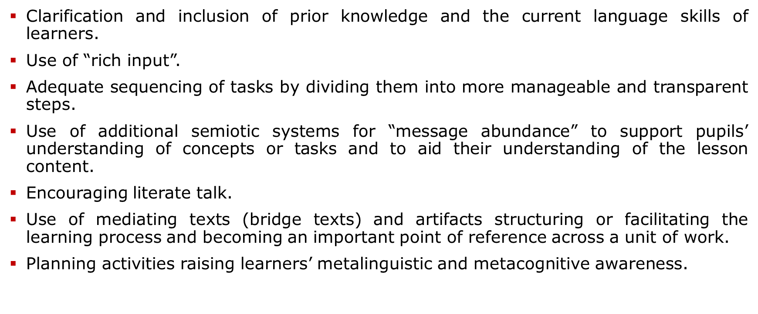
Macro scaffolding - Lesson Planning
Notes:
It is important to plan HOW the lesson will be taught: the teacher should not just give the lesson, but should plan how exactly to explain it to the students, how to introduce the tasks, how to discuss the texts, how to introduce the linguistic devices.
Not every point of view can be used for every subject or in every sequence. It also depends on the subject, the topic, and the phase. However, the first three points of view should always be taken into account when planning.
Establishing forms of learning and work, such as small group work, in which students are challenged to interact with each other while using language, exchanging information, and negotiating content ( More on this in Microscaffolding).
Use of "rich input," i.e., linguistic input that is slightly above the students' linguistic proficiency level (1 level). This is the only way to initiate an expansion of language competence. It is important to pick up on the students' formulations in order to put them into context with the technical formulation ( session micro-scaffolding).
Sequencing of learning tasks. For example, one can sequence the learning tasks from a concrete view to a more abstract level, from a more everyday, context-bound use of language to a context-reduced, more explicit use of language (see mode continuum). Or take tasks from the textbook and revise them (see example next slide).
Inclusion of the students' previous knowledge, experience and current language level
Selection of appropriate (additional) material depending on the knowledge and language level of the students. If necessary, it is necessary to use concrete illustrative material or to let the students carry out their own experiments first in order to introduce them to the subject matter.
Selection of different forms of presentation through which the (new) contents are to be presented. Either one specifies the forms of presentation oneself; here it is important that one connects/allows to connect step by step the information in the text with the information in the e.g. illustration. This is important as an intermediate step before proceeding to further tasks. Or you can transfer texts into other forms of presentation. Example for this in a moment.
Use of mediating texts (bridge texts). This may be necessary if the texts in the textbook are too far above the students' level of competence - and thus beyond the "zone of proximal development".
Planning of meta-linguistic and metacognitive phases - various studies (e.g. the DESIStudy 2006) show that meta-linguistic/metacognitive reflection can promote learning progress. cf. our microteaching example from FG I!!!

Slide 36
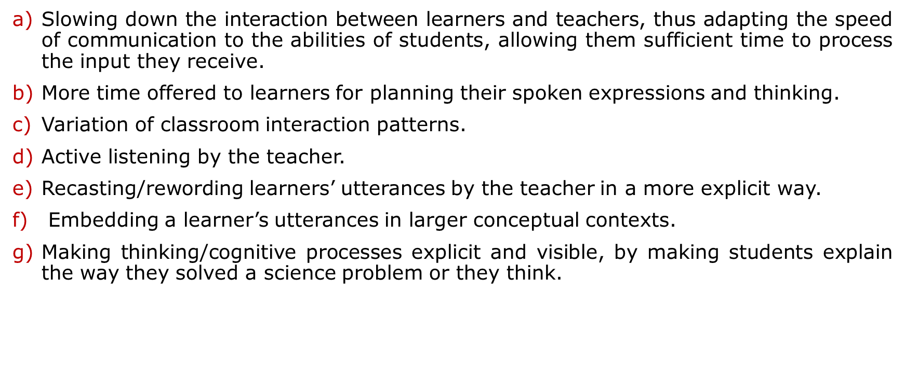
Micro scaffolding - Principles of classroom interaction

Slide 37
Group work: Analysis of scaffolding in the lesson
Watch the second part of the movie with a part of a science lesson!
Answer the questions on worksheet 3. Recognise the most important aspects of scaffolding listed, in additionally,on worksheet 3.

Slide 38
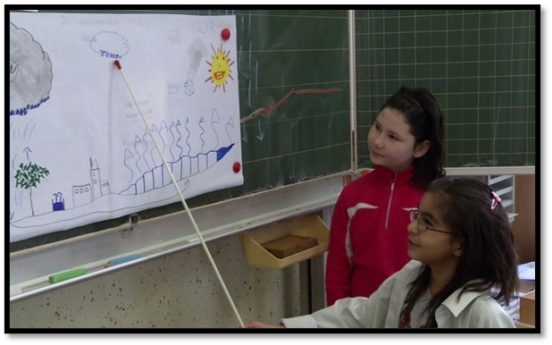
Presentation of the results: Scaffolding in class discussion

Slide 39
Supporting and shaping language-sensitive teaching
(simplistic) scaffolding through selected recommendations for material design: selected hints for teachers to provide (new) students with (very) strong support

Slide 40
General hints for strong support of new students through material design
Keep a standard (e.g. terminology/formulas), stick to some core terminology and provide a glossary
Use colorful diagrams, photos, drawings
Apply the consistency of text and image
Think through the difficulty of exercises and their instructions
Include other languages that pupils know
Include language exercises into the general pool of exercises
Help students acquire functional language for a given subject, e.g. in biology - describing functions/systems/organisms; in history – giving the cause-event-consequences reasoning

Slide 41
General hints for strong support of students through material design
if you explain a word always put the term in the main text and simpler version in brackets; pupils need to learn the specialist vocabulary
Chrząstkozrosty to rodzaj (typ) połączeń kości.
kind
if you need chemical formulas, use them everywhere;
make sure they are written correctly e.g:
O₂ (oxygen), CO₂(carbon dioxide)
XIX wiek – 19th century

Slide 42
General hints for strong support of students through material design
Repetition and revision is important - think what terms students really need and try to stick to some core vocab.;
Think in terms of frequency of use in the subject register and everyday language;
Explain to them plainly, e.g. using illustrations, sentences, short definitions;
Tricky words are not necessarily terms, e.g. środowisko/environment, ciało/body, długość/length, szerokość/width, grubość/thickness, wzór/pattern
Create a glossary of terms and tricky words.

Slide 43
General hints for strong support of students through material design
The same items and vocab. should appear in the pictures and in the main text;
Tłuszcze
Glicerol to część tłuszczu
Tłuszcz ma dwie warstwy:
•glicerol/glyceryl
•kwasy tłuszczowe/fatty acids

Slide 44
Notions of scaffolding:
semiotic systems in general hints
Provide access to similar information from a variety of sources (Additional semiotic systems by using colorful diagrams, photos, charts, graphs, maps,pictures and drawings attached to the schoolbook texts)
Combine visual and aural supports through use of videos, films and the Internet
Combine visual, aural and tactile supports through demonstration
Use physical movement and gestures
Apply the consistency of text and image
Think through the difficulty of exercises and their instructions
Include other languages that pupils know
Include language exercises into the general pool of exercises
Help students acquire functional language for a given subject, e.g. in biology - describing functions/systems/organisms; in history – giving the cause-event-consequences reasoning

Slide 45
Notions of scaffolding:
semiotic systems added to the text

Slide 46
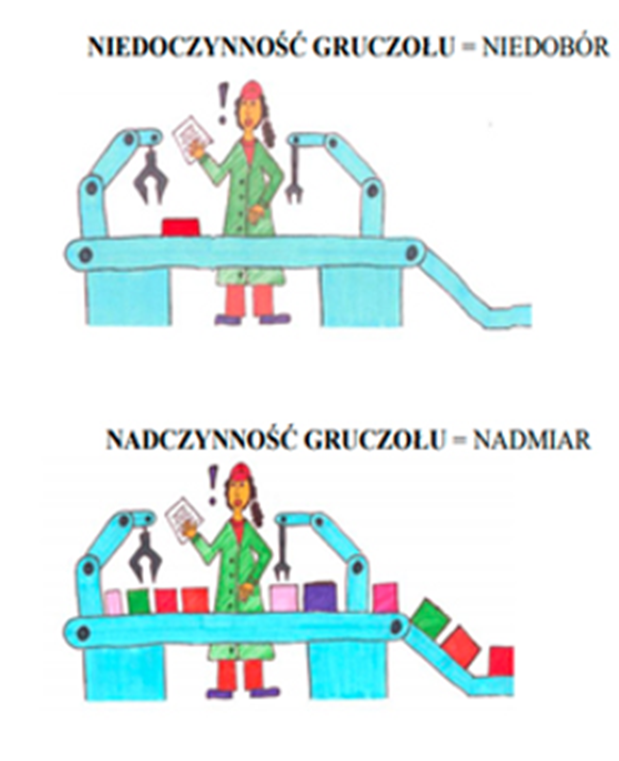
Notions of scaffolding:
semiotic systems
Endocrinal system:
superactivity/underactivity
of the gland

Slide 47
Notions of scaffolding:
selection and sequencing of tasks

Slide 48
Notions of scaffolding:
selection and sequencing of tasks
1. Complete the table
2. Connect the verbs and adjectives with its nominalizations
Verb / Adjective |  | Nominalization
to discover | →
 | → | the sensitivity
to repulse | →
 | → | the revelation
sensitive | the repulsion
achieve | the revelation
to reveal | the sensitivity
to repulse | the achievement

Slide 49
Notions of scaffolding:
mediational texts
Provide access to information from instrumental texts or artefacts (reflections sheets with linguistic and conceptual support for the individual reporting by students and experiments)
Think through the difficulty of exercises and their instructions
Include other languages that pupils know
Include language exercises into the general pool of exercises
Help students acquire functional language for a given subject, e.g. in biology - describing functions/systems/organisms; in history – giving the cause-event-consequences reasoning

Slide 50
Notions of scaffolding:
metalinguistic and metacognitive awareness
The target is the content, but teaching the content of the lesson should focus also on the language related to that content!
Focus in particular on notions of register and genre (e.g. investigate a science topic by drawing on Internet information but, at the same time, analyse the language choices made by the writers of these Internet texts
Draw students’ attention to the use of emotive vocabulary, rhetorical questions and the choice of powerful visual images in the texts
Offer texts and exercises to compare languages and use strategies of translanguaging

Slide 51
Notions of scaffolding:
metalinguistic and metacognitive awareness (in grammar adjustment)
Help students acquire functional language for a given subject ( e.g. in biology students often need to describe bodily functions/ systems/ organisms)
Draw students‘ attention to grammatical forms which are less frequent in other languages. To illustrate, in Polish, there are relatively many diminutives, which are used in language specific of subjects, e.g. most (Eng. bridge) – mostek (Eng. little bridge); młot (Eng. a hammer) – młotek (Eng. little hammer) – młoteczek (Eng. tiny little hammer).

Slide 52
Creative space for group work
Form working groups by finding participants with the same picture or the same subject.
Use notions/features of scaffolding and general hints for material design introduced in the 2. part of the workshop and listed on the worksheet 3 and worksheet 4 while preparing a part of a lesson based on a text of your schoolbook.
You can choose any topic, text, task and principles of Subject Specific Language-Sensitive Teaching with selected aspects of scaffolding
→ time: 20 minutes

Slide 53
Discussion & Reflection
How and why did you use the features/notions of scaffolding?
What do you think are advantages of subject-specific language-sensitive teachings in your subject?
What kind of problems might occur in subject-specific language-sensitive teaching in your subject?

Slide 54
Thank you for your attention! Dziękujemy za uwagę!
Ευχαριστώ για την προσοχή σας!

Slide 55
References
Achugra, M./ Schleppengrell, M./ Oteiza, T. (2007): Engaging teachers in language analysis: A functional linguistics approach to reflective literacy. Under: https://www.semanticscholar.org/paper/Engaging-teachers-in-language-analysis%3A-A-approach-Achugar-Schleppegrell/9bacf5cfb403e158c0bcde893581915e9b41cc23
Bruner, Jerome S .(1978): 'The Role of Dialogue in Language Acquisition'. In Sinclair, A, larvella, R & Levelt, W J M. (Hrsg.): The Child's Conception of Language. Springer: New York.
Derewianka, B. / Jones, P. (2010): From traditional grammar to functional grammar: bridging the divide. In: NALDIC Quarterly, 8 (1), 6–17.
Gibbons, P. (2002): Scaffolding Language, Scaffolding Learning. Teaching Second Language Learners in the Mainstream Classroom. Portsmouth, NH: Heinemann.
Gibbons, P. (2009): English Learners, Academic Literacy, and Thinking. Learning in the Challenge Zone. Portsmouth: Heinemann.
Gibbons, P. (2015): Scaffolding Language, Scaffolding Learning. Teaching English Language Learners in the Mainstream Classroom, 2nd Ed. Portsmouth, NH: Heinemann.
Halliday, M. A. K. (1978). Language as social semiotic. The social interpretation of language and meaning. London: Edward Arnol
Halliday, M. A. K. (1985). An Introduction to Functional Grammar (1st ed.). London: Edward Arnold
Hammond, J.; Gibbons, P. (2001): What is scaffolding? In: Hammon, Jennifer (Hrsg.): Scaffolding: Teaching and Learning in Language and Literacy Education. Newton: PTA, 13–26.

Slide 56
References
Hammond, J./ Gibbons, P. (2005). Putting scaffolding to work: The contribution of scaffolding in articulating ESL education. Prospect, 20(1), 6–30.
Huang, J./Normandia, B. (2008): Comprehending and Solving Word Problems in Mathematics: Beyond Key Words. In: Fang, Zhihui; Schleppegrell, Mary J. (Ed.): Reading in Secondary Content Areas. A language-based pedagogy. Ann Arbor: University of Michigan Press.
Jeuk, S. (2015): Deutsch als Zweitsprache in der Schule. Grundlagen - Diagnose - Förderung. 3. Auflage. Stuttgart: Kohlhammer Verlag (Lehren und Lernen).
Kniffka, G. (2010). Scaffolding. In: proDaZ. Deutsch als Zweitsprache in allen Fächern. Under: https://docplayer.org/29178271-Scaffolding-gabriele-kniffka-november-2010.html
Kniffka, G. (2012). Scaffolding - Möglichkeiten, im Fachunterricht sprachliche Kompetenzen zu vermitteln. In: M. Michalak/ M. Kuchenreuther (Hrsg.). Grundlagen der Sprachdidaktik Deutsch als Zweitsprache. Baltmannweiler: Schneider Verlag Hohengehren, 208-225.
Little, D. / Kirwan, D. (2020). Engaging with linguistic diversity: A study of educational inclusion in an Irish primary school. Oxford: Bloomsbury Publishing.
Mariani, L. (1997). Teacher support and teacher challenge in promoting learner autonomy. Perspectives, 23(2), 5–19.
Schmölzer-Eibinger (2013): Sprache als Medium des Lernens im Fach. In: M. Becker-Mrotzek, K. Schramm, E. Thürmann und H. J. Vollmer (Hg.): Sprache im Fach. Sprachlichkeit und fachliches Lernen. Münster: Waxmann Verlag: 25–40.
Thürmann, Eike; Vollmer, Helmut Johannes (2017): Sprachliche Dimensionen fachlichen Lernens. In: Michael H. Becker-Mrotzek/ J. Roth, /C. Lohmann (Hg.): Sprachliche Bildung - Grundlagen und Handlungsfelder. Unter Mitarbeit von Stefanie Bredthauer. Münster, New York: Waxmann (Sprachliche Bildung, Band 1): 299–320.

Slide 57
CERTIFICATES
Thank you for your participation

