Slide 1
Foreign Language Teaching in Multilingual Contexts
Workshop 4
IO2 © 2023 by MaMLiSE is licensed under CC BY-NC-ND 4.0
Notes:
Information on this workshop:
This workshop is designed for teachers who are interested in multilingual practices in the foreign language classroom. It provides a space in which all participants can equally discuss these practices and develop concepts for their own classrooms and teaching together. The workshop introduces several important concepts, such as different theories of Language Acquisition, Intercomprehension and the Native Speaker. Participants will have the opportunity to jointly design concepts to foster multilingual practices in their own classrooms and school communities.

Slide 2
The MaMLiSE project
Majority and Minority Languages in School Environment
an international project funded by Erasmus+ Programme under Action 2 – Strategic Partnerships, School Education;
running from 01.11.2020 to 31.07.2023;
main aim: supporting school teachers in delivering effective instruction in linguistically diverse classes. Although multilingualism has been present in EU schools for years, the range of in-service training courses and support materials on offer is still insufficient;
The project consortium has been able to prepare a book and materials on how to effectively support teachers and educational staff to teach successfully in linguistically diverse classes and to develop a whole-school inclusion policy, based on the premise that both newcomers and multilingual pupils who have lived in the country for a long time and were born there should be included.

Slide 3
Getting to know each other
Please find a person in the room you do not know yet.
Ask this person three questions using any language but English, French and German. You can also use gestures, body language or draw something on a piece of paper.
Notes:
This activity helps the participants to get to know each other by making use of their linguistic and semiotic repertoires. The languages have to be adapted to the respective context and group.

Slide 4
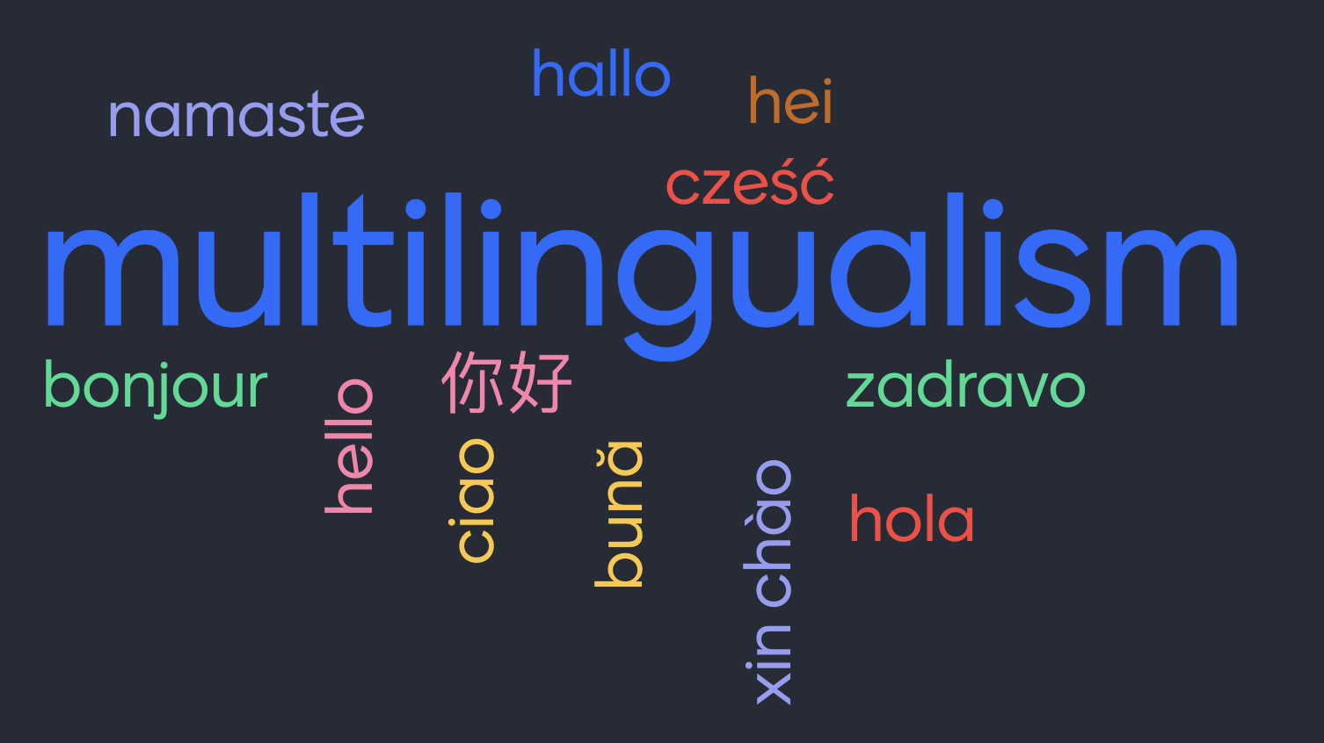
Understanding Multilingualism

Slide 5
Multilingualism
Please get together in groups of 4-6 persons and discuss the following questions:
What does the term “multilingualism” mean to you?
When would you consider someone “multilingual”?
Would productive skills (speaking, writing) be necessary for a person to be considered multilingual, or would you also include receptive multilingualism (reading, listening)?
Would you describe your pupils as multilingual? What might be multilingual about your classroom?
Would you define yourself as being multilingual? Which languages play a role in your life?
How does being multilingual differ from being a native speaker?
Notes:
A recent understanding of multilingualism encompasses different language constellations, language competencies and ages of onset. Moreover, the focus has moved from competence-based approaches to a use-based understanding of multilingualism. Hence, someone would be considered multilingual if she or she uses more than one language regularly. This can include receptive multilingualism, i.e. someone having listening skills in a language, but cannot speak this language. Interestingly enough, this understanding of multilingualism has been applied in most parts of linguistics for some time now and many teachers might be aware of it but still feel that they or there pupils are not true multilinguals. Monolingual ideals and thus the concept of balanced bilingualism are deeply rooted in the European, rather monolingual, understanding of multilingualism.
With some support by the workshop leader, the participants might become aware of this gap between the understanding of multilingualism in research and their own expectations. Moreover, this discussion allows the participants to share their perspectives on multilingualism and language learning while also reflecting on their own linguistic repertoires.
The answers to the last question (native speaker) can also later serve as a transition to the slides about native speakerness.

Slide 6
Mapping the foreign language classroom
How do you use different languages in the foreign language classroom? You can use the following questions to reflect on your foreign language classroom:
In what way do your pupils use other languages in group work?
Do you compare languages in your classes? If so, how and when do you do it?
Do the pupils use dictionaries/apps? Which ones?
Do you practice language mediation? If so, how and when?
Or do other languages exist in your pupils’ heads?
Please draw your classroom and mark places and situations where other languages are used. You might want to use different colours for the languages.
Notes:
See Worksheet 1
This activity helps participants visualize the presence and use of different languages in the context of their own foreign language classroom. This will also tell a lot about the group – not only which languages the pupils speak, but also which languages the participants speak and actively use when teaching in the classroom.

Slide 7
The foreign language classroom
In foreign language teaching, there have been times and contexts when/where the target language was rarely used in communication, while at other times, the contrary was true, i.e. the target language was the only means of communication in the L2 classroom. More recent approaches try to balance the L2/target language and the language(s) of schooling by
using the target language as the default means of communication;
integrating the language(s) of schooling where it is needed to fulfil the pupils’ and teachers’ communicative needs;
using the language(s) of schooling and ideally all L1s in the L2 classroom to compare languages and systematically build on pre-existing knowledge;
using translanguaging;
…
What other ideas can you think of?
What is the ideal balance for you?
Notes:
Translanguaging is a cross-linguistic phenomenon, where a person uses several languages simultaneously within the same communicative situation. Originally, it referred to the practice in which bilinguals receive information in one language and then use or apply it in the other. In its expanded sense, it refers to the natural and normal ways bilinguals use their languages in their everyday lives to make sense of their bilingual worlds.
In teaching, it refers to pedagogical practices that use multilingualism as a resource and that make space for different voices over the pupils’ entire linguistic repertoire. In the classroom context, this could mean making room for pupils to express themselves in different ways, simultaneously using all languages available to them and other semiotic resources together.

Slide 8
Second language acquisition
Our understanding of foreign and second language acquisition changes over time and with more and more research in this area (for a fuller discussion of second language acquisition see for example Lightbown & Spada 2013; Ortega 2008, VanPatten & Williams 2014).
To what extent do you agree to the following statements?
Second Language Acquisition is identical to First Language Acquisition.
The interlanguage is an incompletely acquired foreign language and thus can be considered a step towards complete language proficiency.
Adults cannot fully acquire a foreign language.
Language mixing is a sign of a lack of language competencies.
Language acquisition has numerous variables and is a highly individual process.
Notes:
You can discuss these questions in class or use a polling tool such as mentimeter. It can be helpful for the participants to see how different the perception of SLA is among colleagues.
The first point refers to the identity hypothesis. This is not considered to be true. There are significant differences in the circumstances of L1 and L2 acquisition, a major one being time.

Slide 9
Exploring language acquisition
Second Language Acquisition is identical to First Language Acquisition.
The interlanguage is an incompletely acquired foreign language and thus can be considered a step towards complete language proficiency.
Adults cannot fully acquire a foreign language.
Language mixing is a sign of a lack of language competencies.
Language acquisition has numerous variables and is a highly individual process.
Notes:
The first statement refers to the identity hypothesis. More recent research has shown that L1 acquisition differs greatly from the acquisition of an L2 in many respects, one of them being the contact time with the language.
The interlanguage hypothesis (Larry Selinker) shows how in the process of language acquisition, the target language contains elements that are not compliant with the respective language standard. At the same time, it conveys a monolingual bias, showing that the language used by learners cannot be considered the target language.
This statement refers to two widespread misconceptions: First, the idea of “fully acquiring” a language is quite vague and based on a monolingual understanding of languages. Second, it is based on the idea that children learn languages effortlessly, while this is not the case for adults. Research has shown that adults have an advantage in acquiring complex grammar while children can learn the pronunciation more easily than adults (Riemer & Wild 2018).
Following a monolingual ideal, forms of language-mixing, such as code-mixing or code-switching, are sometimes associated with deficient language skills. In fact, language-mixing is a regular form of language use in the communication between multilinguals.
This refers to the fact that language acquisition is an individual process, influenced by affective, cognitive and social factors (see for example Riemer 1997).

Slide 10
Language and meaning
If you think of a bus, what comes to your mind?
Notes:
How we understand certain terms is influenced by our experiences, and languages develop under the influence of social situations. Accordingly, being multilingual does not only mean to know the structure and vocabulary of more than one language but also to act in the respective linguistic and social environment.
This exercise is intended to show that even under a seemingly unambiguous term like 'a bus', different ideas and associations are possible and common, as these are based on different previous experiences and (societal) imprints. Participants are supposed to share ideas in small groups or with a partner, and describe what comes to their mind - or even look for a picture on their computer/phone and show it around.

Slide 11
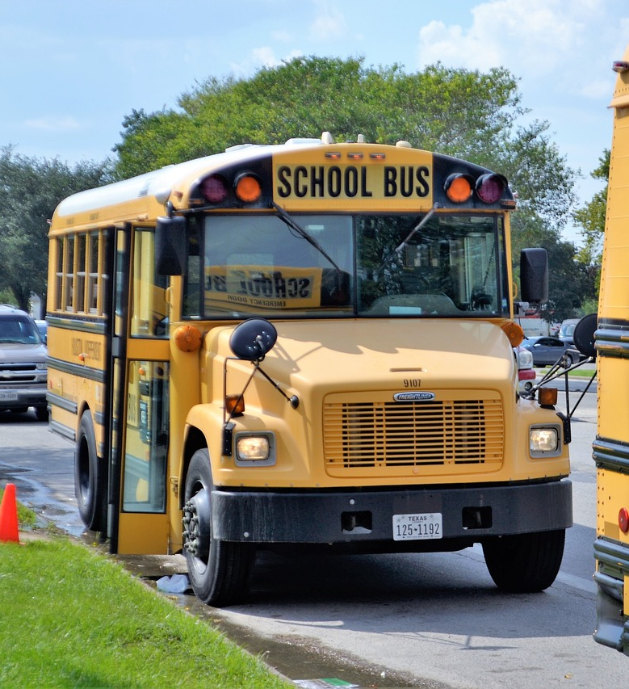
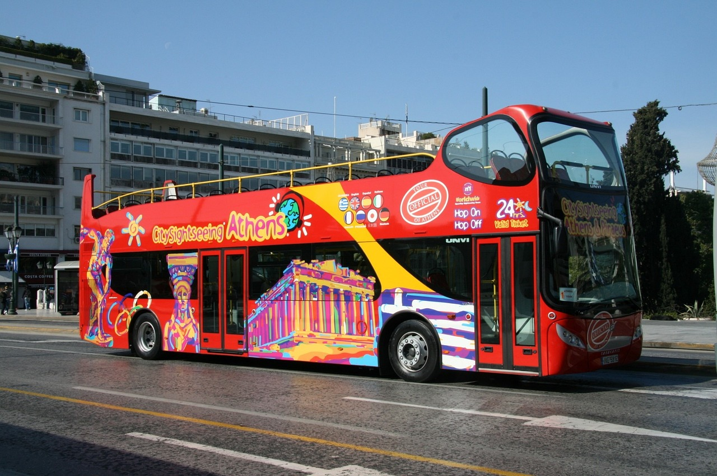
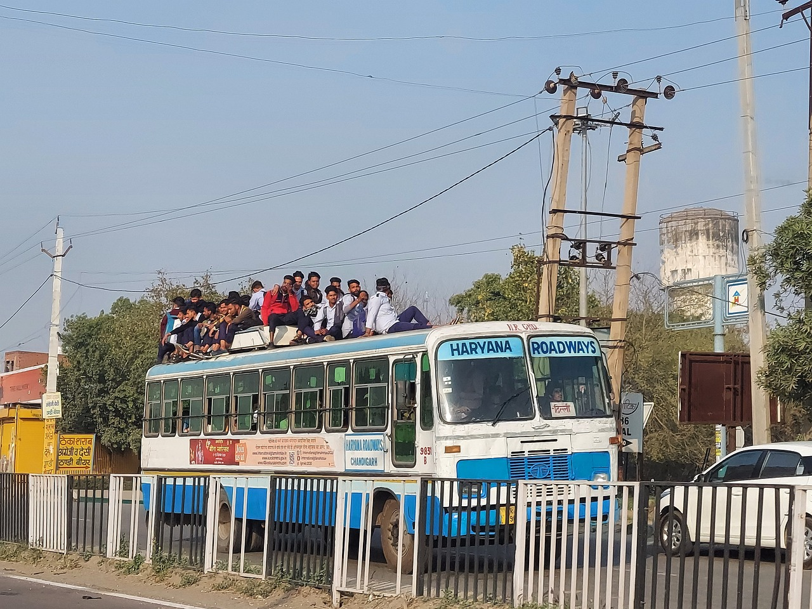
Notes:
After the exchange in groups, you can use these pictures to illustrate how different ‘a bus’ can look like.

Slide 12
Language and meaning
If you think of freedom, what comes to your mind?
Notes:
The ambiguity of different expressions can be illustrated even better by much more abstract concepts like "freedom." While the previous exercise was more about a different look and different functions of buses, concepts and terms like "freedom" can be viewed, defined, and described very differently, especially in light of recent events concerning the COVID pandemic.

Slide 13
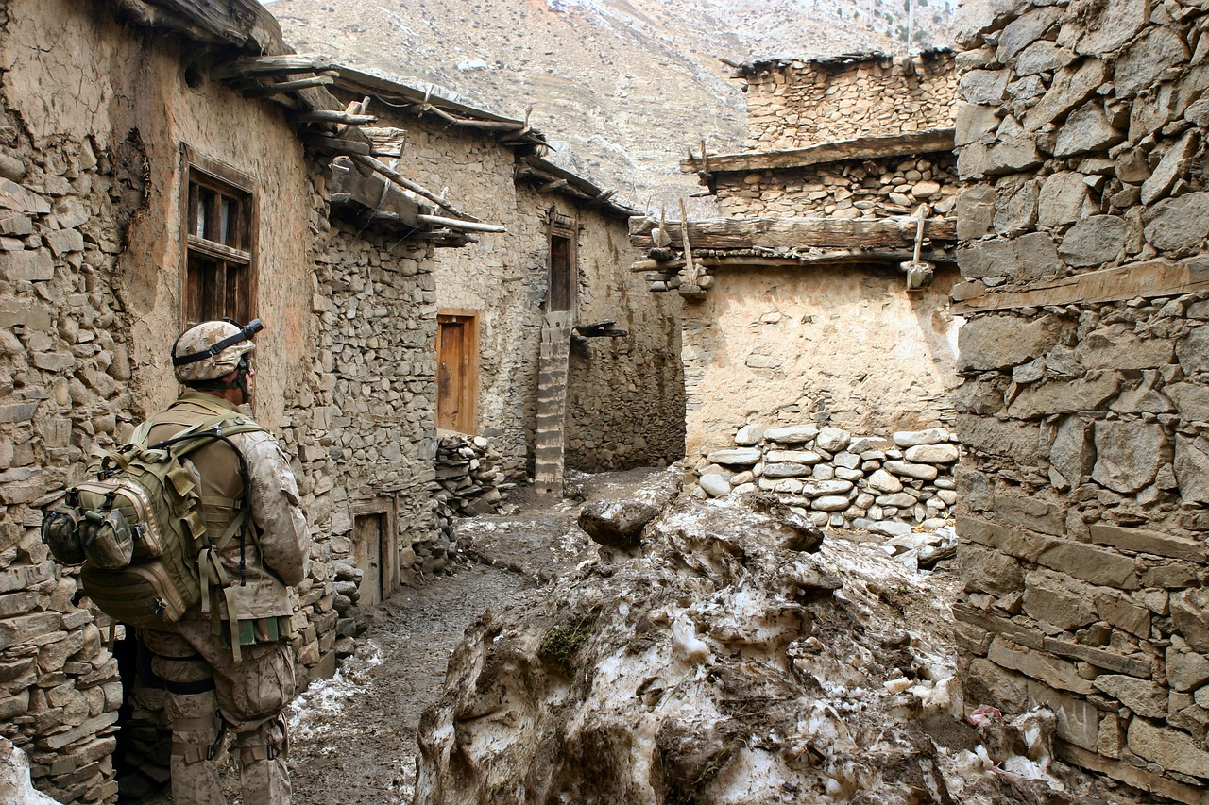
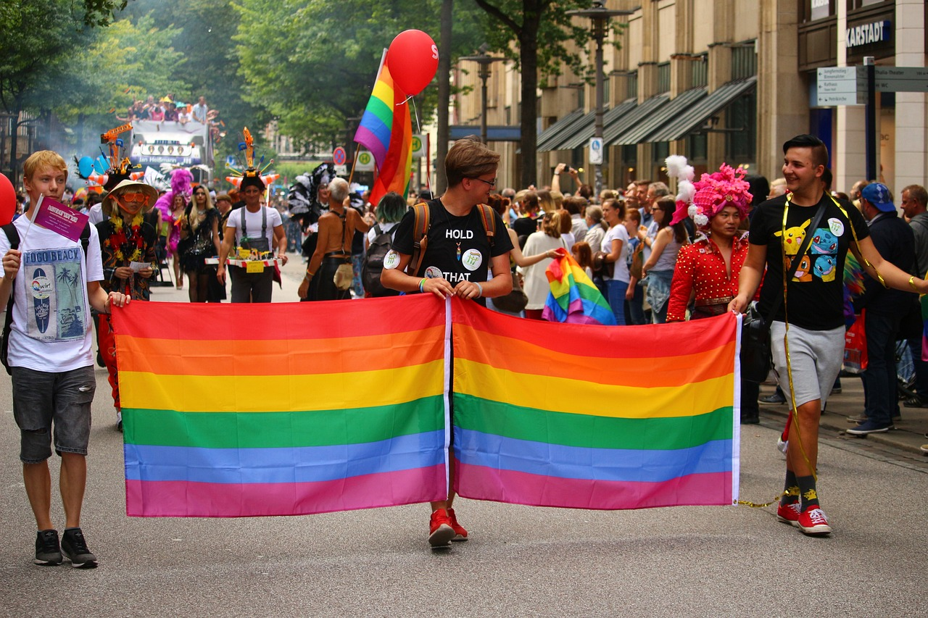
Notes:
You can use these pictures to address certain aspects that have come up in the discussion.

Slide 14
Multilingual speakers
How we understand words is influenced by our experiences, and languages develop under the influence of social situations. Accordingly, being multilingual does not only mean to know the structure and vocabulary of more than one language but also to act in the respective linguistic and social environment.
“The ability to operate between languages is not an exercise in playful polyglottism or inconsequential code switching. It is the much more risky circulation of values across historical and ideological time scales, the negotiation of non-negotiable identities and beliefs” (Kramsch 2010: 18).

Slide 15
The monolingual norm in multilingualism
Monolingual bias in Linguistics, Second Language Acquisition Research (SLA) and Foreign Language Teaching (Cook 1992: 577; Kramsch 2000)
Many key concepts in SLA such as the ‘native speaker’ and the ‘learner’ perpetuate “an analytic mindset that elevates an idealized 'native' speaker above a stereotypicalized 'nonnative', while viewing the latter as a deficient communicator, limited by an underdeveloped communicative competence” (Firth & Wagner 1997: 285).
Notes:
This part is supposed to critically discuss the term ‘native speaker’ and its implications for FLT.

Slide 16
The monolingual norm in multilingualism
These mindsets are historically situated (Belz 2003: 211) and in the European context closely linked with the founding of the nation states in the 19th century.
Multilingualism is often conceptualized as “parallel monolingualism” (Heller 1999: 5) instead of multilingual repertoires (Fishman 1967; Grosjean 1989).
Notes:
Heller (1999: 271) coined the term “parallel monolingualism”, in which each variety must conform to certain prescriptive norms (Creese/Blackledge 2010: 106). Multilingual repertoires, on the other hand, are constructed during practical activities and connected to various sociocultural settings. They can be described as rather dynamic and the languages within these repertoires are interconnected and cannot be entirely separated from one another.

Slide 17
The “native speaker” as a model in FLT?
Please discuss the following questions with a partner:
Think of the situation at your school/institution: are categories such as “native” and “non-native” foreign speakers used among language teachers? Are there any specific tasks/roles that some teachers take on while others might not?
What are the students' expectations regarding the teachers' language profiles?
If you are teaching your “native” language: do you remember a particular experience in class that made you doubt your own “native” language?
Notes:
This activity is supposed to make participants aware of their assumptions about the concepts of “the native speaker” in foreign language teaching and learning.
In the foreign language classroom, there is often an assumption that so-called “native speakers” are more competent in the language they are teaching. These native speakers are also more likely to succeed on the job market, as it seems that the most important qualification for a foreign language teacher is that they can demonstrate native-like language competencies. Foreign language teachers who cannot be considered as “native speakers” often experience discrimination on the job market. Moreover, it is not uncommon for them to view themselves as less qualified than someone who teaches their native language.
Instead of talking about “native” language, the terms “L1” or “first language” would be preferred today. Nevertheless, these terms naturally maintain the power imbalance between “first language speakers” and “language learners”. Slides 25-27 are optional and offer an alternative model of looking at different language users.

Slide 18
The “native speaker” as a model in FLT?
Please think about the following question:
What range of linguistic competence have you seen or experienced in “native speakers” of your first language?
After that, please work together in groups and have a look at the worksheet on which you will find some examples with slightly different grammatical and/or lexical features. Please discuss these examples in groups and decide which option(s) is/are correct.
Notes:
Ideally, there are both “native” and “non-native” teachers in the workshop. Together, they discuss grammatical/linguistic constructions that can be considered difficult, or that are not even clearly defined, in the language in which the workshop is taught: Worksheet 2. The examples on the slides refer to the English language but need to be replaced with examples from the language used in the workshop, they cannot simply be translated.

Slide 19
The “native speaker” as a model in FLT?
Option A:
The government have decided to increase security measures.
Option B:
The government has decided to increase security measures.
-> Both options are correct!
Notes:
Insert the solution for your language-specific examples on the following slides.
Explanation for this example: Both options are correct, as these are so-called collective nouns that are technically defined as singular nouns but refer to groups of people or things. Therefore, they can be used as either singular or plural nouns, depending on the variety of English the speakers use.

Slide 20
The “native speaker” as a model in FLT?
Option A:
My family are vegetarians.
Option B:
My family is vegetarians.
-> Option A is correct!
Notes:
Insert the solution for your language-specific examples on the following slides.
Explanation for this example: Option A is correct as the plural noun in the end (vegetarians) refers to a group of people, so “family” requires a plural verb.

Slide 21
The “native speaker” as a model in FLT?
A building made mostly of glass, used by gardeners to keep plants warm, is known as a …
Option A:
greenhouse
Option B:
green-house
Option C:
green house
-> Options A and B are correct.
Notes:
Insert the solution for your language-specific examples on the following slides.
Explanation for this example: Options A and B are correct, even though Option A is more frequently used. In most cases, writers have a choice whether to use a hyphen or not, depending on the context and what they would like to express. Option C is incorrect as a “green house”, without a hyphen, refers to a house painted green.

Slide 22
The “native speaker” as a model in FLT?
If we want to describe dresses with a lot of colours and patterns, we would use the expression of
Option A:
many coloured dresses
Option B:
many-coloured dresses
-> Option B is correct!
Notes:
Insert the solution for your language-specific examples on the following slides.
Explanation for this example: Option B is correct, as the first option refers to a high number of colored dresses and, therefore, does not say anything about the dresses being exceptionally colorful.

Slide 23
The “native speaker” as a model in FLT?
How many tenses does the English language have?
Option A:
Six
Option B:
Twelve
-> Both options are correct!
(https://linguapress.com/grammar/points/pointsindex.htm)
Notes:
Insert the solution for your language-specific examples on the following slides.
Explanation for this example: Both options are correct as it is not clearly defined what a “tense” in the English language actually is.

Slide 24
The “native speaker” as a model in FLT?
The “native speaker” is often thought of as an ideal person with a “complete and possibly innate competence in the language” (Pennycook 1994: 175).
This is based on the idea that there is a bounded, homogenous, and fixed language with a homogeneous speech community that is linked to a nation state (Pennycook 1994, 2007).
Defining the term “native speaker” itself is a complicated and loaded act, as Davies (2003) and Liu (1999) state:
But when we look for a definition of the native speaker which will act as an applied linguistic benchmark, the concept slips away [...] (Davies 2003: 1).
Who does the defining of a NNS or a NS? [...] If it identifies a NNS as less competent than a NS, then the definition and the dichotomy would be political [...] In fact, the NS/NNS dichotomy embodies linguistic imperialism (Liu 1999: 174).
Notes:
The “native speaker” is often considered a model speaker whose intuition in the language makes them a natural judge. However, this assumption has been contested by several researchers and alternative ways of judging the proficiency of language learners and teachers have been suggested, such as the concept of multicompetence by Vivian Cook (1999: 191) who states that L2 learners should be viewed as multicompetent language users rather than as deficient native speakers. This section of the workshop is meant to challenge the position of the native speaker in foreign language teaching and possibly think about alternative terms (slides 25-27).

Slide 25
The “native speaker” as a model in FLT?
The standardization of language, as well as the distinction between “native” (NS) and “non-native” speakers (NNS), creates a hierarchy between the aforementioned groups with the former positioned as the standard to which the latter should aspire (Kachru 1992).
Moreover, such a hierarchy is not caused by linguistic elements but by social relationships between groups of people who use certain linguistic varieties. Relationships between languages are manifestations of social relationships perpetuated by language ideologies (Doerr 2009: 5).

Slide 26
The “native speaker” as a model in FLT?
The “native speaker” is often considered a model speaker whose intuition in the language makes them a natural judge.
However, this assumption has been contested by several researchers and alternative ways of judging the proficiency of language learners and teachers have been suggested, such as the concept of multicompetence by Vivian Cook (1999: 191):
L2 learners must be viewed as multicompetent language users rather than as deficient native speakers.

Slide 27
An alternative approach: “Expertise” and “Allegiance”
Ben Rampton (1995: 340) suggests decomposing the concept of “native speaker” into “the simple distinction between ‘expertise’ (skill proficiency, ability to operate with a language) and ‘allegiance’ (identification with a language, with the values, meanings and identities that it stands for).”
“Expertise” and “allegiance” refer to linguistic identities as well as to cultural interpretations of a person’s relationship to a language (ibid.).
The advantage of the concept is that “expertise is learned, not fixed or innate [...] Expertise is relative and partial [...] To achieve expertise, you go through processes of certification, in which you are judged by others whose standards of assessments can be reviewed and disputed” (Rampton 1995: 340-42).

Slide 28
Multilingualism in foreign language teaching
Notes:
The participants can discuss their experiences and ideas.

Slide 29
Reasons to foster multilingualism
efficiency in learning
representation of full linguistic identity and linguistic human rights (Skutnabb-Kangas 2006)
a natural way of communication
multilingual and culturally reflective speaker as learning aims
…
(see, e.g., Dietrich-Grappin 2017, Kramsch 2010)
Please discuss: Why would you support multilingualism in your classroom?
Notes:
There are several reasons to foster multilingualism in your foreign language classroom. First of all, research has shown that students can learn more efficiently when they are allowed to use all kinds of different languages to discuss or talk about the contents of the lesson. Second of all, using their full linguistic repertoire allows students to express their full linguistic abilities and identity, and it creates a classroom that values linguistic human rights. Moreover, this way of communicating is natural to a high number of students. Last but not least, foreign language curricula often demand teachers to educate their students in becoming “multilingual and culturally reflective speakers”, so fostering multilingualism in the classroom is actually in line with the objectives of the foreign language curriculum.

Slide 30
Chances and challenges
Chances:
Multilingualism in the classroom offers rich resources for learning and comparing languages.
Multilingual pupils tend to learn foreign languages differently than their monolingual peers, and in many cases more successfully (Klieme & Beck 2007; DESI-Konsortium 2008).
Foreign language learning as a joint experience for all pupils and “common L2 glue” (Little & Kirwan 2019: 165)
If there are multilingual speakers in an L2 classroom, multilingualism will play an important role in the learners’ minds and identities.
Notes:
For the German context, this has been shown in the extensive DESI survey with 11,000 pupils in Grade 9, where pupils with an L1 other than German learned English as their first foreign language more easily than their monolingual peers. They were about half a school year ahead of their peers in a similar socioeconomic situation (Klieme & Beck 2007; DESI-Konsortium 2008).

Slide 31
Chances and challenges
Challenges:
Time is needed to meet the curriculum requirements and to engage with the target language. Many teachers feel there is little time for other languages or multilingual activities.
Teachers might feel they are losing control when they encourage pupils to use languages they do not speak or understand.
While there are many good reasons to include multilingualism in the foreign language classroom, there are not many practical guidelines.

Slide 32
Ways to include multilingualism
Allowing and encouraging the use of other languages
Comparing languages in syntax, morphology, vocabulary and pragmatics
Supporting learners to develop translinguistic and transcultural competencies
Fostering a positive attitude towards languages, language learning and multilingualism
…
What other ideas do you have?

Slide 33
Newcomers to the school system
In many cases, newcomers have no prior knowledge of the foreign languages that are taught in their new host countries and at their specific schools, which makes it necessary for them to catch up quickly.
Some countries work towards formally acknowledging competencies in other languages (e.g. a student’s first language) instead of a foreign language.
Many newcomers to the school system have experiences in unguided language acquisition outside the classroom that cannot always be put to use in the L2 classroom. This can lead to situations where they, for example, are able to acquire communicative skills quickly but struggle with grammar.

Slide 34
Newcomers to the school system
Accordingly, it can be helpful to
⇒ support learners in adapting to the way foreign languages are taught in a specific context
⇒ include elements of free language acquisition with meaningful interaction and a strong focus on the content of communication
⇒ integrate other languages that are relevant to a student into the L2 classroom

Slide 35
Some activities
Notes:
The last part of the workshop contains sample activities that can be used in the foreign language classroom.

Slide 36
Analysing Languages
What do you see when you compare these three languages?
Can you add more languages to the table?
Regarding the analysis, learners could check the number of words in a sentence, the word types, word order, whether there are articles or not, similarities in lexical elements, spelling, etc.
 | subclause | main clause
English | When the weather is nice, | everyone goes to the beach.
German | Wenn das Wetter schön ist, | gehen alle an den Strand.
Turkish | Hava güzel olduğunda, | herkes sahile gider.
Notes:
Comparing languages can help learners to understand structures in a new language and to develop metalinguistic competences.

Slide 37
Intercomprehension
Nederland is een land binnen het Koninkrijk der Nederlanden op het vasteland van West-Europa. Het wordt in het westen en noorden begrensd door de Noordzee, langs de oostgrens door Duitsland en in het zuiden door België. De hoofdstad van het land is Amsterdam, de regeringszetel is Den Haag. Nederland heeft een inwonertal van 16.515.057 (2009) en met een oppervlakte van 41.526 km² een hoge bevolkingsdichtheid van 397,7/km² (2009). Terwijl ruim 18% van het oppervlak bestaat uit water, ligt een groot deel van het land en de bevolking onder zeeniveau. Het land wordt beschermd tegen het water door middel van een systeem van dijken en waterwerken. Door landwinning zijn polders gecreëerd. Bestuurlijk is het land verdeeld in twaalf provincies.
Ongeveer 27% van het oppervlakte van Nederland, waaronder grote delen van het dichtbevolkte en economisch belangrijke westen, ligt beneden NAP (Normaal Amsterdams Peil [= Normalnull]).
http://www.cea.ulg.ac.be/eurocomgerm/texte/nl/index.php (28.02.2023)
Notes:
Intercomprehension is a form of receptive multilingualism within one language family, here: the Germanic languages (also see chapters to receptive multilingualism in Hufeisen & Marx 2014 - EuroComGerm) . Based on the knowledge in two languages from this language family, another language can be analyzed. Here, the participants in the workshop can try to understand the text and then discuss how it worked for them. Based on the participants’ language repertoire, this text can be replaced by a text in another language.

Slide 38
“Die sieben Siebe”: Understanding languages
Internationalisms
Vocabulary
Sound Equivalences
Spelling and Pronunciation
Syntactic Structures
Morphosyntactic Elements
Prefixes and Suffixes (“Eurofixes”)
This can be adapted for younger learners (see Kordt 2015).
Notes:
Gerhard Kischel and Horst G. Klein and their teams developed a system of “seven sieves”, seven transfer techniques, to achieve receptive reading competence in a rapid way.

Slide 39
Why Intercomprehension?
Intercomprehension: understanding unknown languages within a language family from which other languages are already known
originally used in romance languages (i.e. Meißner 2007)
trains hypothesis formation and testing while reading
arouses interest in languages
increases metalinguistic awareness
helps to compare languages

Slide 40
Communicating across different languages
create (playful) situations in which languages are used, e.g. in a virtual exchange
Example: “Market place” (primary school)
reflecting on one’s own multilingualism and languages in their environment
choosing two languages and learning some phrases
put phrases in all “old” and newly learned languages into a dictionary
market place in which all semiotic resources (all languages, gestures, facial expressions) are being used to “buy” things

Slide 41
Literature for linguistic and cultural pluralism
use literary texts and be open to/encourage different interpretations
use literary texts in preparatory classes for newcomers and in foreign language teaching from the very beginning
use literary texts that make different voices and affiliations visible

Slide 42
Teaching across the curriculum
Some topics, strategies and skills can be taught and practiced across the curriculum, for example, the first language classroom, the foreign languages, and - if applicable, the heritage language classroom to create synergies, for example
Learning strategies
Text revision
Speech acts like describing something (on different levels of language competence)
Presentation skills
…

Slide 43
Your ideas
What further ideas do you have?

Slide 44
Map of foreign language teaching
Please have a look at your map again and put down things you would like to try.
Which activity is the most important/interesting to you? When and how would you like to use it?

Slide 45
Thank you for your attention! Dziękujemy za uwagę!
Ευχαριστώ για την προσοχή σας!

Slide 46
References
Belz, J. (2003). Identity, Deficiency and First Language Use in Foreign Language Education. Blyth, C. (ed.). The Sociolinguistics of Foreign-Language Classrooms: Contributions of the Native, the Near-native, and the Non-native speaker. Boston: Heinle & Heinle, 209-248.
Chomsky, N. (1965). Aspects of the theory of syntax. Cambridge, MA: MIT Press.
Coady, M. (2019). Connecting school and the multilingual home. Theory and practice for rural educators. Bristol: Multilingual Matters.
Cook, V. J. (1992). Evidence for multi-competence. Language Learning, 42(4), 557-591.
Cook, V. J. (1999). Going beyond the native speaker in language teaching. TESOL Quarterly 33(2). 185-209.
Creese, A. / Blackledge, A. (2010). Translanguaging in the Bilingual Classroom: A Pedagogy for Learning and Teaching? The Modern Language Journal, 94(1), 103-115.
Davies, A. (2003). The native speaker: Myth and Reality. Clevedon: Multilingual Matters.
DESI-Konsortium (Ed.) (2008). Unterricht und Kompetenzerwerb in Deutsch und Englisch: Ergebnisse der DESI-Studie. Beltz: Weinheim.
Dietrich-Grappin, S. (2017). "Compétence plurilingue" durch "Translanguaging" im schulischen Französischunterricht. Zeitschrift für romanische Sprachen und ihre Didaktik 11(1), 95-111.
Doerr, N. M. (2009). Introduction. The Native Speaker Concept. Ethnographic Investigations of Native Speaker Effects. Berlin: De Gruyter, 1-10.
Epstein, J. / Sanders, M. / Sheldon, S. / Simon, B. / Salinas, K. / Jansorn, N. / VanVoorhis, F. / Martin, C. / Thomas, B. / Greenfield, M. /Hutchins, D. / Williams, K. (2001). School family and community partnership. Your handbook for action. 3rd ed. New York: Corwin.
EuroComGem (2009). Niederländisch. http://www.cea.ulg.ac.be/eurocomgerm/texte/nl/index.php. (11.07.2023).

Slide 47
References
Firth, A. / Wagner, J. (1997). On discourse, communication, and (some) fundamental concepts in SLA research. Modern Language Journal, 81(3), 285–300.
Fishman, J. A. (1967). Bilingualism with and without diglossia; diglossia with and without bilingualism. Journal of Social Issues, 29-38.
Herdina, P. / Jessner, U. (2002). A dynamic model of multilingualism: Perspectives of change in psycholinguistics. Bristol: Multilingual Matters.
Grosjean, F. (1989). Neurolinguists, beware! The bilingual is not two monolinguals in one person. Brain and Language, 26, 3–15.
Heller, M. (1999). Linguistic minorities and modernity: A sociolinguistic ethnography. London: Longman.
Hufeisen, B. / Marx, N. (eds.) (2014): EuroComGerm – Die sieben Siebe: germanische Sprachen lesen lernen. Aachen: Shaker.
Kachru, B. (1992). Teaching World Englishes. The other tongue: English across cultures. Urbana: University of Illinois Press, 355-366.
Klieme, E. / Beck, B. (eds.) (2007). Sprachliche Kompetenzen – Konzepte und Messung. DESIStudie (Deutsch Englisch Schülerleistungen International). Beltz: Weinheim.
Kramsch, C. (2000). Language and Culture. Shanghai: Shanghai Foreign Language Education Press.
Kramsch, C. (2010). Theorizing translingual/transcultural competence. Levine, G. / Phipps, A. (eds.). Critical and Intercultural Theory and Language Pedagogy.. Boston: Heinle & Heinle, 15-31.
Kopeliovich, S. (2013). Happylingual: A family project for enhancing and balancing multilingual development. Schwartz, M. / Verschik, A. (eds.). Successful family language policy. New York/London: Springer, 249-276.
Kordt, B. (2015). Sprachdetektivische Textarbeit. Praxis Fremdsprachenunterricht. Englisch 04, 4-8.

Slide 48
References
Lightbown, P. / Spada, N. (2013). How Languages are Learned. 4th ed. Oxford: Oxford University Press.
Linguapress (2022). Difficult words and expressions in English. https://linguapress.com/grammar/points/pointsindex.htm (11.07.2023).
Little, D. / Kirwan, D. (2018). From plurilingual repertoires to language awareness: Developing primary pupils’ proficiency in the language of schooling. Hélot, C. / Frijns, C. / Sierens, S. / Gorp, K. (eds.). Language awareness in multilingual classrooms in Europe: From theory to practice. Berlin: De Gruyter, 169-205.
Little, D. / Kirwan, D. (2019). Engaging with linguistic diversity: A study of educational inclusion in an Irish primary school. London: Bloomsbury Academic.
Liu, J. (1999). From their own perspectives: The impact of non-native ESL professionals on their students. In: Braine, G (ed.). Non-native educators in English language teaching. Mahwah: Lawrence Erlbaum, 159-176.
Meißner, F.-J. (2007). Grundlagen der Mehrsprachigkeitsdidaktik. In: Werlen, E. / Weskamp, R. (eds.). Kommunikative Kompetenz und Mehrsprachigkeit. Diskussionsgrundlagen und unterrichtspraktische Aspekte. Baltmannsweiler: Schneider Hohengehren, 81-101.
Ortega, L. (2008). Understanding Second Language Acquisition. London/New York: Routledge.
Otheguy, R. / García, O. / Reid, W. (2015). Clarifying translanguaging and deconstructing named languages: A perspective from linguistics. Applied Linguistics Review, 6(3), 281–307.
Pennycook, A. (1994). The cultural politics of English as an international language. London: Longman.
Pennycook, A. (2007). The myth of English as an international language. Disinventing and reconstituting languages. Clevedon: Multilingual Matters, 90-115.
Rampton, B. (1995). Crossing: Language and ethnicity among adolescents. London: Longman.

Slide 49
References
Riemer, C. (1997). Individuelle Unterschiede im Fremdsprachenerwerb. Eine Longitudinalstudie über die Wechselwirksamkeit ausgewählter Einflußfaktoren. Baltmannsweiler: Schneider.
Riemer, C. / Wild, K. (2018). Individuelle Einflüsse auf den Fremdsprachenerwerb - Einführung in das Themenfeld. DAAD (eds.): Dhoch3-Studienmodule Deutsch als Fremdsprache. moodle.daad.de.
Smith-Christmas, C. (2016). Family language policy. Maintaining an endangered language in the home. Basingstoke: Palgrave Macmillan.
VanPatten, B. / Williams, J. (2014). Theories in Second Language Acquisition. New York: Routledge.

