Slide 1
Subject Language-Sensitive Teaching
in the Humanities
Workshop 3
IO2 © 2023 by MaMLiSE is licensed under CC BY-NC-ND 4.0

Slide 2
The MaMLiSE project
Majority and Minority Languages in School Environment
an international project funded by Erasmus+ Programme under Action 2 – Strategic Partnerships, School Education;
running from 01.11.2020 to 31.07.2023;
main aim: supporting school teachers in delivering effective instruction in linguistically diverse classes. Although multilingualism has been present in EU schools for years, the range of in-service training courses and support materials on offer is still insufficient;
The project consortium has been able to prepare a book and materials on how to effectively support teachers and educational staff to teach successfully in linguistically diverse classes and to develop a whole-school inclusion policy, based on the premise that both newcomers and multilingual pupils who have lived in the country for a long time and were born there should be included.

Slide 3
Workshop 3 Overview and Outcomes
This workshop seeks to:
explore language-sensitive teaching in action highlighting key related strategies that teachers can apply in different classroom contexts.
provide concrete examples of how discipline specific subject, such as literature, geography and history, can be taught in a way that includes and facilitates the learning of children and young people from varying multilingual backgrounds.
show how teachers can draw on the multilingual resources of learners to better promote inclusive and supported learning in the multilingual school environment for the benefit of all learners.

Slide 4
What is Language-Sensitive Teaching?
Language-sensitive teaching:
draws on approach draws on an understand that multilingual pupils possess important linguistic reservoirs that should be utilized during instruction for more effective learning.
promotes both the majority language of schooling, and minority and heritage languages where they exist, both in school and in the home environment.
supports good educational practice and values inclusivity and diversity.

Slide 5
What is Scaffolding?
Socio-cultural theorists view language and language learning in social terms, as suggested by the Vygotskyan Educational Theory (1978).
The role of the more competent “knower” who scaffolds the learning process through “supportive dialogue“, known as scaffolding.
Scaffolding gives minority language learners support to enable them to perform tasks and construct meaning which may be at the time beyond their capability (Carter and Nunan 2001).

Slide 6
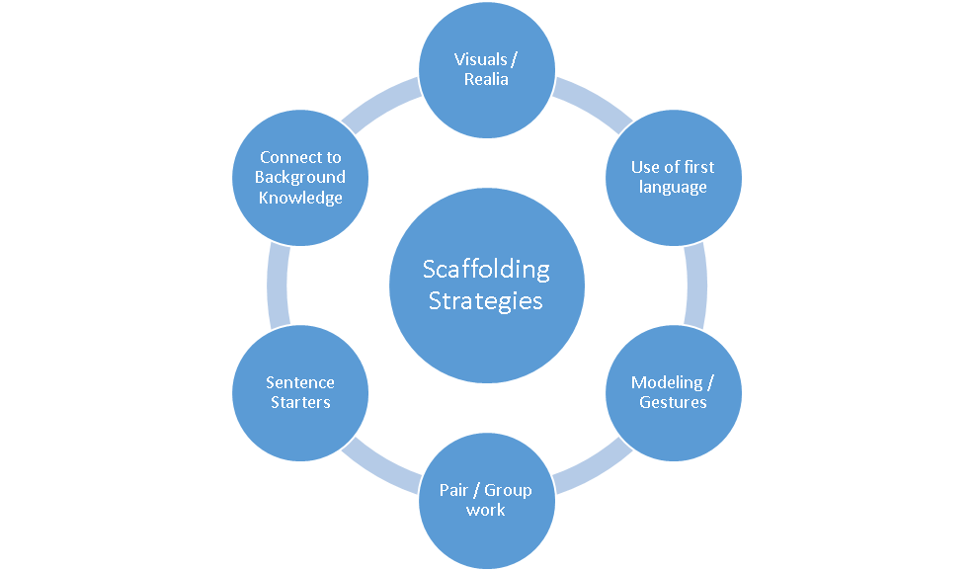
Scaffolding Strategies
How can teachers use scaffolding strategies in mainstream classrooms?

Slide 7
Scaffolding Strategies for all Classrooms
Pre-Teaching Vocabulary and Activating Schemata
Teacher Considerations:
What do the learners already know about the topic?
What do the learners now need to know to support their learning?
Teacher Strategies:
Pre-teach vocabulary required for the task.
Encourage peer-teaching whereby more able learners help peers.

Slide 8
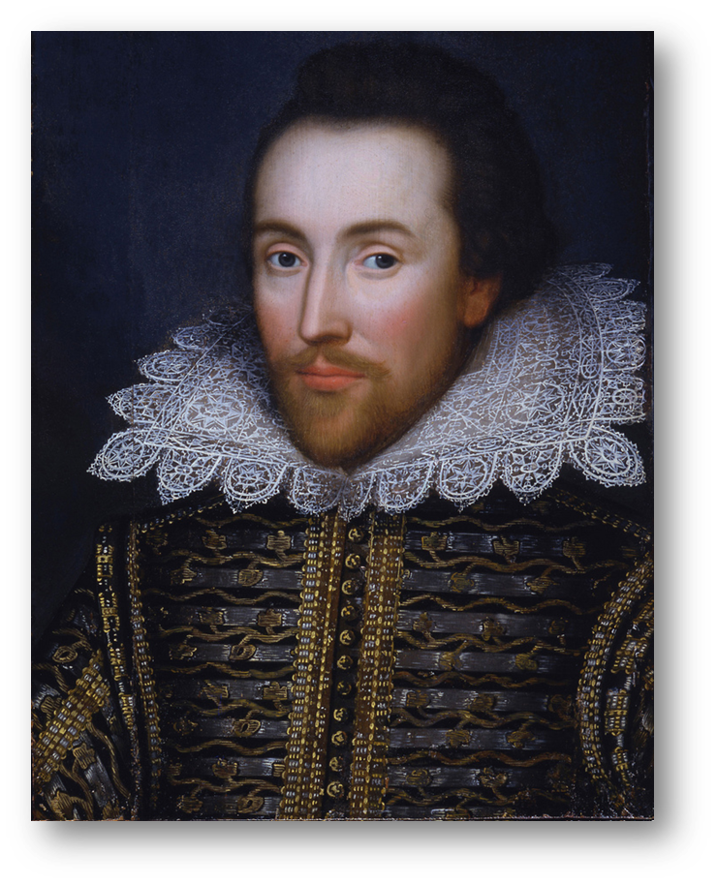
Examples of Scaffolding Strategies in Practice
Predicting, Articulating and Reinforcing
Teacher Considerations:
Use visual support and context to facilitate the learning process.
Use prompts and cues and noticing strategies (explicitly direct them to key words or pictures).
Teacher Strategies:
Encourage interaction and social learning in any language learners know (e.g., learners from Syria being allowed to explore and exchange ideas in their L1)
(Murray, 2016)

Slide 9
Scaffolding Strategies for all Classrooms
Noticing Strategies
Teacher Considerations:
Bring explicit attention to key language items required for comprehension and use targeted repetition of key language items.
Create opportunity for learners to explore and differentiate between key language items.
Teacher Strategies:
Corrective feedback to the class.

Slide 10
Scaffolding via Effective Teacher Talk
Guiding Principles
Teacher talk is central for the learning process.
Teacher talk provides a model for language learning.
Suitable teacher talk supports learning.
Unsuitable teacher talk hinders learning.
What is suitable teacher talk?
Teacher talk must be must be clear, accessible and culturally sensitive when you are:
Giving instructions – e.g. Please open your books on page 40.
Asking questions – e.g. Why did the Romans build so many roads?
Providing explanations – e.g. The first main reason is….
Giving corrective feedback – e.g. That’s an interesting idea but what did it say in the text?

Slide 11
Scaffolding Strategies for all Classrooms
Language Aware Teachers for Effective Scaffolding
Teachers Considerations:
Know the language level of each learner.
Adapt and accommodate for each learner level.
Set differentiated tasks for each language level learner.
Teacher Strategies:
Plan differentiated lessons.
(British Council, 2017)

Slide 12
Fostering Language Friendly Classrooms
Value all Languages in the Classroom
Teachers Considerations:
Identity the language/s used by your learners.
Encourage learners draw on their language resources in their thinking and problem solving.
Teacher Strategies:
Brainstorm five ways you can promote multilingual practices in the classroom.

Slide 13
Teaching Literature, Geography and History in a Multilingual Mainstream Classroom
Please see accompanying documents for practical application of the content presented in the slides.
Sample Lesson - Literature (see 03_W_01_WS)
Sample Lesson - Geography (see 03_W_02_WS)
Sample Lesson – History (see 03_W_03_WS)

Slide 14
Self-Reflection for Professional Development
Reflection:
Identify three scaffolding strategies you would like to develop in your classroom and why.
Consider the suitability and effectiveness of your teacher talk and how you can improve it.
How can you help learners appreciate their own language, knowledge and skills?

Slide 15
Bibliography
British Council (2017) CEFR and Language Assessment. Available at: CEFR and Language Assessment – YouTube (Accessed: November 27, 2022).
Murray, P. (2016) Macbeth New Edition. Available at: https://www.edco.ie/teachers/macbeth-new-edition-2016.4890.html (Accessed: November 27, 2022).
Nunan, D. and Carter, R. (2001) The Cambridge guide to teaching English to speakers of other languages. Cambridge University Press.
Vygotsky, L.S. and Cole, M. (1978) Mind in society: Development of higher psychological processes. Harvard University Press.

Slide 16
CERTIFICATES
Thank you for your participation

