Slide 1
Introduction to Language-Sensitive Teaching
in the Humanities -
Principles for Good Practice
Workshop 2
IO2 © 2023 by MaMLiSE is licensed under CC BY-NC-ND 4.0

Slide 2
The MaMLiSE project
Majority and Minority Languages in School Environment
an international project funded by Erasmus+ Programme under Action 2 – Strategic Partnerships, School Education;
running from 01.11.2020 to 31.07.2023;
main aim: supporting school teachers in delivering effective instruction in linguistically diverse classes. Although multilingualism has been present in EU schools for years, the range of in-service training courses and support materials on offer is still insufficient;
The project consortium has been able to prepare a book and materials on how to effectively support teachers and educational staff to teach successfully in linguistically diverse classes and to develop a whole-school inclusion policy, based on the premise that both newcomers and multilingual pupils who have lived in the country for a long time and were born there should be included.

Slide 3
Workshop 2 Overview and Outcomes
This workshop seeks to:
raise awareness of inclusive classroom contexts.
introduce language sensitive teaching as a broad educational approach that can be applied in a flexible way to different classroom contexts.
highlight core educational principles such as learner-centredness, inclusion and scaffolding which can help promote multilingualism in the school environment for the benefit of all pupils.
equip teachers with a broad educational framework that they can apply in their own teaching context at in terms of classroom strategies to achieve these transformational goals.

Slide 4
Exploring Diversity in Schools and its Impact
Listen to Livia, an Irish teacher talking about the growing phenomenon of linguistic /cultural diversity in her own school context and its impact and complete the following related tasks (see 02_W_01_R)
Task 1 – Summary of key points (see 02_W_01_WS)
Task 2 – Teacher Self-reflection
Meet post-primary foreign language and
language support teachers Livia working in
the Irish educational context

Slide 5
Raising Awareness of Language-Sensitive Teaching
Complete a short survey based on the following two questions.
Survey Link: https://forms.gle/ww2frVVmi2JxHPXy6
1) What is your understanding of language-sensitive teaching and learning?
2) How can it benefit:
Learners?
Schools?
Society?
Notes:
Menti

Slide 6
Raising Awareness of Language-Sensitive Teaching
Language-sensitive teaching is an inclusive teaching approach that takes account of the challenges and the linguistic abilities of pupils to better support their learning across the curriculum.
Now let’s investigate the core principles underpinning this approach.
Notes:
Menti

Slide 7
What is Language-Sensitive Teaching?
Brainstorm what you think are the core educational principles that support language-sensitive teaching and then check with the following slide.
Language Sensitive Teaching

Slide 8
Guiding Principles for Language-Sensitive Teaching
1. Inclusive classrooms
7. Reflective teaching
2. Learner -centredness / diversity
Language- Sensitive Teaching
6. Emotionally- safe classrooms
3. Scaffolding
5. Culturally sensitive classrooms
4. Language aware / friendly classrooms

Slide 9
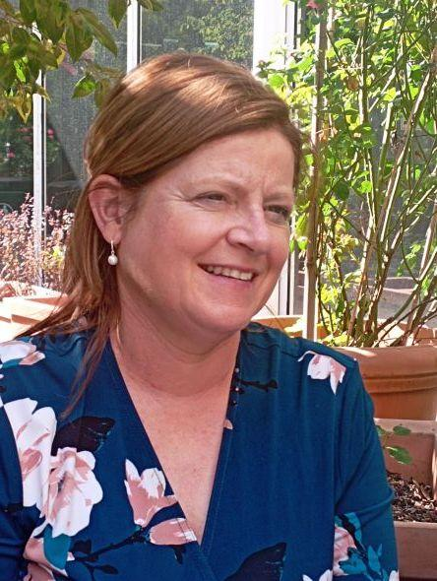
Principle 1: Exploring Inclusive Classrooms
Read the United Nations definition of inclusive education and reflect on its relationship with your own national educational policy.
What does inclusive education mean in practice? Which of the following areas should inclusive education extend to?
a) Additional needs e.g. disabilities
b) Cultural diversity
c) Diverse language abilities and needs
Meet secondary school teacher educator Mary and listen to her talking about how pre-service teachers are prepared in the Irish context for inclusive classroom practice (see 02_W_02_R)
Are teachers being prepared in your school for inclusive classroom practice? In what ways?
Listen to teacher educator Mary’s account of inclusive education

Slide 10
Principle 2: Learner-Centredness / Diversity
Thinking about your learners
Learner-centredness refers to the process of teaching and learning which places the learners at the center as active agents.
Learners differ in many ways, for example, in languages, cultures, language proficiency level, prior experiences, aptitude, motivation, learner styles and strategies, maturity, needs and interests.
What strategies can teachers develop/implement to foster learner-centredness in the classroom? (see 02_W_02_WS)

Slide 11
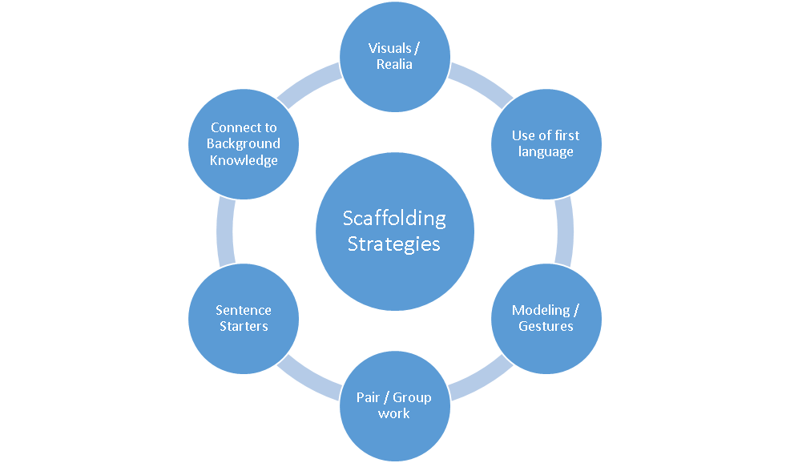
Principle 3: Scaffolding
What is scaffolding?
Scaffolding is a support given to learners by teachers or peers to enable them to perform tasks and construct meaning which may be at the time beyond their capability (Carter and Nunan 2001).
What are the various strategies that teachers can use in order to support the learning process and add some of your own.
Brainstorm ways in which peer scaffolding can be promoted.

Slide 12
Dialogic Learning as a Scaffolding Strategy
What is Dialogic Learning?
Dialogic learning is learning that takes place through dialogue between teachers and learners or between peers.
Learning is a social process.
How can teachers best support learners through their own teacher talk? (see 02_W_03_WS)

Slide 13
Principle 4: Language Aware / Friendly Classrooms
Language Aware Teachers for Effective Scaffolding
Teachers Considerations:
Know the language level of each learner.
Adapt and accommodate for each learner level.
Set differentiated tasks for each language level learner.
Teacher Strategies:
Plan differentiated lessons.
(British Council, 2017)

Slide 14
Fostering Language Friendly Classrooms
Value all Languages in the Classroom
Teachers Considerations:
Identity the language/s used by your learners.
Encourage learners to draw on their language resources in their thinking and problem solving.
Teacher Strategies:
Brainstorm some ways you can promote multilingual practices in the classroom.

Slide 15
Principle 5: Culturally Sensitive Classrooms
Key Considerations for Culturally Sensitive Classrooms
Respect and appreciate different cultures.
View cultural diversity as a valuable teaching and learning resource.
Are critically aware of culturally / ethnically related issues, such as discrimination / racism / exclusion / unconscious bias.
Develop a more open mind-set and empathy towards those from different backgrounds.
List some opportunities to promote culturally sensitive classrooms
Read the example of a strategy used by teacher Sophie in the Irish primary context (see 02_W_04_WS)
Meet recently qualified Irish primary school teacher Sophie whose teacher educator programme informed her about linguistic and culturally sensitive teaching

Slide 16
Principle 5: Culturally Sensitive Classrooms
Developing and Using Interculturally Sensitive Materials
Listen to Livia talk about a strategy she created with her students entitled ‘The Multicultural Calendar of Events’ (see 02_W_03_R) and reflect on how you might use/adapt such a resource for your own context.

Slide 17
Principle 6: Emotionally-Safe Classrooms
Key Considerations for Promoting Emotionally-Safe Classrooms
Emotions affect the learning process.
The classroom environment needs to be welcoming and inclusive for all learners.
Positive relationships between teacher and learners and between peers need to cultivated.
What can teachers do to foster emotionally-safe classrooms?
Listen to teacher Michelle outlining what she learned from trauma-informed teacher training to support the inclusion of pupils from refugee backgrounds and reflect on the relevance of this training for your own teaching context (see 02_W_04_R)
Listen to teacher educator Michelle talking about trauma-informed teacher training

Slide 18
Principle 7: Reflective Teaching
Reflection
Reflective teaching is an ongoing process in which teachers monitor, evaluate their own practice continuously (Pollard 2008).
How can you apply some of the principles and strategies you have learned about in this workshop to your own teaching to promote and support inclusion and diversity in the multilingual school environment?

Slide 19
Bibliography
British Council (2017) CEFR and Language Assessment. Available at: CEFR and Language Assessment – YouTube (Accessed: November 27, 2022).
Nunan, D. and Carter, R. (2001) The Cambridge guide to teaching English to speakers of other languages. Cambridge University Press.
Pollard, V. (2008) Ethics and reflective practice: Continuing the conversation. Reflective Practice, 9(4), pp.399-407.
Tudor, I. (1996) Learner-centredness as language education (Vol. 279). Cambridge: Cambridge University Press.
United Nations (2022) Article 24 – Education Enable. Available at: https://www.un.org/development/desa/disabilities/convention-on-the-rights-of-persons-with-disabilities/article-24-education.html (Accessed: November 27, 2022).

Slide 20
CERTIFICATES
Thank you for your participation

