Slide 1
INTEGRATION OF HOME AND SCHOOL LANGUAGE for parents and teachers
Workshop 10
IO2 © 2023 by MaMLiSE is licensed under CC BY-NC-ND 4.0
Notes:
Information on this workshop:
This workshop is designed for both parents and teachers who are interested in multilingual practices and their promotion in schools and families. It provides a space in which all participants can equally discuss these topics and develop concepts together. The workshop is based on and works with first-hand-experience of students, families, schools and teachers and it introduces several important concepts, such as Family Language Policy and Schools’ Linguistic Landscapes. Participants will have the opportunity to jointly design concepts for successful family-school collaborations and school communities as well as to develop strategies to foster multilingualism in families and classrooms.

Slide 2
The MaMLiSE project
Majority and Minority Languages in School Environment
international project funded by Erasmus+ Programme under Action 2 – Strategic Partnerships, School Education;
running from 01.11.2020 to 31.07.2023;
main aim: supporting school teachers in delivering effective instruction in linguistically heterogeneous classes. Although multilingualism has been present in EU schools for years, the range of in-service training courses and support materials on offer is still insufficient;
on the basis of the training courses prepared in the project, teachers will learn e.g.:
(1) how to adapt teaching materials from various subjects to their pupils’ proficiency in the language of the school education and
(2) how to didactically support them with teaching principle of scaffolding.

Slide 3
Warm-up
When you think about (minority-language) families and schools working together, what comes to your mind?
Please write down 5 key words (in whatever language you like).
Notes:
To warm-up and to introduce the topic of the workshop, the workshop leader can ask the participants to write down 5 key words on the question shown on this slide. The participants can work in groups or individually, they can use a sheet of paper or collect their ideas on large posters or on the board. In that case, everyone could walk around, see the other participants’ key words, ask for translations, etc. The participants could also discuss their contributions in groups or in pairs.

Slide 4
Pupils’ Perspectives
Please listen to what Kamelia and Natalie say about learning the majority language in school and try to answer the following questions for yourself.
What impresses you most in the pupils’ account of their experiences in school?
What kind of challenges did they face?
What did the pupils consider helpful?
Notes:
Two recordings are made available here. Participants can start by thinking about the questions on their own, or, if preferred, in pairs.

Slide 5
Discussion
In mixed groups of teachers and parents, please discuss your impressions from the video statements and your perspectives on family-school partnerships. You may also discuss your keywords from the beginning of the workshop (Worksheet 1) (20 minutes):
Your experience:
Is this similar to your experiences as a parent or as a teacher?
What kind of challenges do pupils in a migrant situation face at school and how do they profit from their multilingualism?
How is this different for pupils who are second-generation citizens of the country?
What can schools do to support multilingual families?
What can families do to support their children?
Notes:
In mixed groups of teachers and parents, the participants discuss their thoughts on the recordings that were shown earlier and they start relating them to themselves.
To support this activity, Worksheet 5 can be used for some helpful words and phrases.

Slide 6
Conclusions
What were the 5 most important aspects in your discussion? Please write them down.
Notes:
The key ideas can be collected using a digital tool, such as Etherpad or Mentimeter, to make them available to all participants.

Slide 7
Multilingual Families

Slide 8
Multilingual Families
Families in which two or more languages are used regularly, regardless of the level of competence and the individuals’ linguistic biography
Different types of multilingual families (Smith-Christmas 2016: 22)
Each parent speaks another language
The family language is a minority language (or several languages) in the context of migration
Multilingual families in bi-/multilingual countries
Mixed forms
Notes:
Input on multilingual families. The participants could be asked whether would describe their family as multilingual. If there is enough time, the participants could be asked how they understand the term “multilingualism”.
The definition used in this workshop: Families in which two or more languages are used regularly, regardless of the level of competence and the individuals’ linguistic biography.

Slide 9
Family Language Policies
Family Language Policy describes the way languages are used in a family, including explicit as well as implicit rules of language use, e.g.
Which languages do the parents use when speaking to their children and to each other?
What languages are dominant and why?
Are family members trying to preserve a minority language?
What is the role of the majority language in the family?
Which language is used in which situation?
Notes:
Some input on family language policy as shown on the slide.

Slide 10
Traditional Approaches in Multilingual Families
In the past:
Tradition of monolingual strategies in Europe
Advice for minority language-speaking families to switch to the majority language
Strict division between the language at home and outside the home in minority language-speaking families
One-person-one-language approach in families where the parents speak different languages
Notes:
Many parents and teachers might be familiar with the one-person-one-language approach, even if they do not know the name. On this slide, it is shown that in the past, the focus was on native-like competencies and even if more than one language was spoken in a family, the children were expected to become “fluent” or “native-speakers” in both or all languages. In many cases, there was disappointment when this did not happen.
The next slide shows more recent approaches that might be easier to handle und come with less ambitious expectations.

Slide 11
Multilingual Approaches in Multilingual Families
More recent approaches:
Development of an understanding of language as interconnected (Grosjean 1989, Herdina & Jessner 2002)
Flexible strategies in the families: code-switching, the “happylingual approach” (Kopeliovich 2013: 251), where a home language is promoted while other languages are included and the child’s language preferences are respected
Flexible strategies in schools: the integration of the pupils’ home languages where it is useful and possible, e.g. in translanguaging approaches (Otheguy et al. 2015)
Notes:
While former approaches aimed at “parallel monolingualisms” (Heller 1999), more recent approaches acknowledge that in a monolingual mind, all languages are connected in complex ways. The suggested strategies are less rigid and more flexible and do not only focus on language purity but encourage families to engage in literacy activities, to create a rich linguistic environment etc.

Slide 12
Home Language Practices
code-switching, code-mixing and translanguaging
ritual language practices: e.g. ritual book reading, religious practices, family cultural traditions related to the home language(s)
reciprocal bidirectional learning: e.g. simultaneous learning of two languages, e.g. the majority language by parents and children and the minority language by children with parents/grandparents as experts
Notes:
For more details on code-switching, see the next slide

Slide 13
Code-Switching
Use of language elements in a stretch of speech predominantly framed in another language (Szczepaniak-Kozak et al. 2023: 64)
Notes:
For more details on code-switching, see the next slide

Slide 14
Code-Switching
Example of code-switching in a conversation between parents and a child
Dinner conversation
Talking about activities in kindergarten

Slide 15
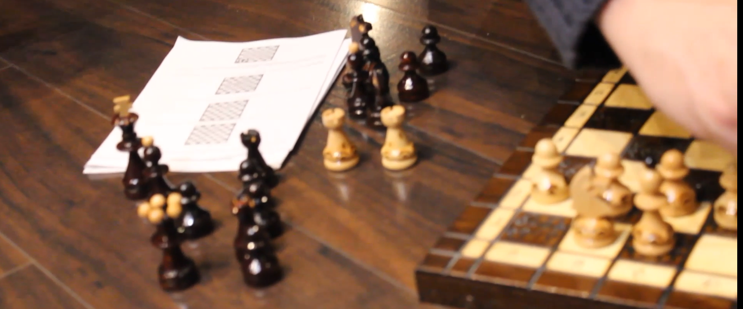
Code-Switching
Example of code-switching in a conversation between a parent, a relative and a child (Dutch, Polish, English)
Vick playing chess with dad: https://youtu.be/XWbrY2fpeH8
Notes:
Playing chess with dad (Dutch)
The video features Vick “playing chess” with his dad – they interact in Dutch, and the boy’s dad teaches him the names of chess pieces in Dutch and asks him to count the pawns. Simultaneously, the boy addresses his aunt in Polish, switching the codes effortlessly. He even corrects his aunt when she takes the name of the chess piece ‘Koning’ [Eng. king] for similarly pronounced ‘konik’ in Polish [Eng. little horse].

Slide 16
Questions
To parents
How do you use the different languages in your family?
What languages do you use in which situation?
What attitudes do the individual family members have towards the individual languages?
To teachers
What do you know about the children’s linguistic backgrounds? What different language policies have you encountered? Which approaches do you find useful?

Slide 17
The School Environment

Slide 18
Sharing experiences: the mother’s and daughter’s perspective
Azalia is a Belarussian refugee who has settled in Poland with her eight-year-old daughter Amina. Listen to their stories:
Amina on her first days at a Polish school
Azalia on school and
parents’ support

Slide 19
Reflection
How do you feel about Amina’s experiences? What could have been done better to make the girl welcome and comfortable at school?
Do you or your children encounter/ have encountered similar problems? If yes, how have they coped with such problems?
Do you agree with Amina’s advice concerning school support? What would you suggest? How could parents facilitate this process?

Slide 20
The School Environment
Now please work together in groups of teachers and groups of parents. Against the backdrop of Amina’s experiences, what are the most urgent questions from your perspective? Could you also find some possible solutions?

Slide 21
Reflect on your school’s linguistic landscape (complete the worksheet)
Please map the linguistic landscape of your/your children’s school. What languages do you encounter? Where could home languages be included?
?
?
?
?

Slide 22
Multilingualism in Schools: Good Practice

Slide 23
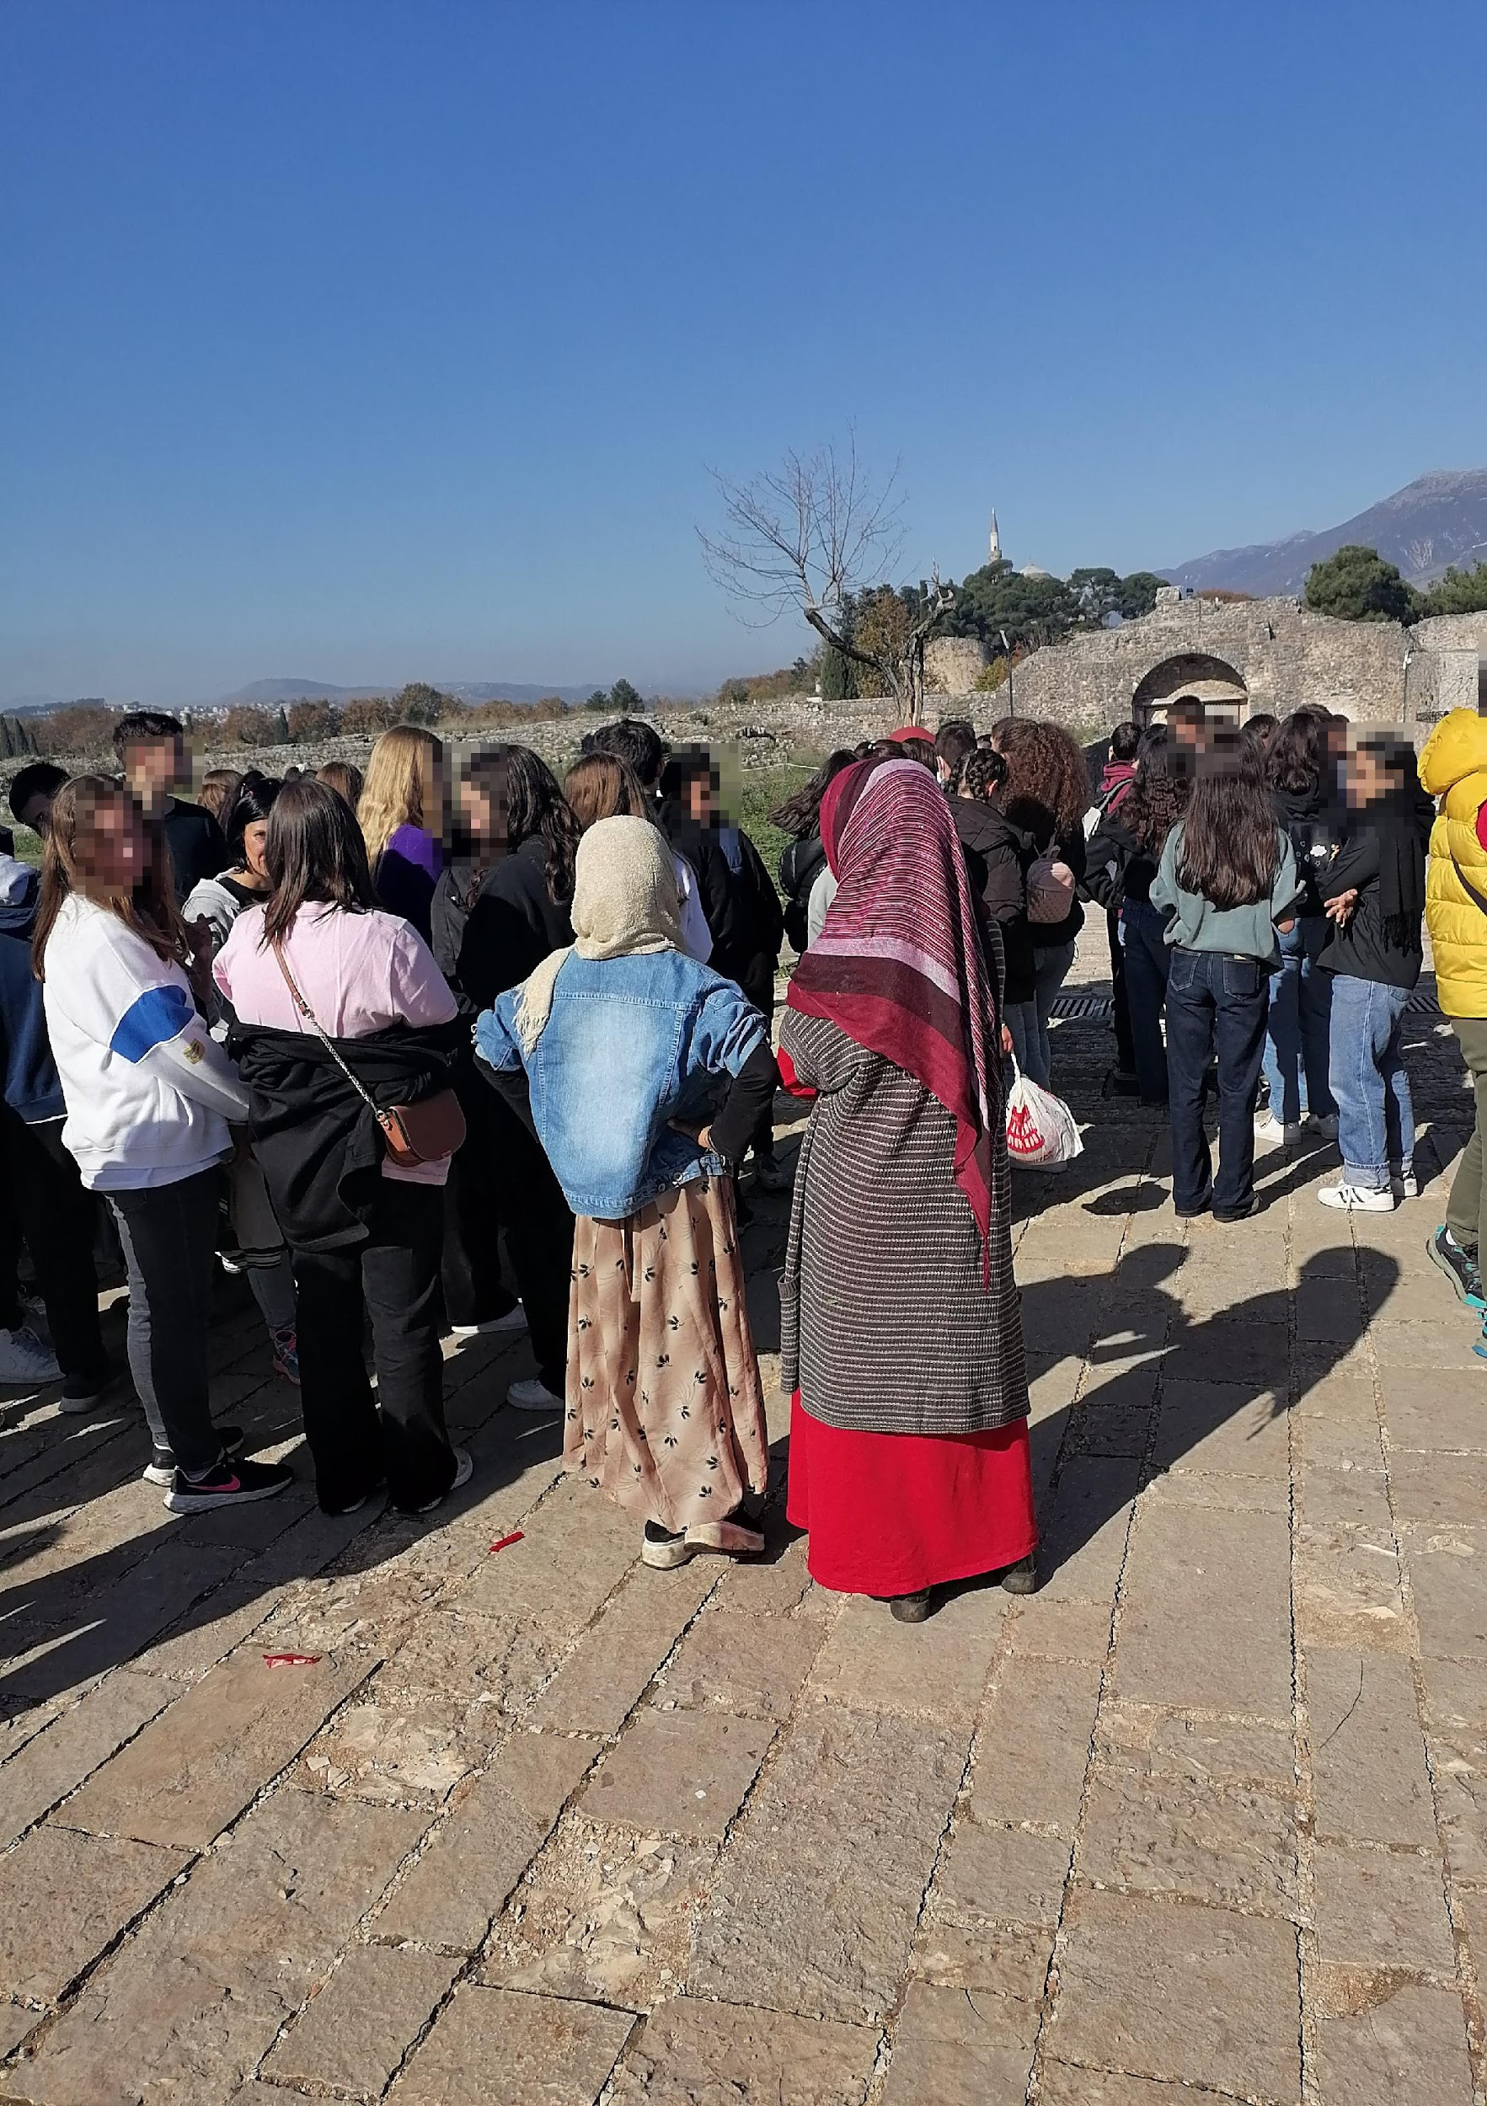
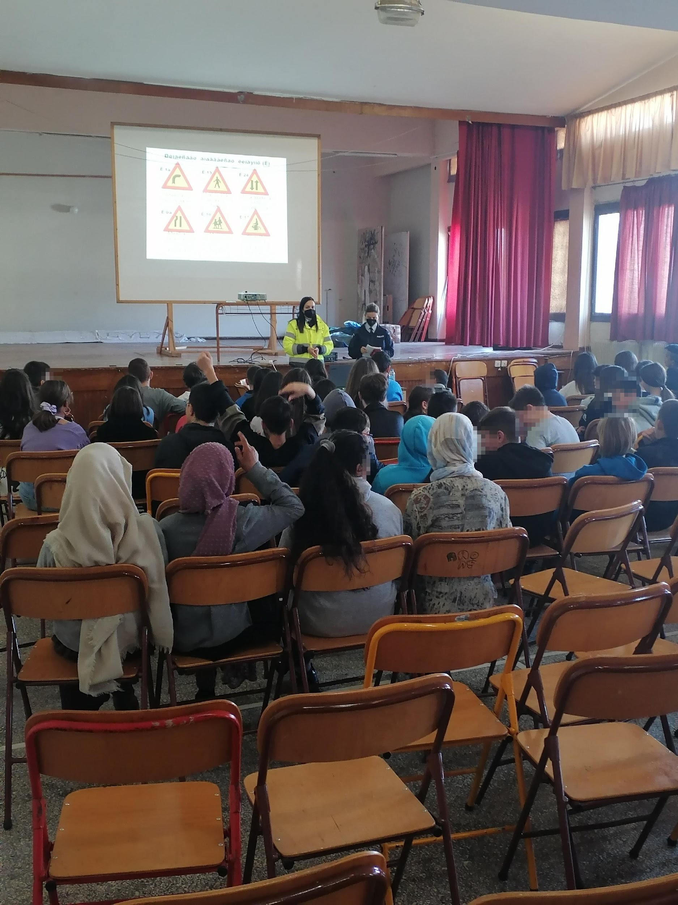
Good practice: Ioannina
Notes:
In multicultural schools, pupils with a migrant experience have a special two-year education programme (reception class). Children in this course of education study 15 hours of Greek in the first year in groups for foreigners, the remaining lessons (English, German, mathematics, computer science, physical education, home economics) they have with pupils of Greek origin. In the second year, there are fewer hours of Greek (7-8 per week), but children with migration experience have instead more lessons in regular classes, i.e. with Greek students.
During our study visit in Ioannina, we had the opportunity to attend a meeting with the parents. Accompanied by community interpreters (into Farsi and Arabic), they shared positive impressions with regard to cooperation with the school and the concerns of daily life on migration. Problems reported mainly concerned the provision of learning materials and getting to the institution. The Ministry of Education's regional coordinator for foreign children also attended the meeting. In her speech, she emphasised the importance of sending a child to school in their current place of residence, regardless of the country with which they associate their future. She stressed the importance of continuity of learning, of acquiring basic knowledge. Children attending school in Greece will receive school certificates and will be able to continue their education in another destination country.

Slide 24
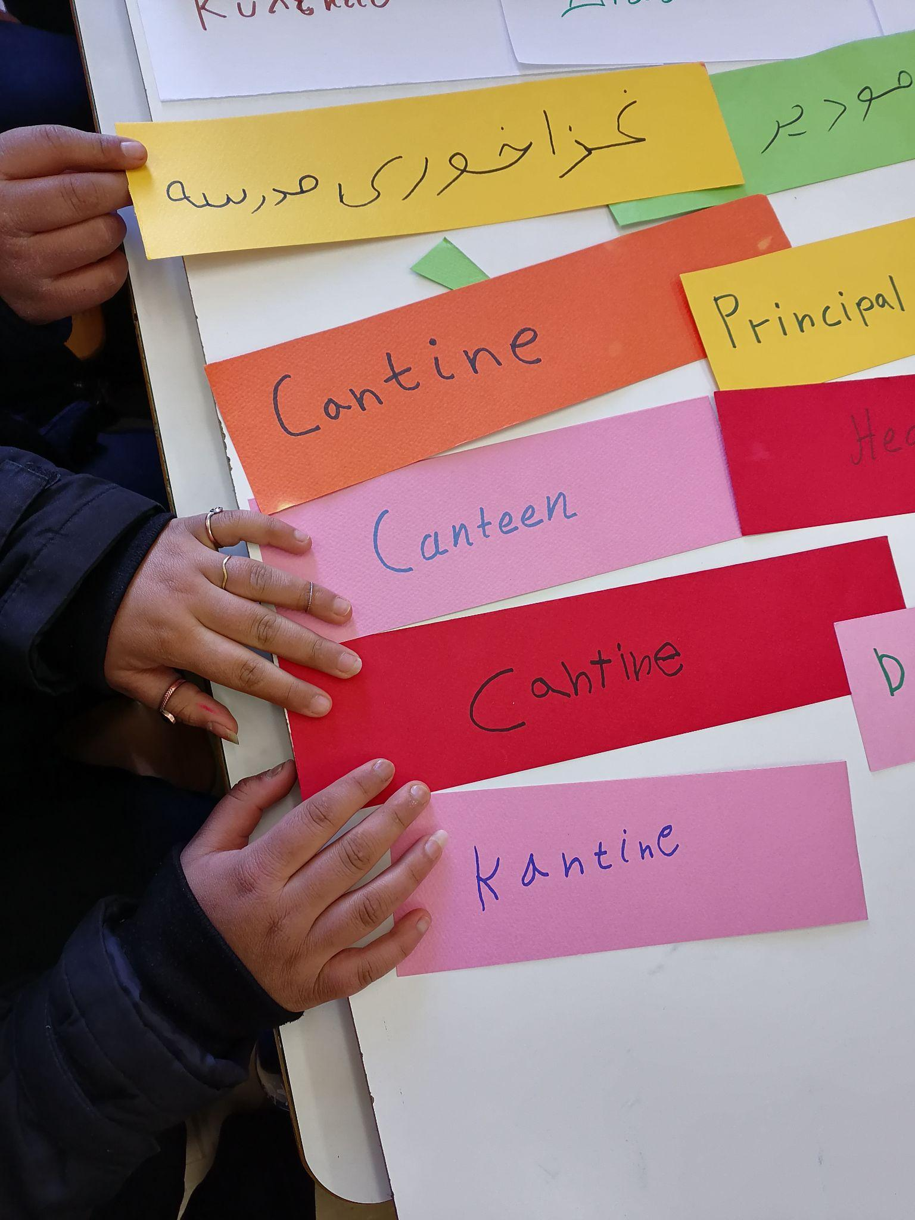
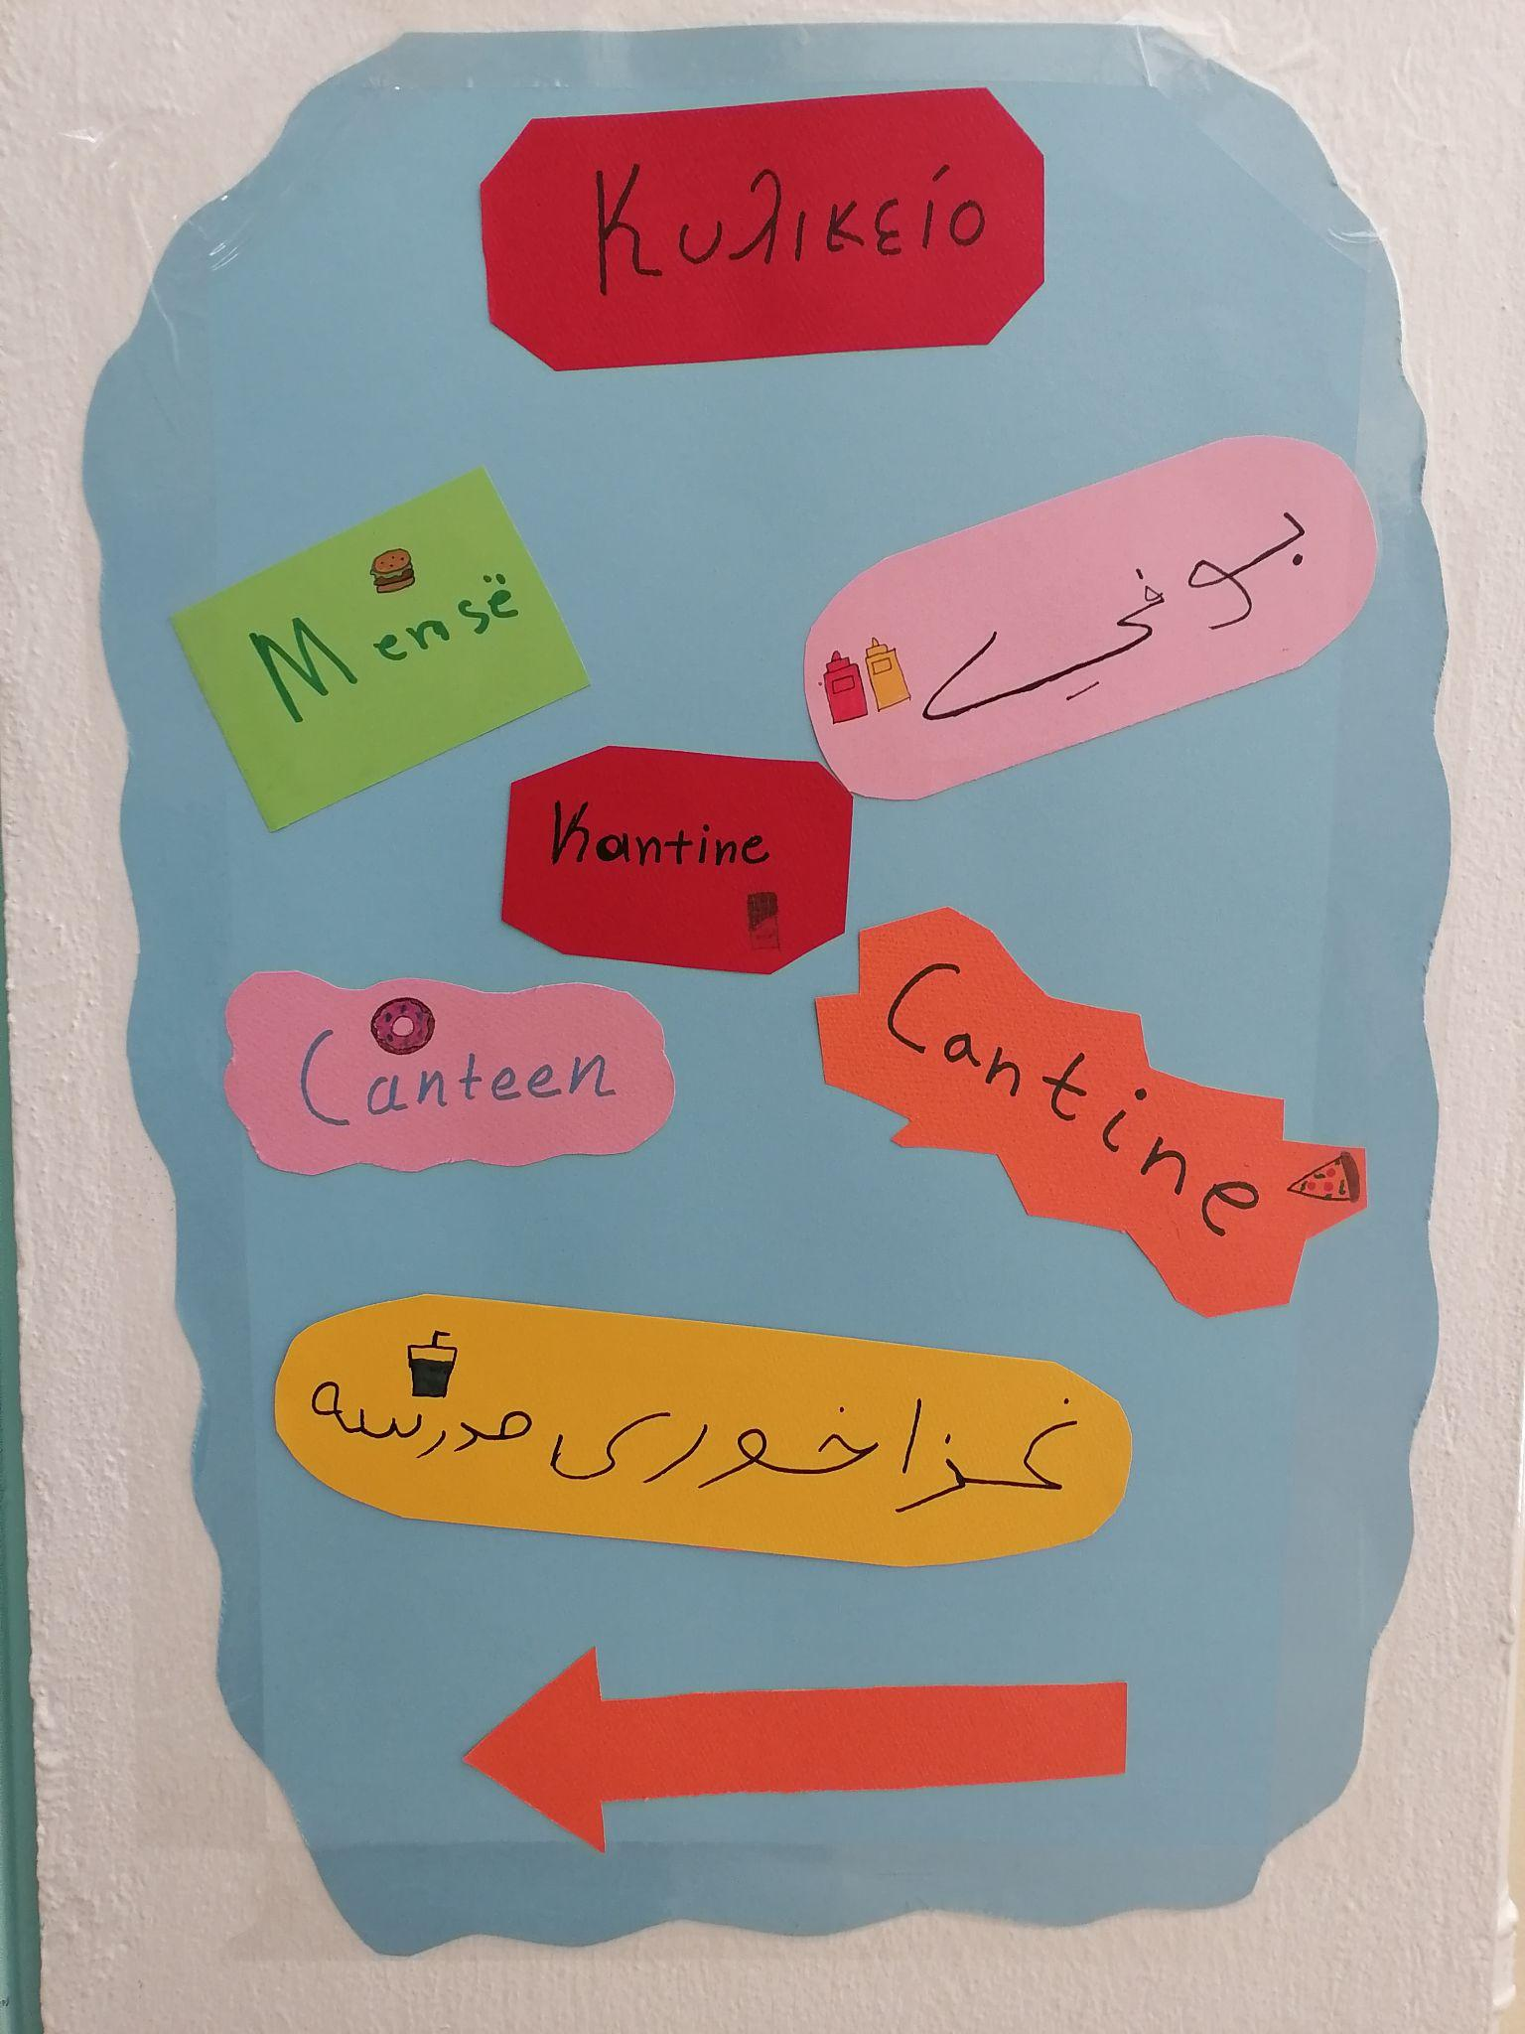
The school's students created multilingual and colourful signs. The languages are Greek, English, French, German, Arabic, Farsi and Albanian.

Slide 25
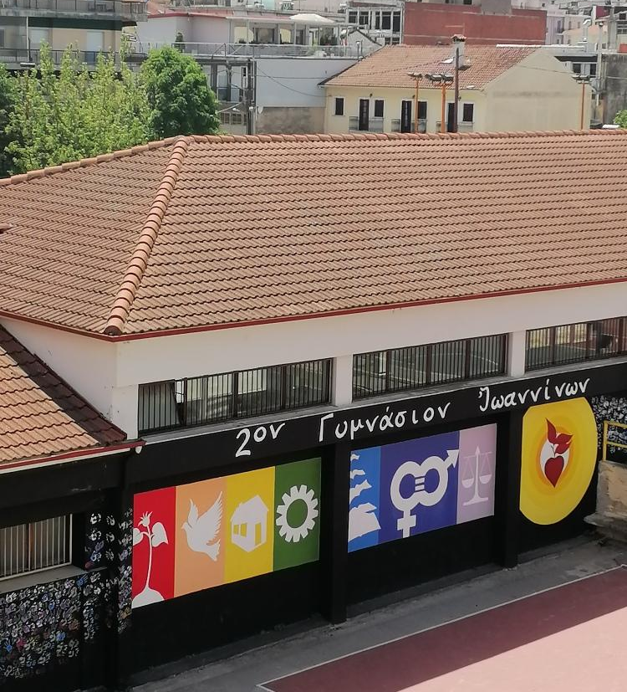
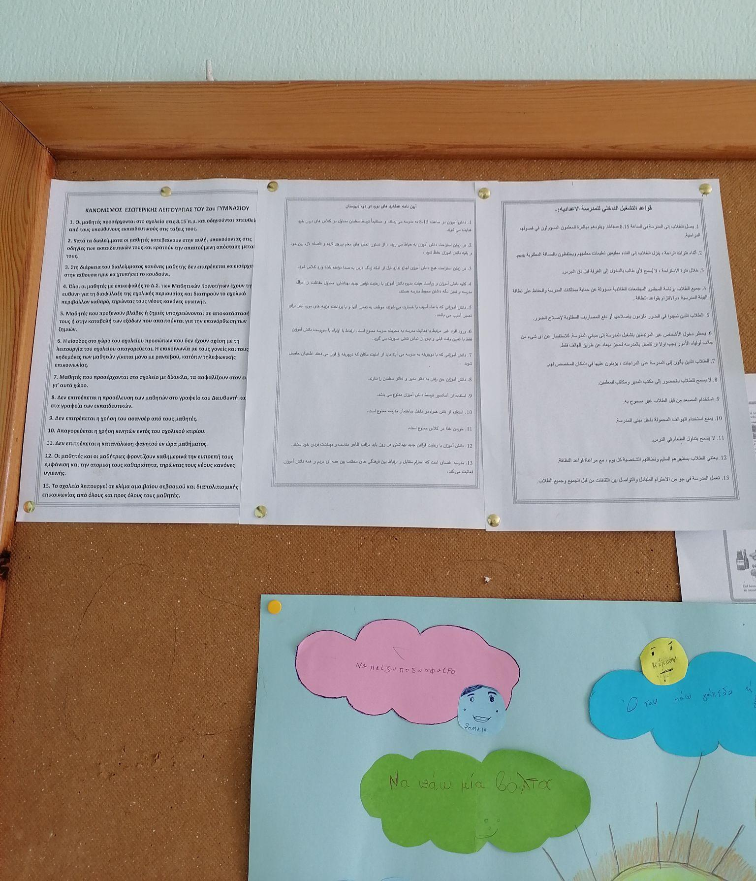
The classroom rules are available in Greek, Arabic and Farsi. An artwork with different symbols was created in the school yard.

Slide 26
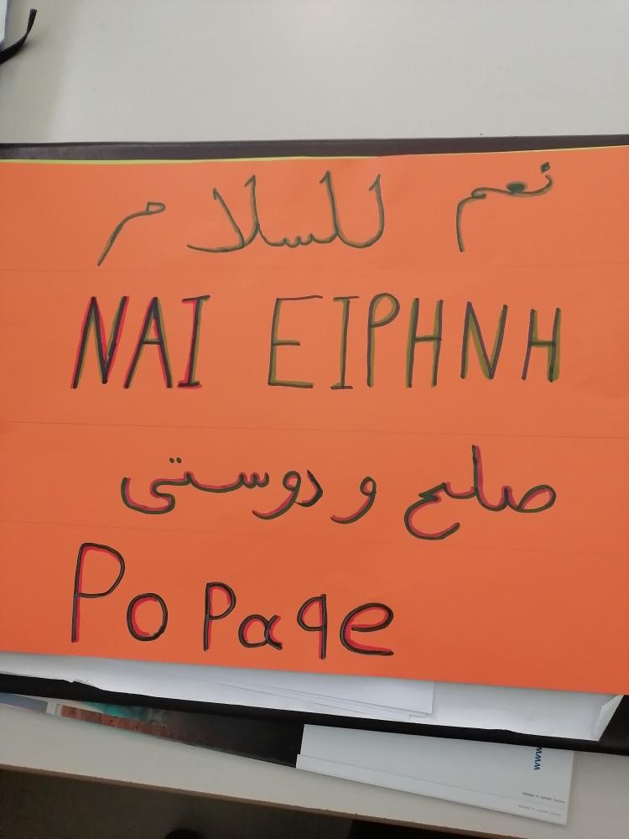
On the school website, there is a welcome packet available in 4 languages. In the activities and banners, all languages of the students are displayed.
07_W_01_P_NEW PACKAGE STUDENT AR-FA.pptx.pdf - Google Drive

Slide 27
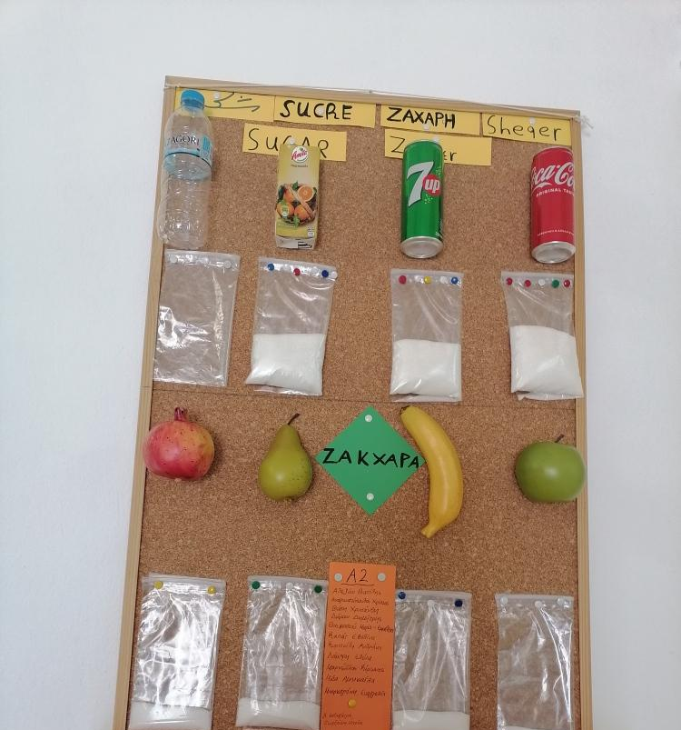
School schedule by curriculum and extra educational projects
2 different classes in Greek as a second language, depending on the level of language learning
Participation in extracurricular activities such as poetry, song writing or food, e.g. a Christmas party with a buffet by the parents

Slide 28
Selected examples of parents-school initiatives (Poznań, Poland)
Welcoming packets
Parent/teacher conferences
Family picnics
Ukrainian-speaking assistants in common-rooms
Psychological support for pupils and parents (7 days a week; online consultations possible)
A peer buddy for newly-arrived pupils
Informal playgroups organised by parents

Slide 29
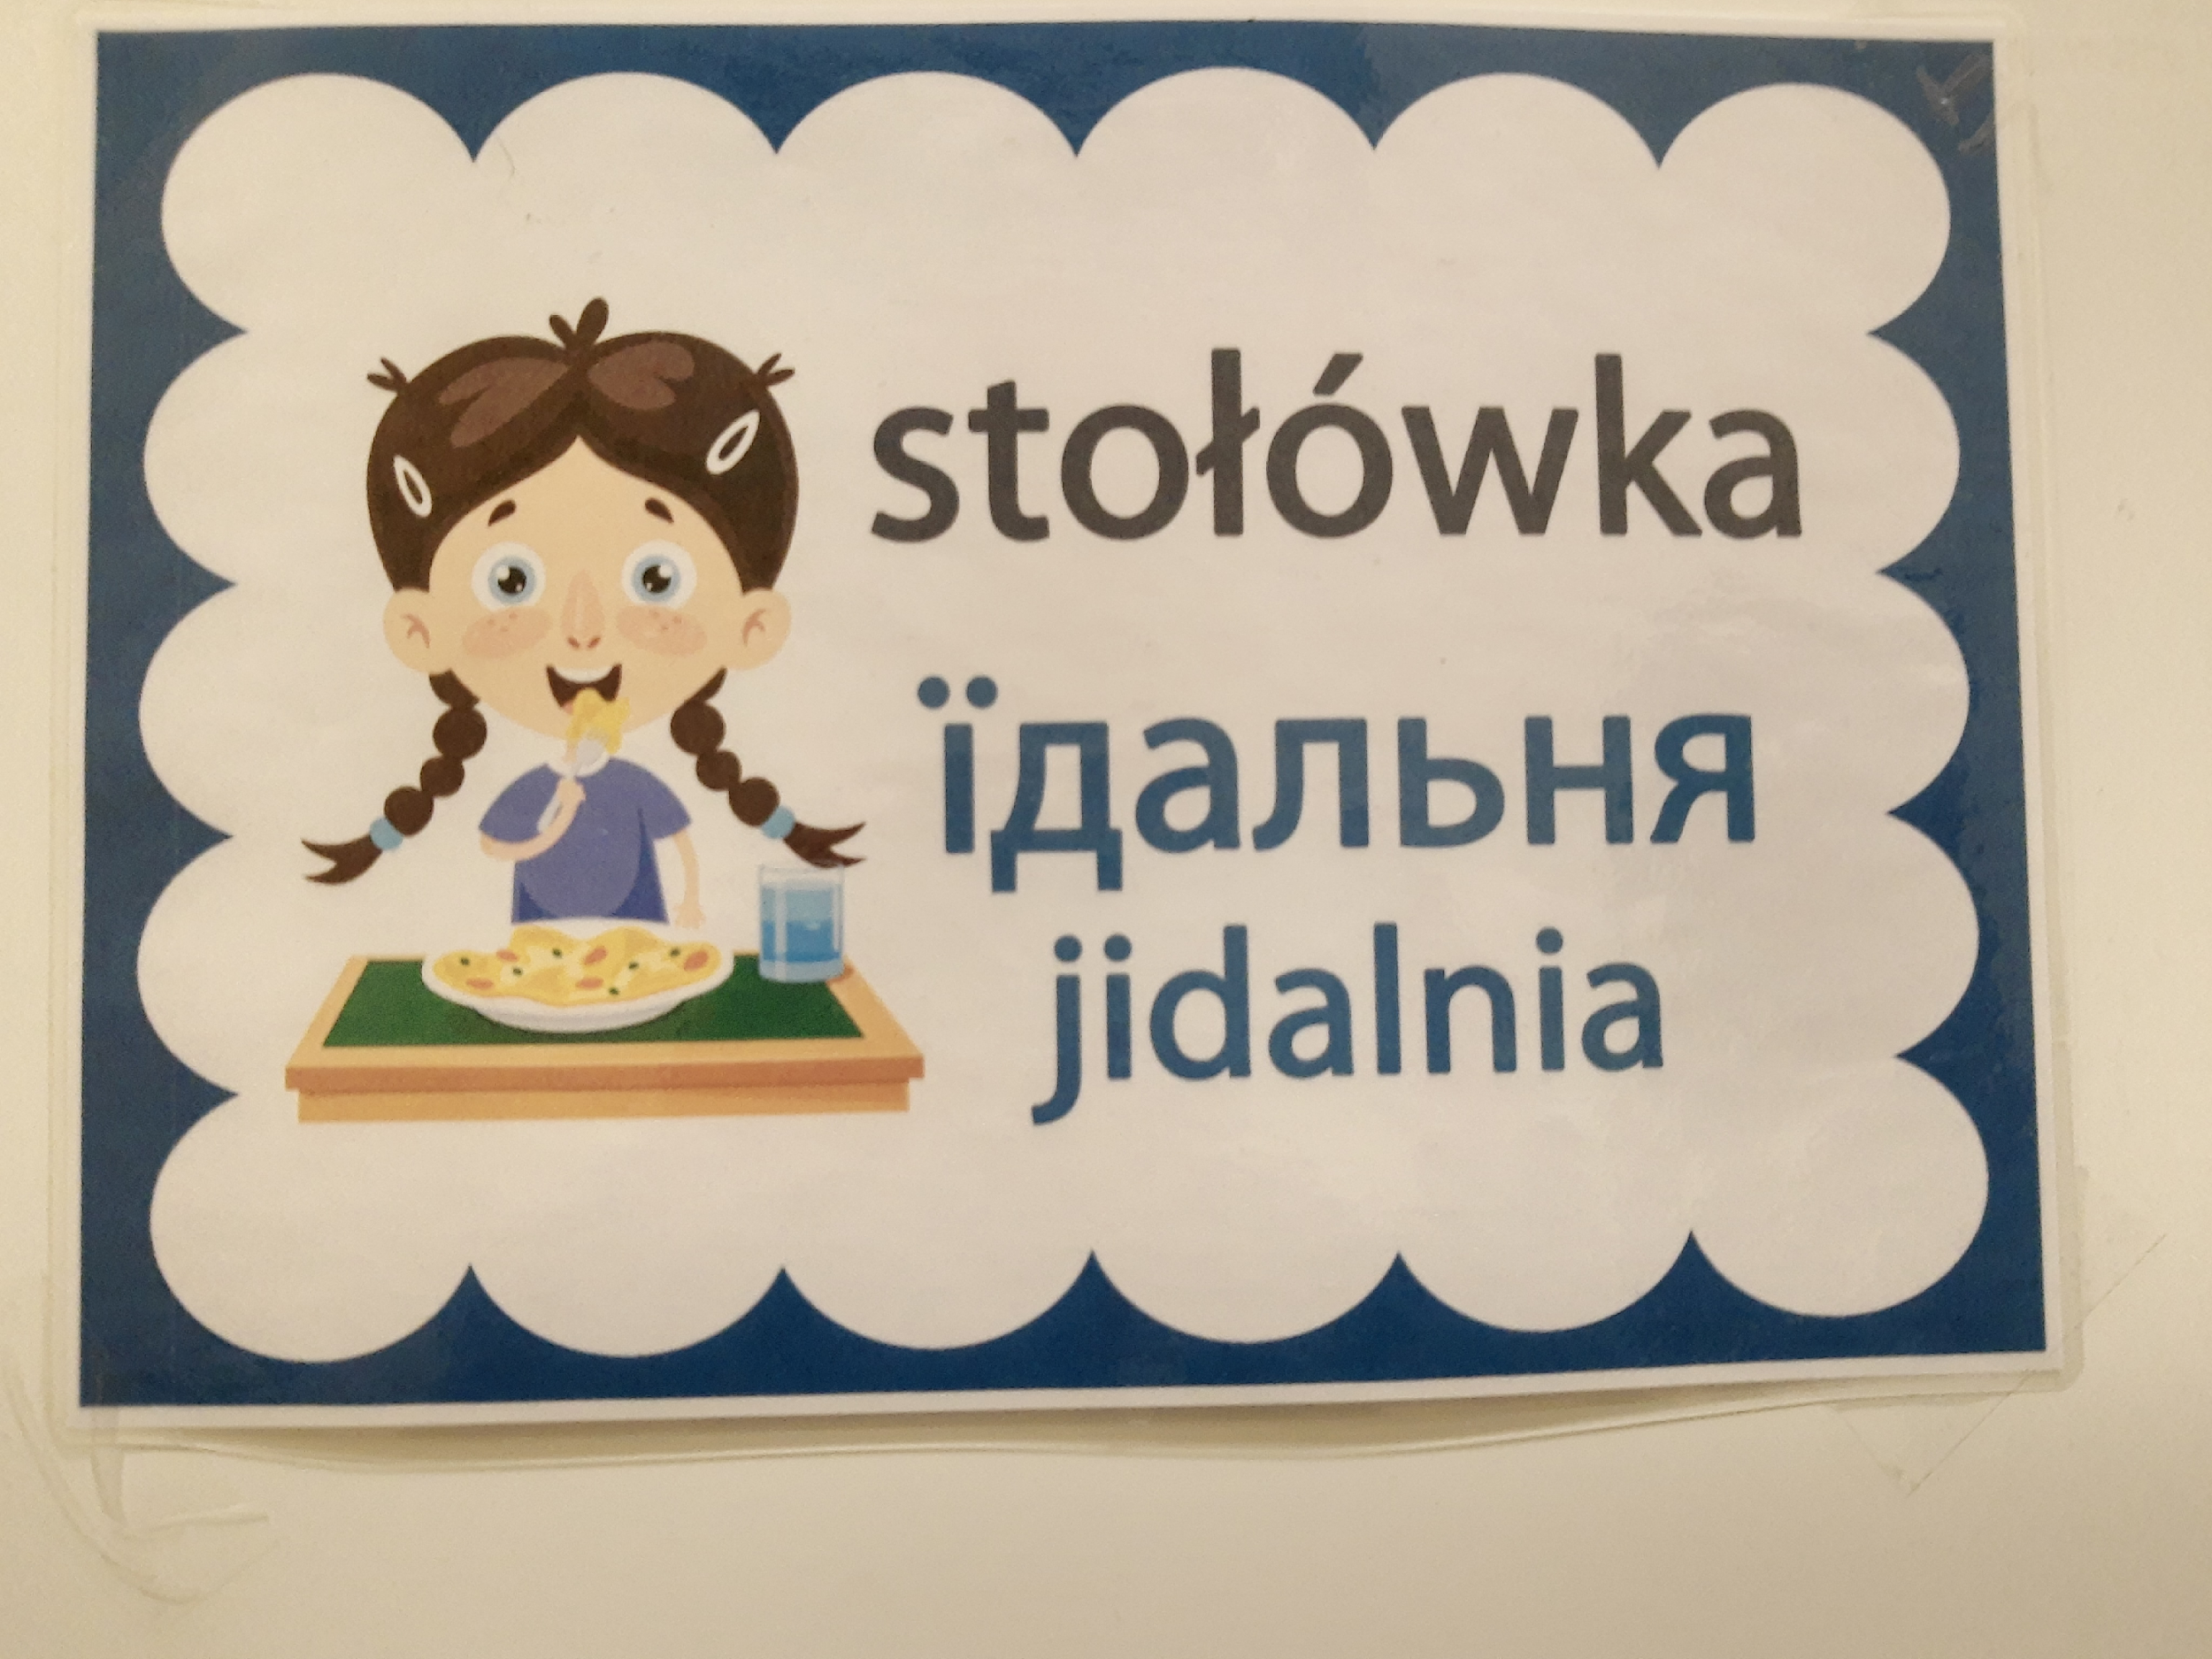
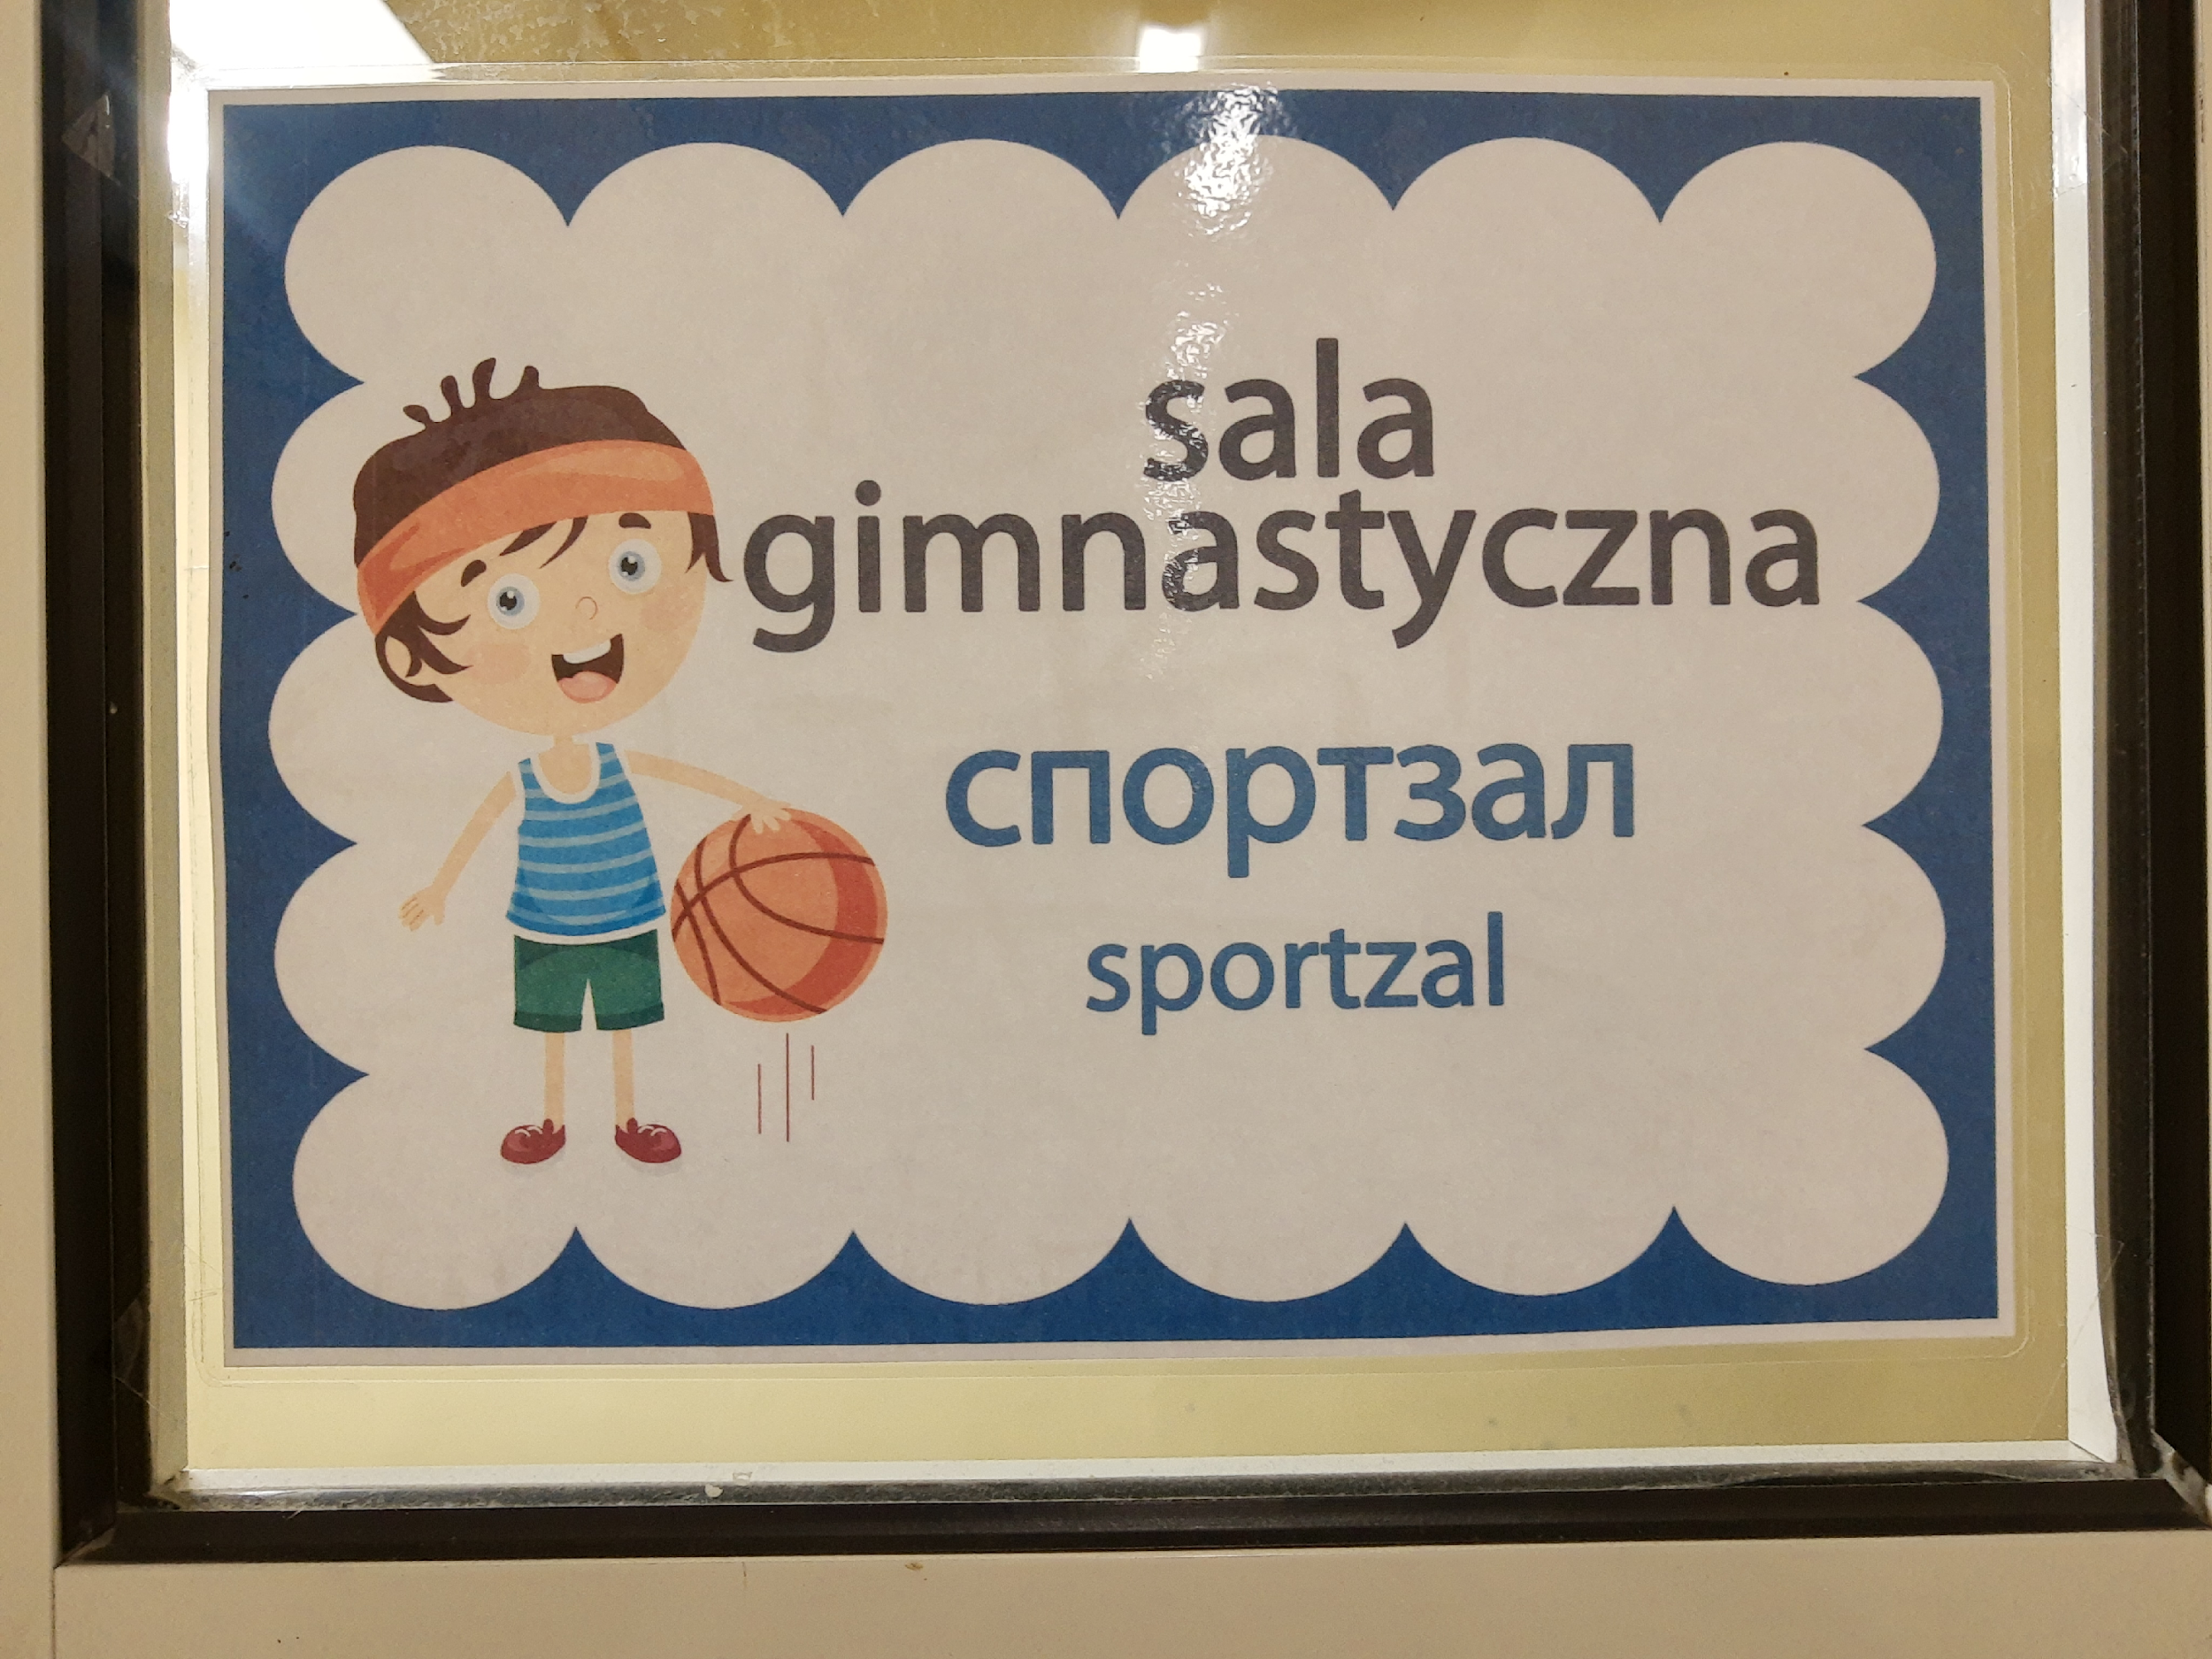
Primary school no 14 in Poznań (Poland)
Welcoming children from Ukraine at school: bilingual signs

Slide 30
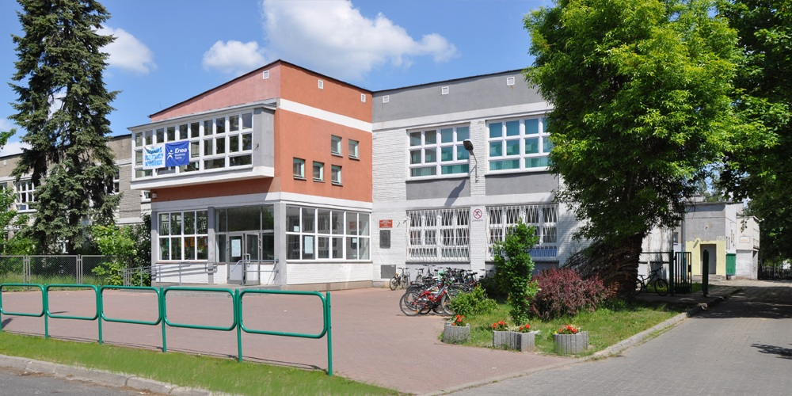
Parents-school cooperation in times of crisis: The case of primary school no 90 in Poznań
Context
Primary school no 90 in Poznań
24th February 2022- the outbreak of war in Ukraine
March 2022- the school accepts 50 Ukrainian refugee pupils
An unprecedented situation the school community has never experienced before
School’s website: http://www.sp90.poznan.pl/index.php

Slide 31
Pupils
School community
Teachers
Parents
School administration

Slide 32
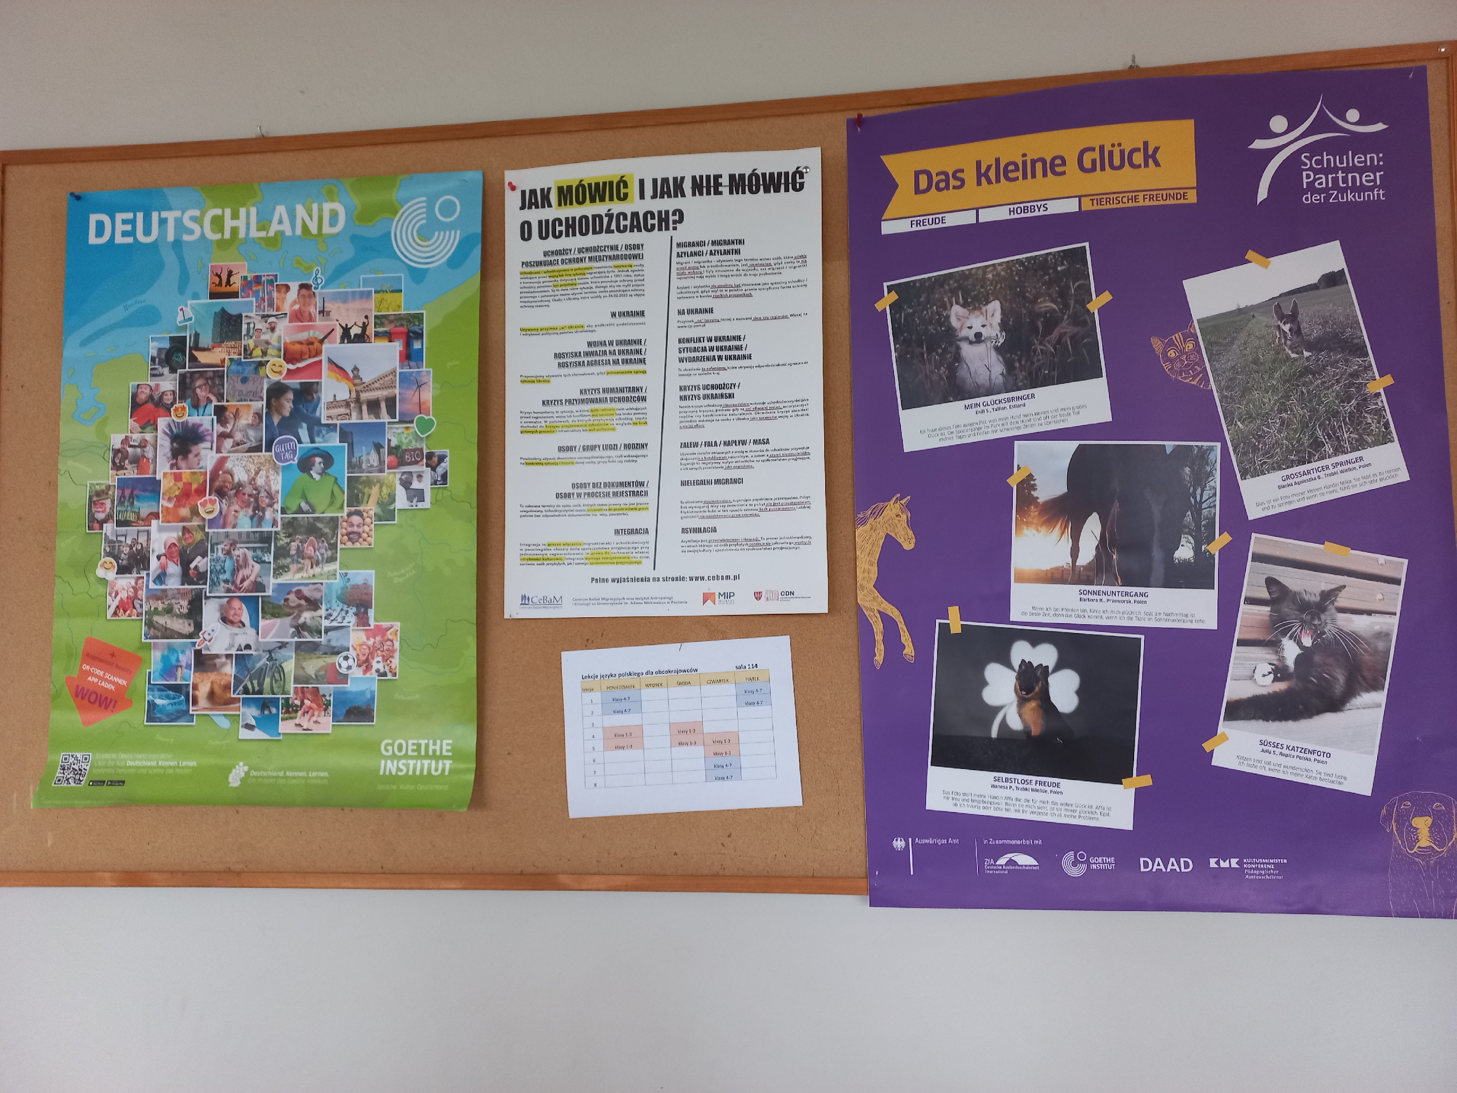
Creating a friendly school environment: Top-down initiatives
A poster (in the middle): How to talk and not to talk about refugees, distributed by Teacher Training Centres

Slide 33
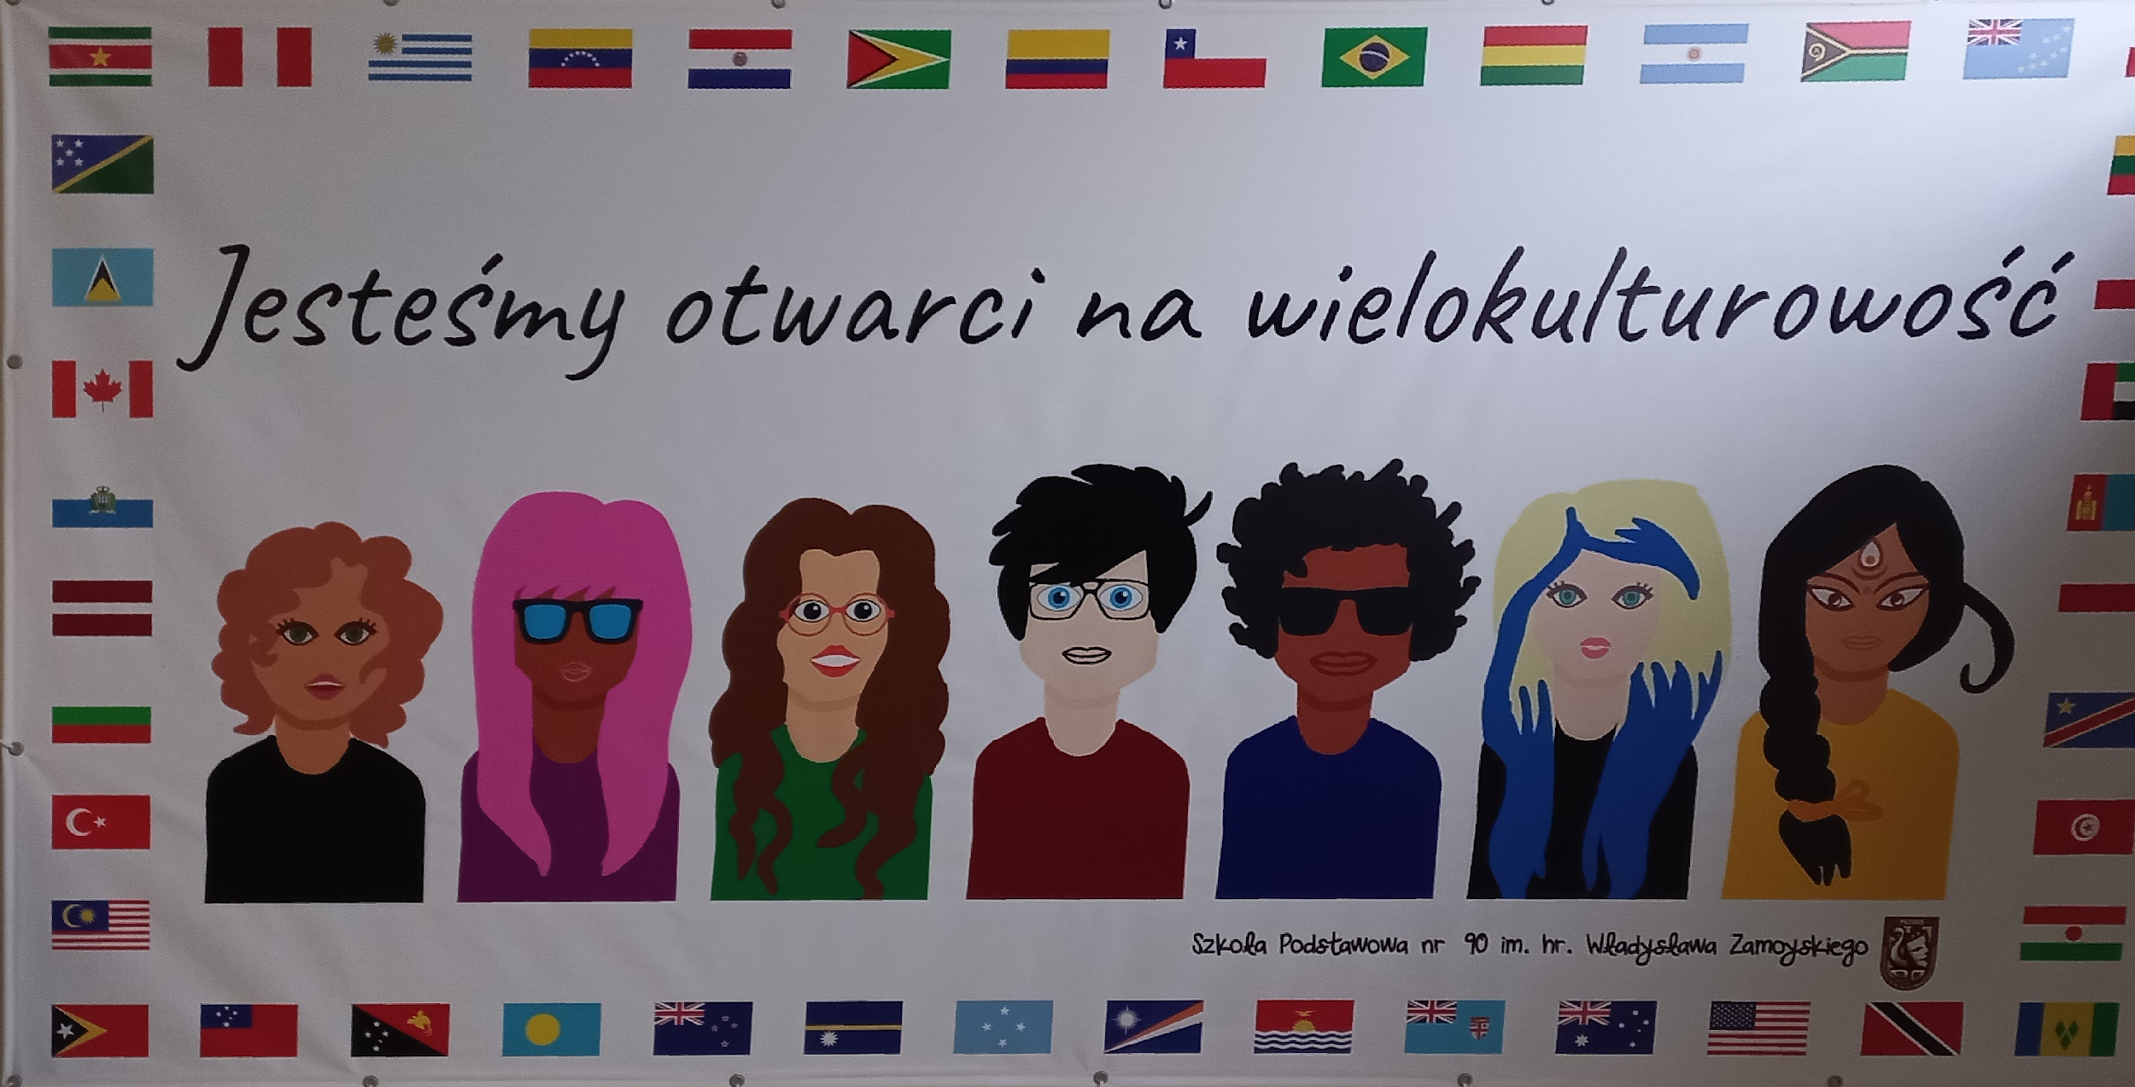
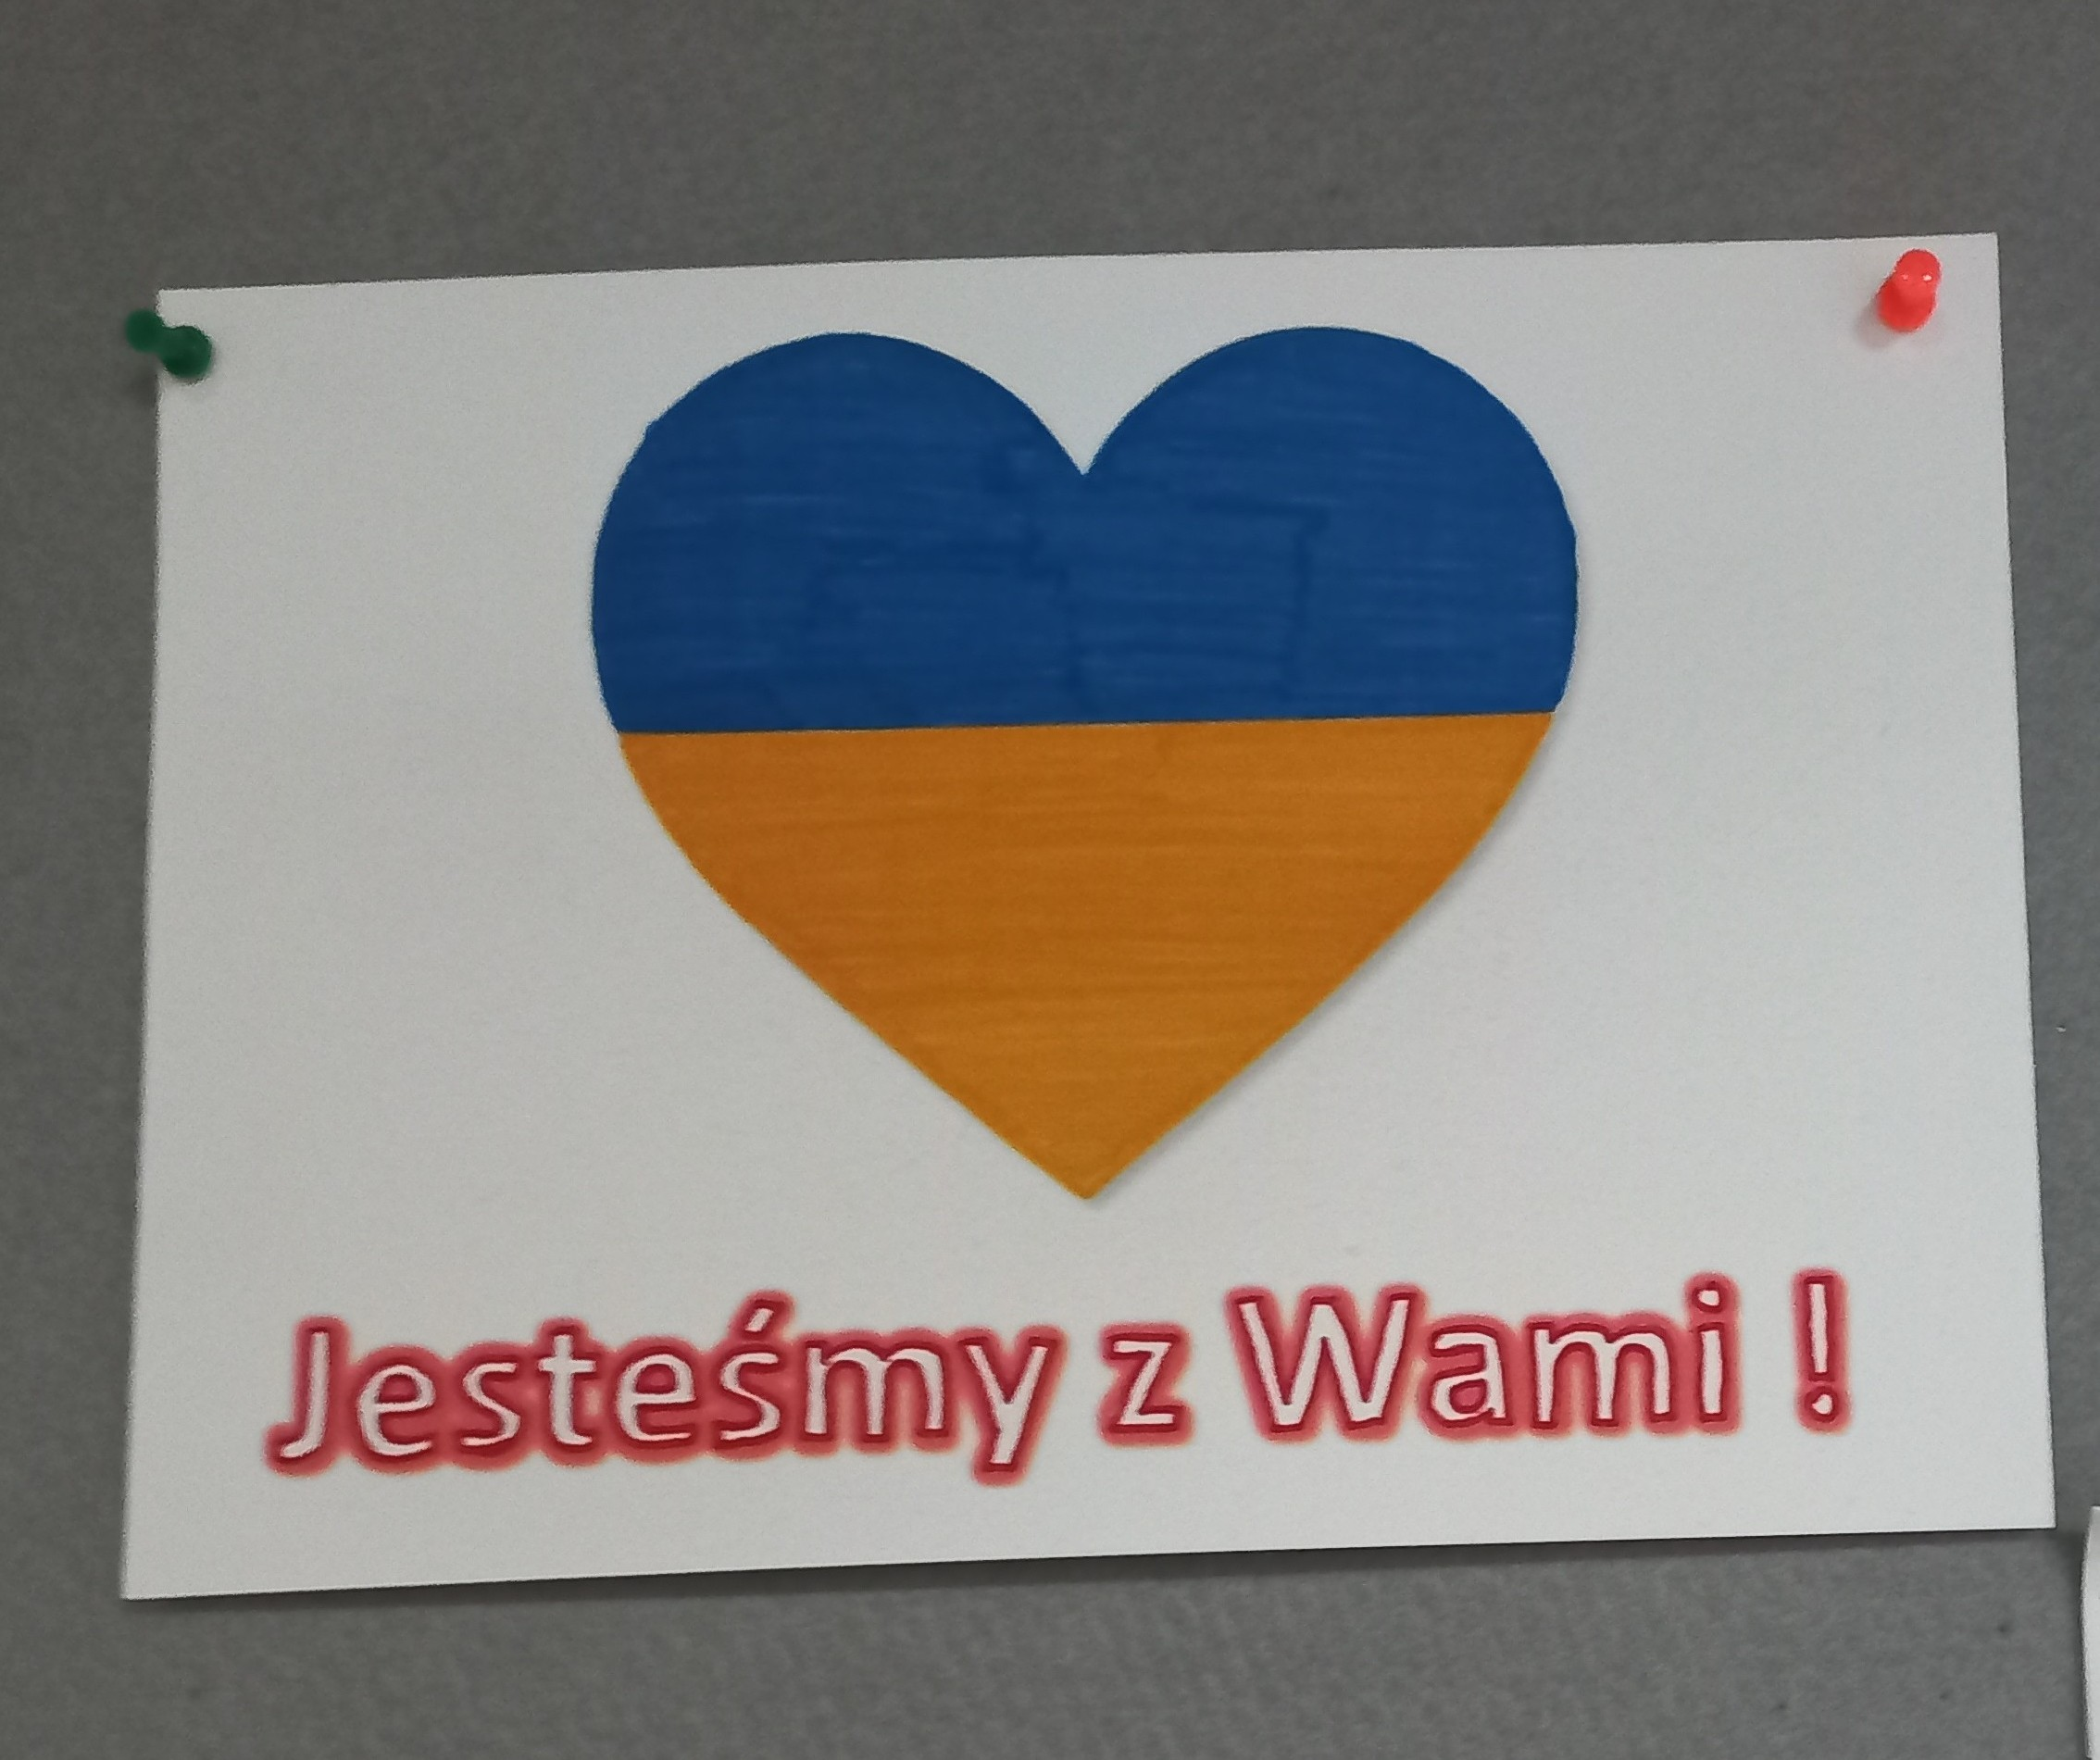
Creating a friendly school environment
We are open to multiculturalism
We are with you!

Slide 34
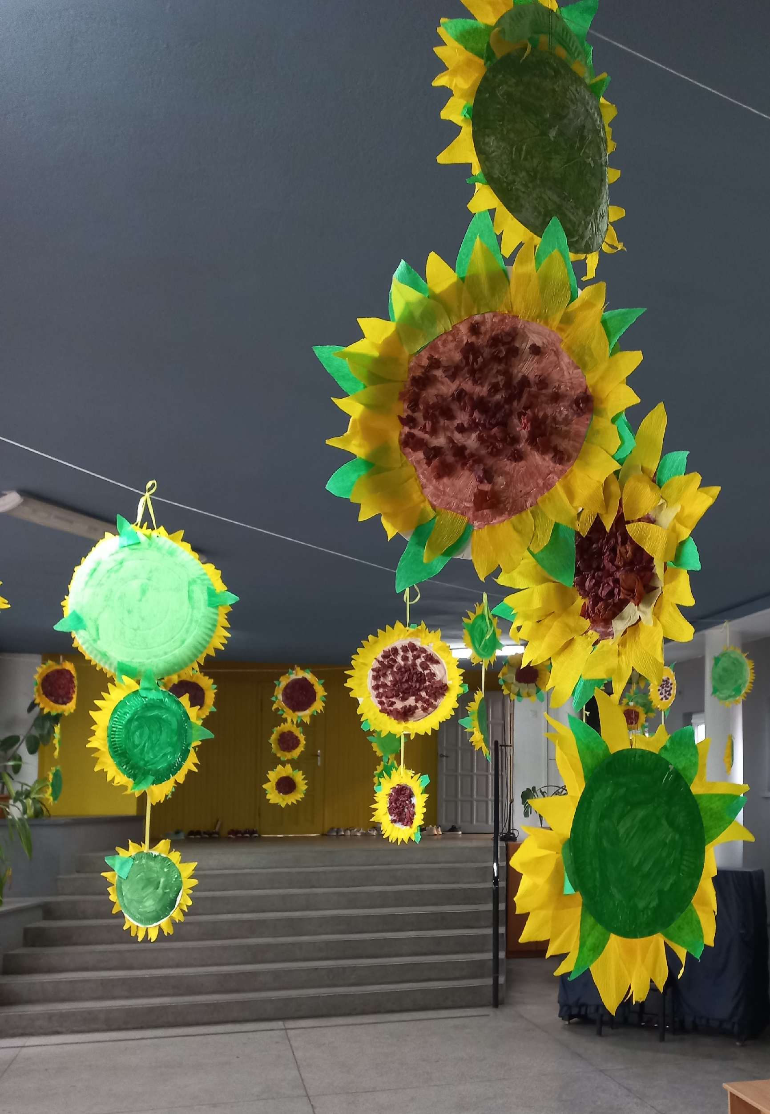
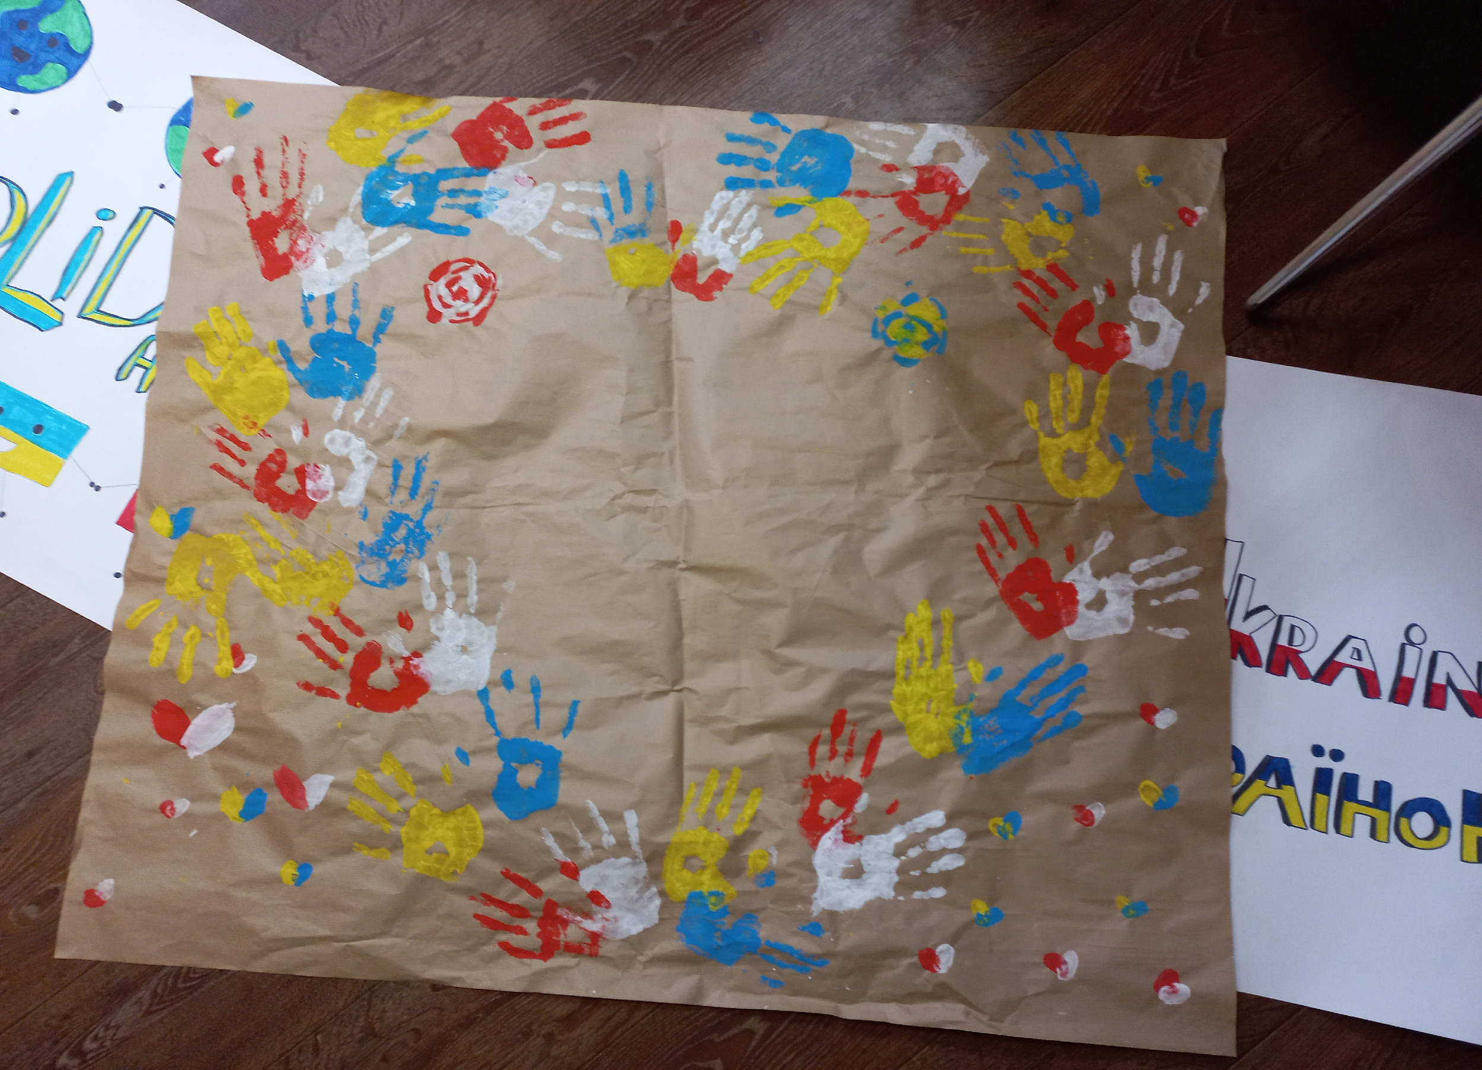
Making the newcomers visible and welcome
Bottom-up initiatives (welcoming posters and Polish language materials prepared by Polish pupils in cooperation with teachers)
Exposing Ukrainian pupils’ handcrafts (traditional decorations)

Slide 35
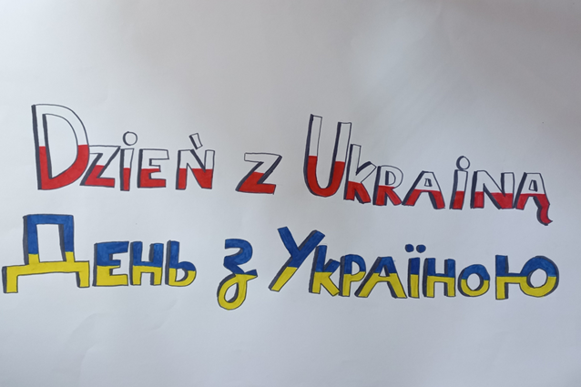
School administration and teachers’ initiatives
Polish language classes
Cultural assistants
Intercultural school workshops (4 neighbouring schools: informative meetings and workshops for Ukrainian parents and pupils
Special events: e.g. Talent show, Day of Solidarity with Ukraine

Slide 36
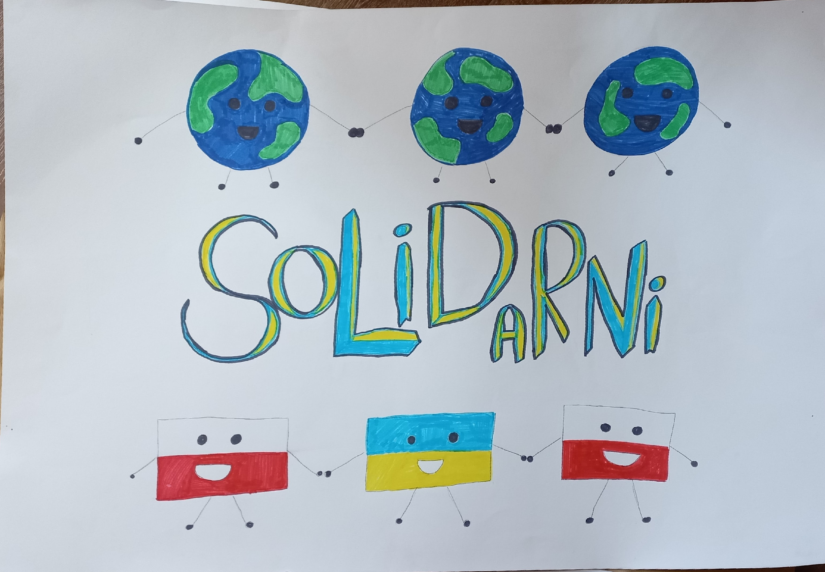
Parents’ initiatives
Community translators
Fundraising and financial support
Involvement in organising school community integrating events combined with fundraising to ensure all pupils’ participation in excursions: e.g. Sweet Fridays; Picnics

Slide 37
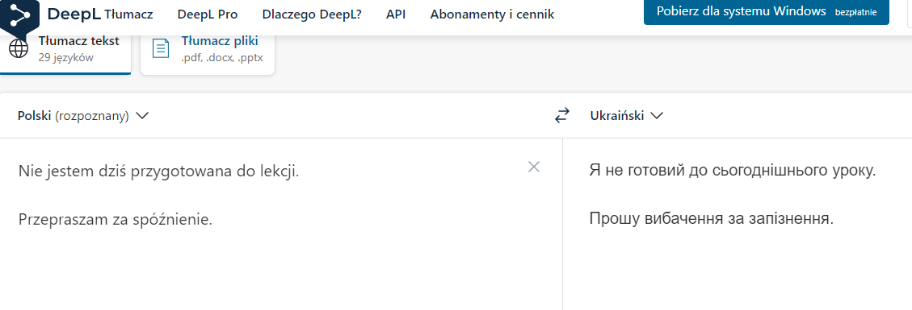
Pupils and teachers’ initiatives
Language support
Other support
Using translators
Adapting teaching materials (simplified bilingual worksheets)
Preparing:
bilingual signs
picture dictionaries
cards to communicate with teachers (most common expressions)
Peer buddies
Informal out-of schools meetings
Relationship building

Slide 38
Good practice: Scoil Brídhe, Blanchardstown (Ireland)
320 pupils from 4.5+ to 12.5+years
Most had little English or no English when they started school
80%from immigrant families
51 home languages, most of them unknown to teachers
51 home languages, most of them unknown to teachers:
Afrikaans, Amharic, Arabic, Bangla Benin, Bosnian, Cantonese, Cebuano, Dari, Estonian, Farsi, Foula, French, German, Hebrew, Hindi, Hungarian, Igbo, Ilonggo, Isoko, Itsekiri, Italian, Kannada, Kinyarwanda, Konkani, Kurdish, Latvian, Lingala, Lithuanian, Malay, Malayalam, Mandarin, Marathi, Moldovan, Polish, Portuguese, Romanian, Russian, Shona, Slovakian, Spanish, Swahili, Tagalog, Tami, Ukrainian, Urdu, Vietnamese, Visayan, Xosa, Yoruba
Source: Little, D. (2021). Mamlise seminar/ infoday, March 24, 2021; Little & Kirwan (2018, 2019)
Notes:
Photo by Allec Gomes on Unsplash

Slide 39
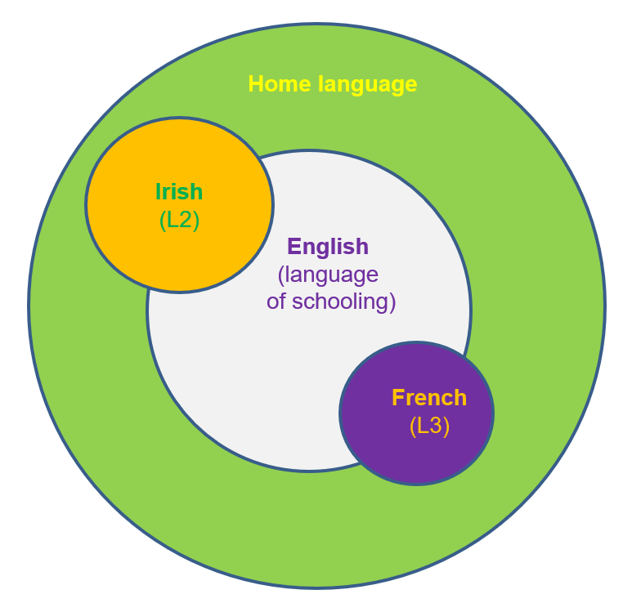
Elements to Scoil Bhríde’s success story
integration of home languages into the mainstream classroom
regular meetings of teachers and other regular staff members
teacher education
teachers’ initiative and responsibility
collaboration with parents
Irish and later French: “common L2 glue” (Little & Kirwan 2019: 165)
Source: Based on Little (2021), MaMLiSE seminar/ infoday, March 24, 2021

Slide 40
Developing literacy in the home languages by all minority students at Scoil Bhríde
Including home languages in the writing activities
Creating and fostering an impulse to write in all languages in pupils’ repertoires
Encouraging pupils to write “stories, diaries, autobiographical texts, poems, etc with gradually increasing linguistic and structural complexity”. (Little & Kirwan, 2019: 89)
Notes:
Sample activities in particular age groups:
Senior infants: writing about themselves, their preferences, often in combination with drawings or labels in their home languages
First class (6+ years old): writing stories
Second class (7+ years old): a more disciplined approach to written composing in English writing stories
Third class (8+ years old): writing in three languages (English, Irish and a home language)
Fourth class (9+ years old): developing vocabulary and producing longer texts in 3 languages unaided
Fifth class (10+ years old): French added - producing texts in 4 languages
Sixth class (11+ years old): full integration of French in classroom discourse, translanguaging, well-developed habit of comparing languages; producing a coherent multilingual text (Little & Kirwan, 2019: 87-125)
Photo by Aaron Burden on Unsplash

Slide 41
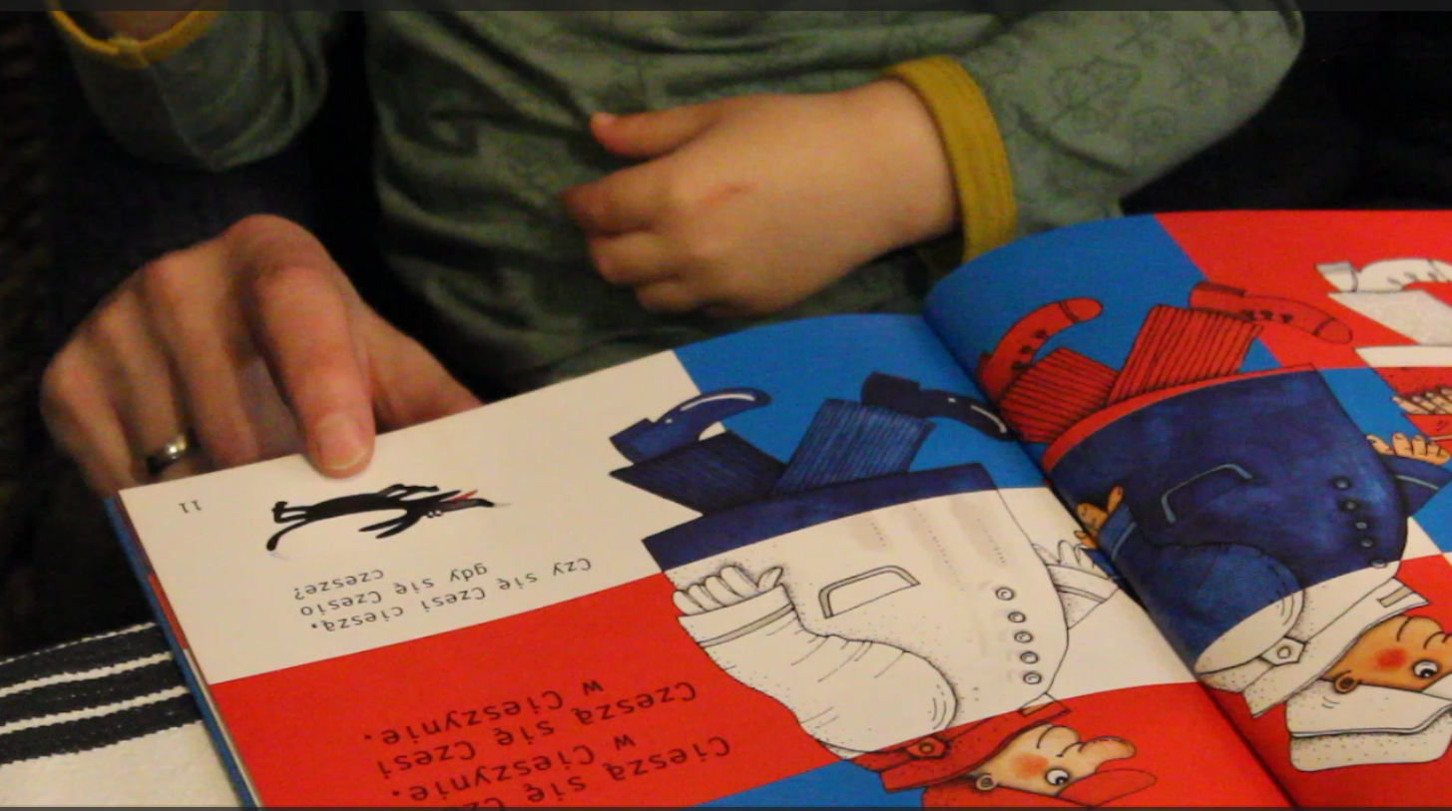
Developing literacy in the home languages by parents
Reading a book together and commenting on the story
Literacy activities
See sample videos:
Reading with mum (in Polish) https://youtu.be/BkuxEJwnJAU
Reading with dad (in Dutch) https://youtu.be/GiNjyI1aaVE
Research shows that literary activities such as looking at picture books together and reading or telling stories are valuable in language acquisition.
Asking questions about the story or the child’s perspective on it fosters the child’s language development and literacy skills.

Slide 42
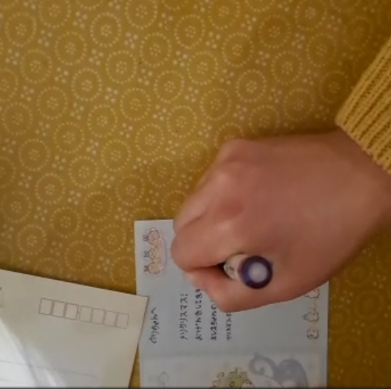
Developing literacy in the home languages by parents
Writing a postcard together in a home language
Developing writing skills in home languages
Sample activities:
Corresponding with relatives in home languages, e.g. writing postcards, letters, text messages, etc.
Keeping a diary
Writing social media posts, comments, etc.
See sample videos:
Wrtign a postcard with mum (in Japanese) https://youtu.be/iGt7TN2NKfw
Writing a postcard with dad (in Polish) https://youtu.be/iaH6APGEkhg

Slide 43
Multilingual Schools
Did you learn something new? Please add them to the linguistic map of your/your children’s school.

Slide 44
Family-School Partnership

Slide 45
Family-School Partnership
Parents as support for the school system:
Monodirectional communication school -> family
Parents support home learning activities (homework etc.);
School provides information for parents.
Mutual support:
Bidirectional communication;
Parents support learning and the school supports the parents, e.g. in the preservation of the home language;
Collaborative decision-making.
(Coady 2019; Epstein et al. 2001)

Slide 46
Making Plans
Building partnerships between schools and families from a migrant background not only addresses multilingualism but all aspects of education and the children’s development.
Can you think of a small project that can contribute to building family-school partnerships?
This could focus on multilingualism, family-school communication, the integration of resources in the community, etc. Please describe the project, its benefits for both sides and the steps that would be necessary to implement your idea at a school.

Slide 47
References
Coady, M. (2019). Connecting school and the multilingual home. Theory and practice for rural educators. Bristol et al.: Multilingual Matters.
Epstein, J. / Sanders, M. / Sheldon, S. / Simon, B. / Salinas, K. / Jansorn, N. / VanVoorhis, F. / Martin, C. / Thomas, B. / Greenfield, M. /Hutchins, D. / Williams, K. (2001). School family and community partnership. Your handbook for action (3rd edition). New York: Corwin.
Herdina, P. / Jessner, U. (2002). A dynamic model of multilingualism: Perspectives of change in psycholinguistics. Clevedon: Multilingual Matters.
Grosjean, F. (1989). Neurolinguists, beware! The bilingual is not two monolinguals in one person. Brain and Language, 26, 3–15.
Kopeliovich, S. (2013). Happylingual: A family project for enhancing and balancing multilingual development. M. Schwartz / A. Verschik, A. (eds.). Successful family language policy (pp. 249–276). New York / London: Springer.
Little, D., & Kirwan, D. (2018). From plurilingual repertoires to language awareness: Developing primary pupils’ proficiency in the language of schooling. C. Hélot, C. Frijns, S. Sierens, & K. Gorp (Eds.), Language awareness in multilingual classrooms in Europe: From theory to practice (pp. 169–205). Berlin: De Gruyter Mouton.
Little, D., & Kirwan, D. (2019). Engaging with linguistic diversity: A study of educational inclusion in an Irish primary school. London: Bloomsbury Academic.
Otheguy, R. / García, O. / Reid, W. (2015). Clarifying translanguaging and deconstructing named languages: A perspective from linguistics. Applied Linguistics Review, 6(3), 281–307.
Smith-Christmas, C. (2016). Family language policy. Maintaining an endangered language in the home. Basingstoke: Palgrave Macmillan.

