Slide 1
Second Language Acquisition and Multilingualism for Teachers and Trainers
Workshop 1
IO2 © 2023 by MaMLiSE is licensed under CC BY-NC-ND 4.0

Slide 2
The MaMLiSE project
Majority and Minority Languages in School Environment
an international project funded by Erasmus+ Programme under Action 2 – Strategic Partnerships, School Education;
running from 01.11.2020 to 31.07.2023;
main aim: supporting school teachers in delivering effective instruction in linguistically diverse classes. Although multilingualism has been present in EU schools for years, the range of in-service training courses and support materials on offer is still insufficient;
The project consortium has been able to prepare a book and materials on how to effectively support teachers and educational staff to teach successfully in linguistically diverse classes and to develop a whole-school inclusion policy, based on the premise that both newcomers and multilingual pupils who have lived in the country for a long time and were born there should be included.

Slide 3
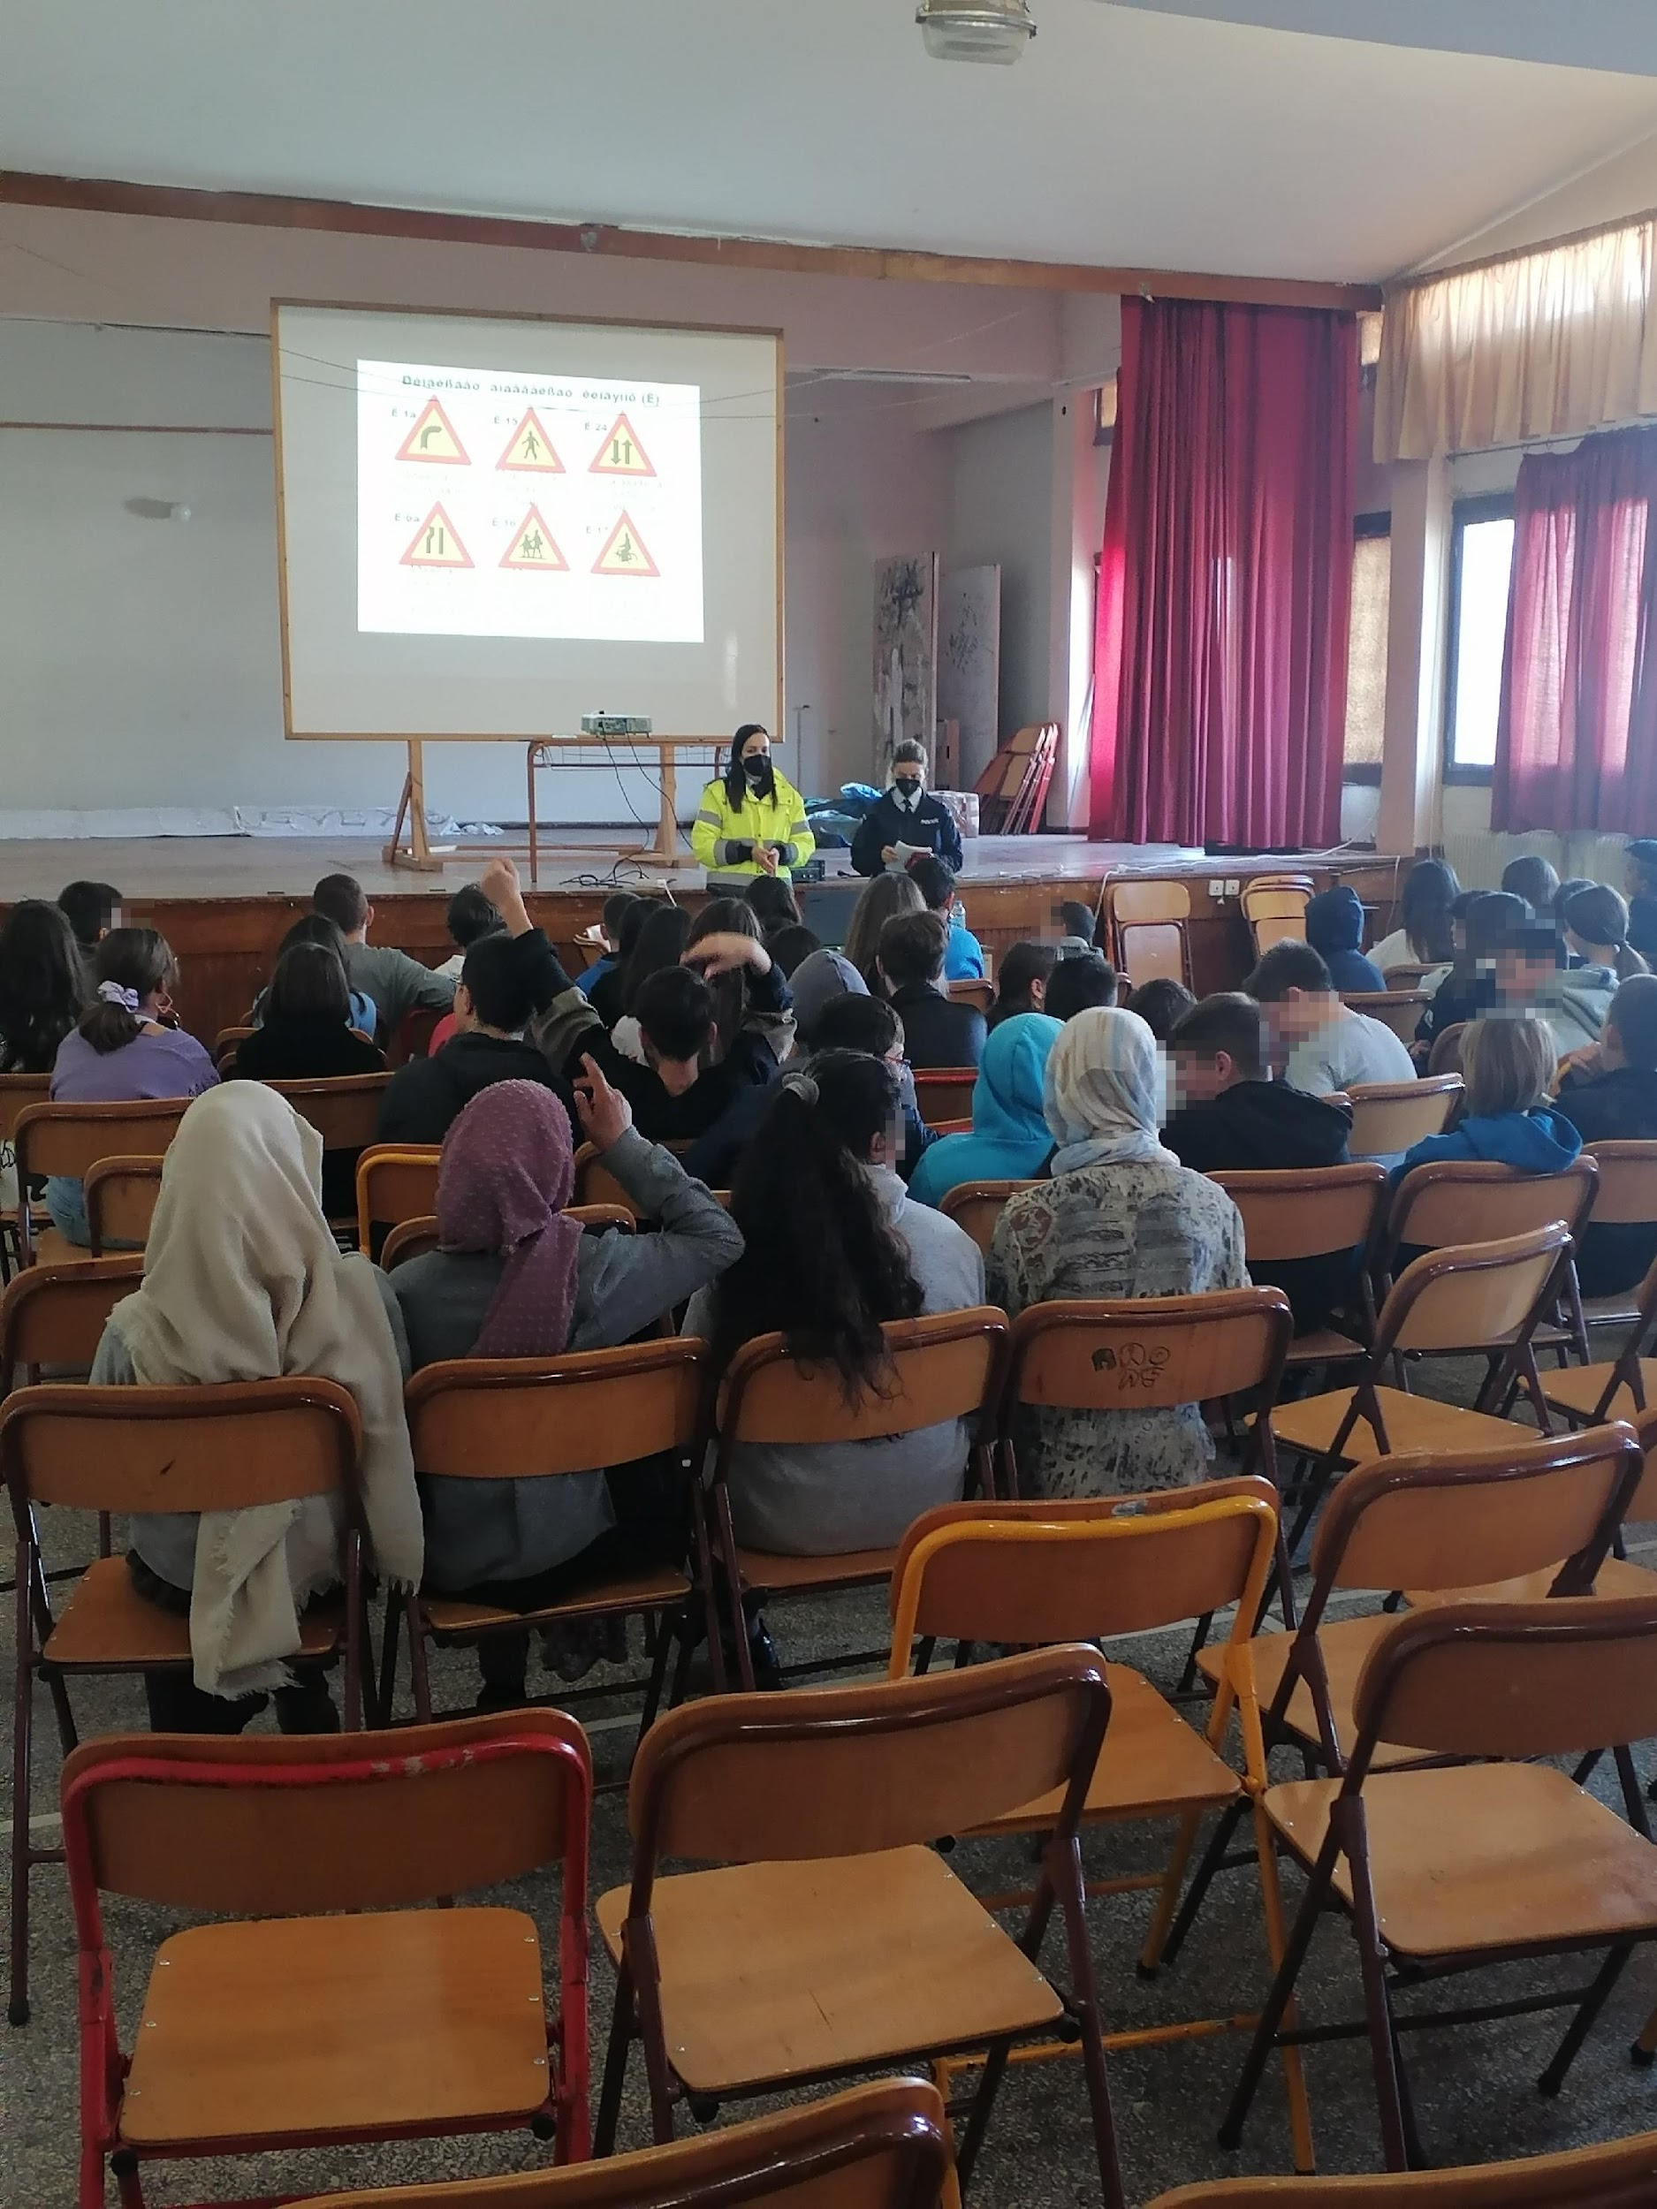
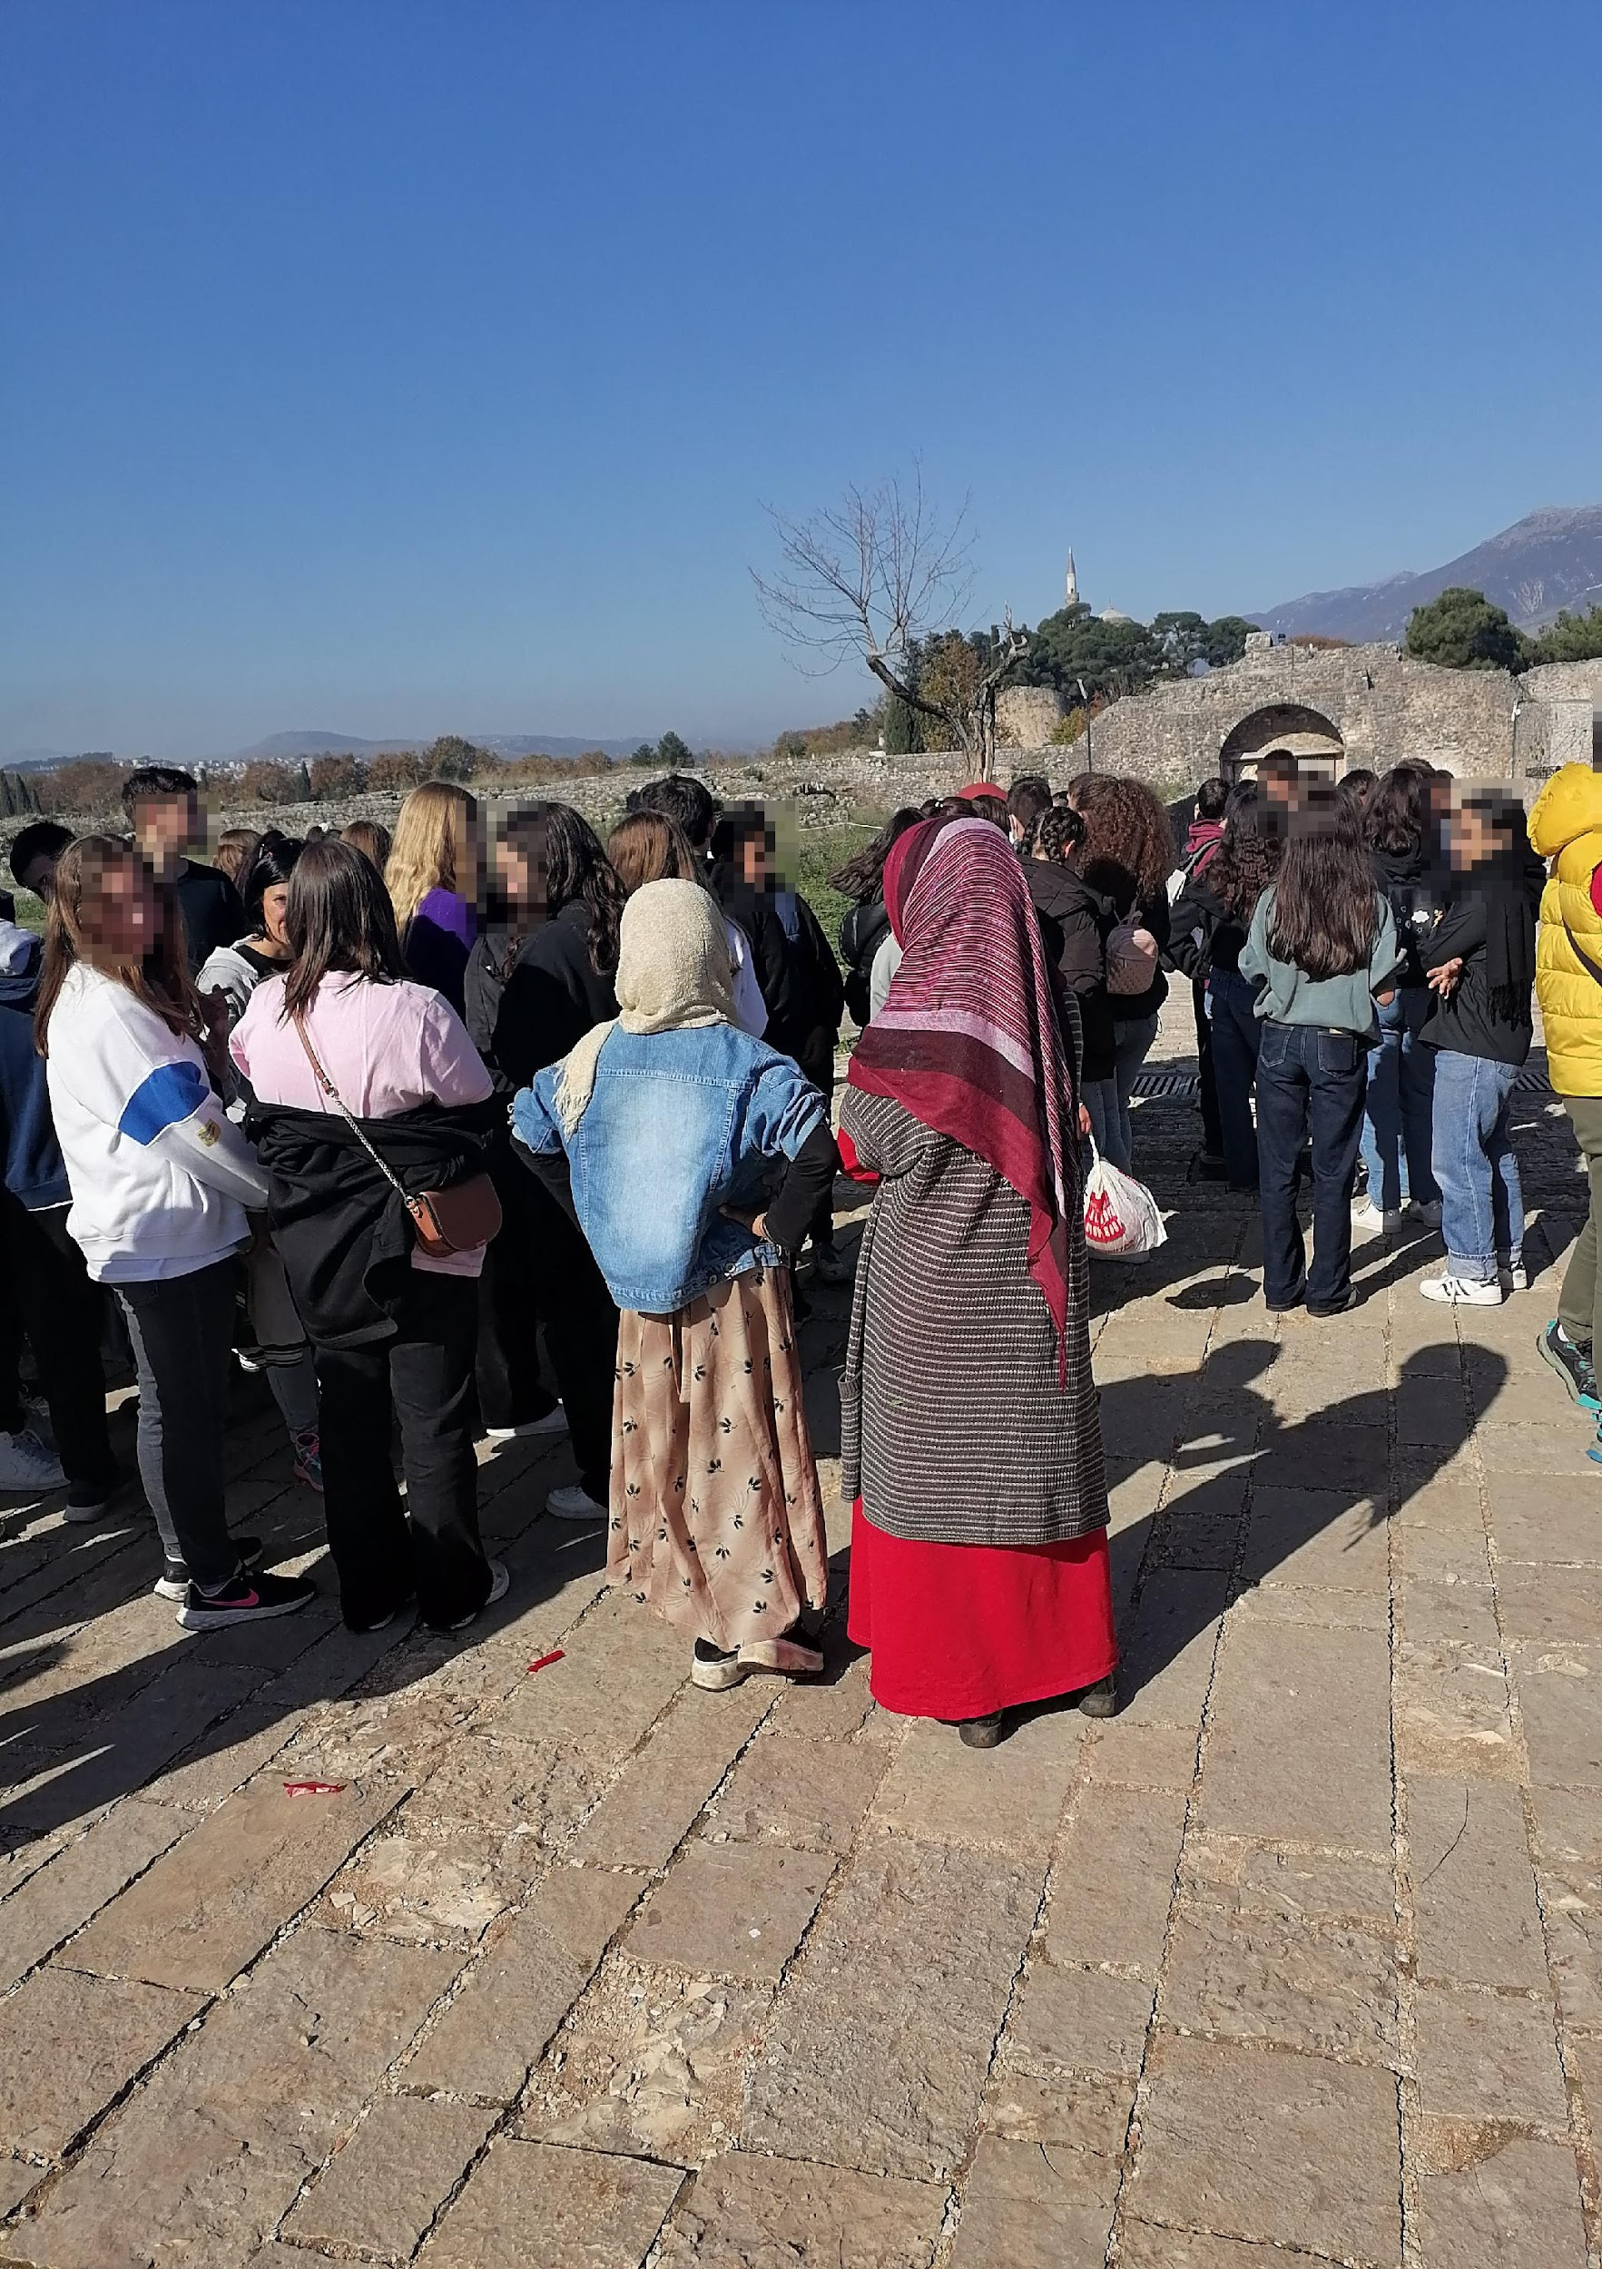
Multilingualism in the school environment

Slide 4
What is your attitude towards multilingualism?
Can you name any advantages or disadvantages of multilingualism?
Have you got any experience in teaching in a multilingual classroom?

Slide 5
Outline
Definitional toolkit: The first language, second language and additional languages
First and second language acquisition
Culture and acculturation
Repertoires and multicompetence
Languages and their functions in different social worlds/ domains
Individual and societal benefits of multilingualism
Multilingual landscapes: Minority and majority languages
Minority language attrition and maintenances (challenges and practices)
Migration experience and multilingualism in the educational setting
Translanguaging in educational context
Language and identity (optional)
Summary: Debunking language myths

Slide 6
Language immersion experience
Activity: A literature class in Danish (10 min). Watch the video (R1).
Look at Worksheet 1 (WS1) and follow the instructions.
What emotions accompanied you during this activity?

Slide 7
How to talk about languages?
A definitional toolkit

Slide 8
Individual perspective
First language(s) (L1)
Mother tongue(s)
Home language(s)
Second language(s) (L2)
Foreign language(s) (FL)
Heritage language(s)

Slide 9
Societal perspective
Majority language
“the language spoken by the socially or economically dominant group” on a particular territorial unit (Sevinç 2020: 85)
Minority language
“[l]anguage that is not the dominant language of a territorial unit such as a state, because the speakers of the language have less power, and the language is generally spoken by a smaller number of people.” (Skutnabb-Kangas & McCarty 2008: 10)
Dominant language
the majority language in the (new) settings used by newcomers and migrants to survive in the new territory.

Slide 10
Lingua franca
any language that is
used between two
people who do not
share the same first
language

Slide 11
Terminological quizz
Read Maya’s story about her linguistic development and follow the instructions in Worksheet 2 (WS2).

Slide 12
1st vs 2nd language acquisition
L1
L2
the learning of L1 is inevitable/children are doomed to success
complete in most cases
showing evidence of incompleteness only in case of severe deprivation
depends on maturation processes/biological ones
not all early beginners of L2 will reach nativelike level
may be incomplete
depends largely on the quality and quantity of input
depends on non-biological factors: motivation, cultural empathy, investment in learning

Slide 13
Language acquisition at different life stages
Children
set stages
more successful in acquiring pronunciation (Grotjahn 2005)
younger children were found to have the advantages of being less inhibited and monitoring their linguistic performance less
less likely than teenagers to be influenced by interference from L1 (Brown 2014: 76)
Teenagers
more efficient learners because they are better at deploying learning strategies based on the language they already knew
some have the ability to rapidly learn an L2 thanks to superior cognitive abilities
Adults
faster/more successful in learning of morphology and syntax due to their cognitive capacities (Tahta et al. 1981: 364; Muñoz 2008: 207–209)
susceptible to obstacles such as: less exposure to the language, work and home duties, and their knowing of at least one language which is likely to serve most of their communicative requirements (Yule 2006: 163)

Slide 14
Does multilingualism equal multiculturalism?

Slide 15
Individual perspectives on multilingualism
Listen to Kamillia (R2), a multilingual person from Algeria, talking about her experiences.
Does Kamillia think that multilingualism equals multiculturalism?
Do you agree with her?

Slide 16
Language repertoires and domains

Slide 17
Repertoire and multicompetence
Repertoire
the collective resources available to anyone at
any point in time (linguistic, semiotic, and
sociocultural resources used in
communication) (Blommaert 2010)
Multicompetence
a multilingual person’s ability to switch and merge their languages, plus the ability to differentiate between them and use them separately and selectively (Cook 2003)

Slide 18
Multilingual repertoires: the case of a Polish-Japanese family residing in the UK
Ayame (mother)
Jan (father)
Maya (daughter)
Age: 42
Country of origin: Japan
L1: Japanese
Other languages: English (C1)
Age: 44
Country of origin: Poland
L1: Polish
Other languages: English (C1/C2), Japanese (A2/B1
Age: 12
Country of origin: UK
L1: English/Japanese*
Other languages:
Japanese (B1), Polish (A1-), French (A1)

Slide 19
Maya (12) – language portrait
Extract 1
I: Blue is for English, yes?
M: Yeah.
I: And why? Just tell me about that.
M: Because it is where I was born and where I live.
I: So it’s in your head, right?
M: Yeah.
I: And why head?
M: Probably because my thoughts are in English. This is how I think. (…)
I: Why is Polish important to you? Why did you put it at all?
M: Because uhm my family half of my family is Polish. So it’s a special language for me.
I: In which sense? Do you speak it? Do you use it?
M: No (..) it’s kind of language … to do with my family.
I: Alright. So do you communicate in this language with your family in Poland?
M: No.
I: Not really. But can you, I don’t know, understand anything?
M: Yes, I do understand.
(Maya LP Audio- R3)

Slide 20
Visualising individual language repertoires
Language portraits/ landscapes/ trees/ houses and biography (20 min, pairwork/groupwork)
https://maledive.ecml.at/Studymaterials/Individual/Visualisinglanguagerepertoires/Examples/tabid/3636/Default.aspx
https://maledive.ecml.at/Home/Studymaterials/Individual/Visualisinglanguagerepertoires/tabid/3611/Default.aspx

Slide 21
Languages and their functions in different domains
Domain: a set of social situations where a certain language is used (cf. Myers-Scotton 2010: 77).
Domains are areas of social life that differ in terms of participants and their relationships, and the nature and function of their interactions.
The basic domains are family, friendship, religion, education and employment.
In multilingual communities, each domain is “commonly associated with a particular variety of language” (Fishman 1972: 44). For example, in the family domain, a minority language may be used. In the work domain, the majority language may be used (Baker & Wright 2017: 426).

Slide 22
Language use in different domains
Listen to Kamillia (R4), a multilingual person from Algeria, commenting on her language use in different domains. Match particular languages to the domains she mentions (WS 3).

Slide 23
Activity: Reflection on language use in different domains
Template completion (WS4)
Reflect on your language use in different domains: Complete the template, comment on it and add a domain of your own (if necessary)
Discussion

Slide 24
Benefits of multilingualism for individuals and society

Slide 25
Multilingualism and the brain
using more than one language has a positive effect on the brain (e.g. Bialystok et al. 2009)
exposure to two or more languages has an impact on the functional ability and microstructure of the brain
language acquisition (and not other types of learning) makes the brain grow (cf. Mårtensson et al. 2012).
https://pixabay.com/vectors/brain-mind-a-i-ai-anatomy-2750415/

Slide 26
Benefits of multilingualism for some individuals
better listeners, tend to be less distracted, have a better working memory and process more acute memories and augmented abilities
cognitive flexibility, outperform monolinguals at task-switching as well as problem-solving
a higher level of phonological awareness (Jessner 2008b)
better communicators
more proficient and sensitive communicators in all the languages that speak, including their L1
more open-minded and more aware of different cultures
better at making a proper choice of topic, register, speech acts with reference to the age, sex, socio-economic status of interlocutors and contexts in which they communicate (Chłopek 2011: 109)

Slide 27
Benefits of multilingualism for some individuals
Better language learners
learn languages more effectively thanks to their well-established metacognitive awareness and heightened metalinguistic awareness (cf. Andrews 2007, 2008).
higher learning autonomy and motivation to learn (see Chłopek 2011: 53–56).
Health benefits when ageing: competence in more than one language may mitigate cognitive decline and delay Alzheimer‘s disease (Bialystok et al. 2009).

Slide 28
TedEd: Multilingual brain: benefits
Video: part 2 (3.10-5.03); (R5)
https://www.youtube.com/watch?v=MMmOLN5zBLY

Slide 29
Societal benefits of multilingualism
business and economy,
culture,
education,
security,
and health (Chibaka 2018: 25)

Slide 30
Multilinguals on multilingualism
Listen to two multilinguals talking about benefits of multilingualism:
Sara (R6) and Rayenne (R7).
Do they mention any disadvantages of being a multilingual person?
How do you see it?

Slide 31
Interplay between languages in multilingual societies
Language maintenance and attrition

Slide 32
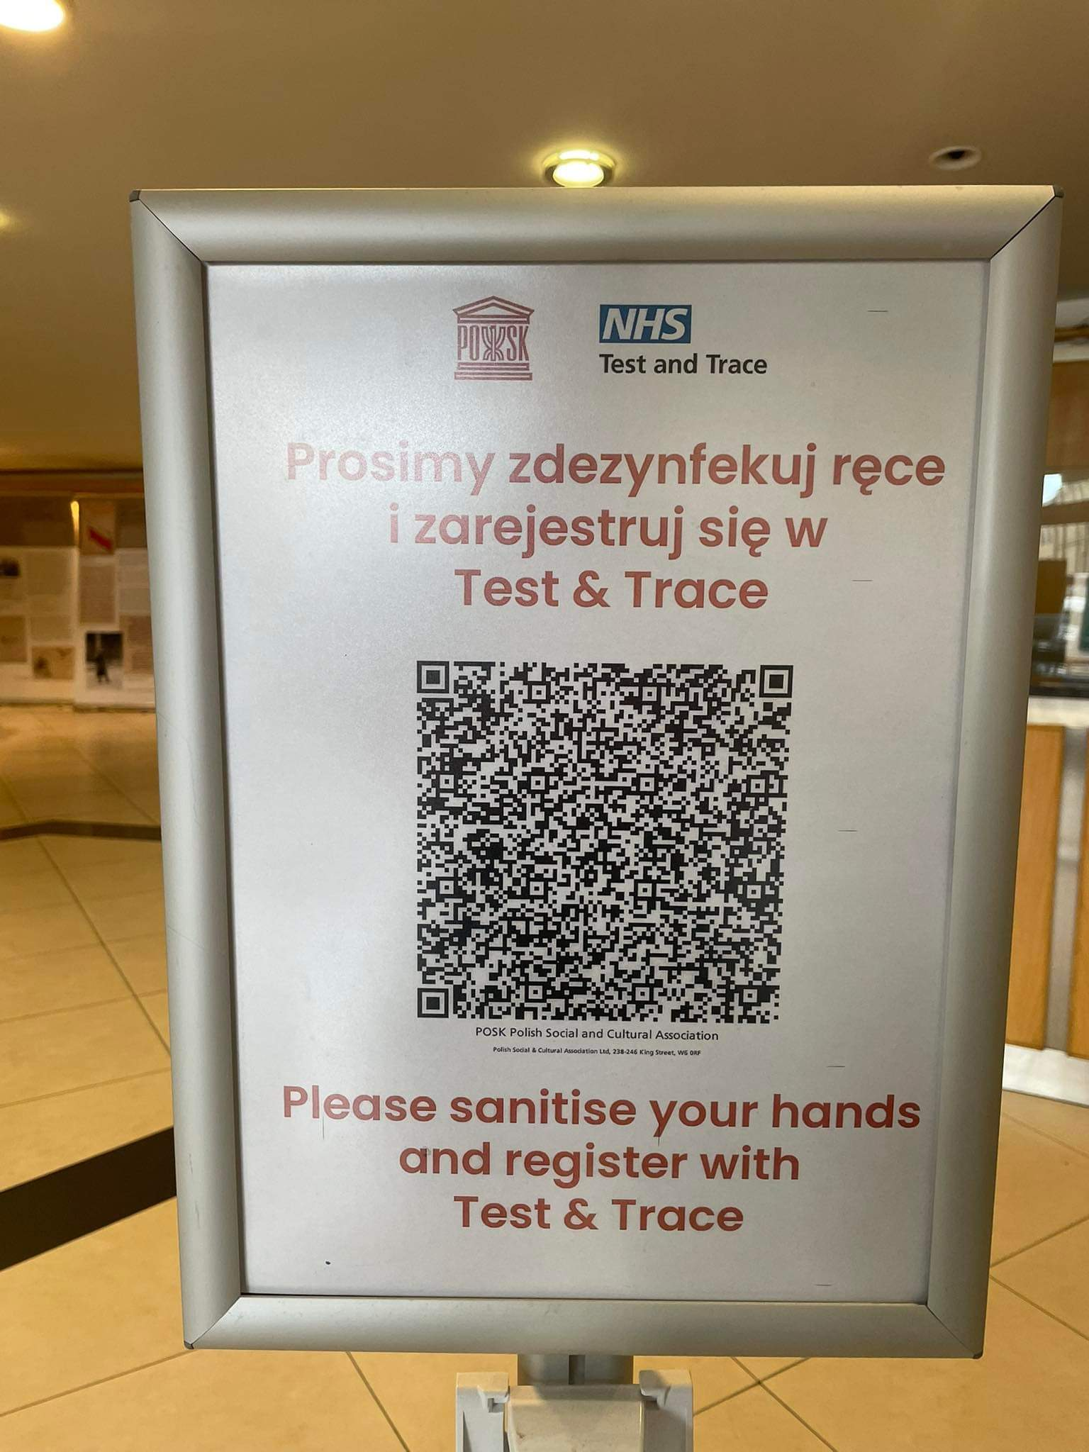
Multilingual landscapes: Minority and majority languages
London, UK
Killarney, Ireland

Slide 33
Minority language attrition and maintenance
Language attrition
the loss of, or changes to, grammatical and other features of a language as a result of declining use by speakers who have changed their linguistic environment and language habits (Schmid 2011).

Slide 34
One of the most common problems: rejection of the home or minority language
Children quickly understand which language holds a higher status in the community, which language is spoken by the majority, and which language is more effective in their everyday lives.
Friesen, D. C., Luo, L., Luk, G., & Bialystok, E. (2015). Proficiency and control in verbal fluency performance across the lifespan for monolinguals and bilinguals. Language, Cognition and Neuroscience , 30 (3), 238-250. Copy at https://tinyurl.com/yxc9lto2)
https://www.gse.harvard.edu/news/uk/15/10/bilingualism-life-experience

Slide 35
Minority language maintenance: challenges
Maya (6, 2015)
Maya (8, 2017)
Jan: Maya, chodź poczytamy. (Maya, let’s read.)
Maya: I don’t want you to read me a Polish book!
Jan: Dlaczego? (Why?)
Maya: I don’t like it.
Jan: Dobrze, poczytamy inną. (OK, we can read another one)
Maya: No! Not in Polish!
Jan: Dlaczego nie? (Why not?)
Maya: Polish is too difficult. I don’t like it
Jan: Maya, let’s read this book you got from aunt Ola.
Maya: I’ve already done it.
Jan: I know. But we can read in Polish.
Maya: What for?

Slide 36
Displacement and majority language learning
A change of one’s place of residence/ migration typically boosts motivation for learning the language of the majority/hosts in the country where they reside to
to survive in the new settings
and to benefit materially from improving their lives. The same applies to the language of business or worldwide communication.
Most members of a minority group sooner or later acquire a good command of the majority language due to social pressure on them to participate fully in social activities, e.g. to do business, attend school (Myers-Scotton 2010: 37).
Merging with the mainstream community constitutes a very important motivational factor.
Teachers need to realise that migrant children are very often keen to learn the majority language, which is a motivation very often absent in learning a foreign language.

Slide 37
Minority language maintenance
Threats
Opportunities
L1 attrition
Language attitudes and ideologies (e.g. ethnolinguistic assumption Blommaert 1996)
Power issues
Language attitudes and awareness of the dominant majority
Pressure for linguistic integration
Language as a token of citizenship
Voice appropriation
Official recognition:
Translation services in public offices, translanguaging accepted
Language rights and empowerment

Slide 38
Migration experience and multilingualism in the educational setting

Slide 39
Put yourself in my shoes: stories of migration and multilingualism
Analysis of and reflection on real experiences of multilingual children and adults with migration experience.
Listen to Amina, an eight-year-old girl from Belarus (R8) and her mother Azalia (R9) talking about their experiences at a Polish school.
Group discussion and recommendations

Slide 40
Translanguaging
Translanguaging
Translanguaging involves the use of the speaker’s “full linguistic repertoire without regard for watchful adherence to the socially and politically defined boundaries of named (and usually national and state) languages” (Otheguy et al. 2015: 283).
In translanguaging, speakers not only bring together all languages they know for meaning-making (García & Li 2014) but also rely on multimodal repertoires that are not limited to linguistic resources. This can include body language, visual cues and even interactions between individuals and technology (García & Otheguy 2019).

Slide 41
Examples of translanguaging: Rayenne
Listen to Rayenne: R10

Slide 42
Examples of translanguaging (Sara)
Examples of how multilingual speakers transfer between languages:
-Thanks a lot for your good advice; hope to see you next week.
Merci beaucoup pour votre aide, انشاء الله نتلقاو la semain prochaine (French-Arabic)
- Today I have to go the bank, but I should first get the needed documents.
Assagi (ⴰⵙⴰⴳⵉ) j’ai un rdv dhi (ⴹⵉ) la blanque, mais ilaq (ⵉⵍⴰⵇ) d’abord ad 3edigh (ⴰⴹ ⵄⴻⴷⵉⴴ) pour récupérer les documents a déposés ghoursen (ⵖⵓⵔⵚⵏ) (French-Berber)
I would like to conduct an interview with them but I am afrad to be late.
J’aimerai faire un entretien de travail معهم mais راني خايفة نلحق retard (French- Arabic)
-If you don’t mind, can you sign this document, please!
Moulach oughilif (ⵎⵓⵍⴰⵛ ⵓⴴⵉⵍⵉⴼ), tu peux me signe le papier agi (ⴰⴳⵉ) s’il te plait (French-Berber)
Nb : The signs next to the Berber words are called ‘TIFINAGH’ (the Berber alphabet); it is a common practice to write Berber in the Latin alphabet.

Slide 43
Translanguaging in educational context
Listen to Rayenne (R11) and Kamillia (R12)– Algerian multilinguals commenting on their school experiences.
What was their teachers’ attitude towards multilingualism and translanguaging ?
How did it affect pupils’ multilingual development?

Slide 44
Classroom translanguaging:
An asset or hindrance?
To what extent are we able to incorporate translanguaging in the classroom?
In which tasks can it be useful?
How can it foster classroom interaction?
What about assessment?

Slide 45
Language and identity
Optional module

Slide 46
Language and identity
Any other?

Slide 47
Language and identity
2015
Ayame: Maya, don’t sit like this. Japanese girls do not sit in this way.
Maja: But I’m not a Japanese girl.
Ayame: Of course you are!
Maja: No, I’m not. I’m English. And a bit Polish.
Ayame: What did you say?! I can’t believe it! Janek, did you hear what she said?
2017
Maja: I’m English. I have always lived here. My home is here, my school, friends…

Slide 48
Language and identity
Language: “a positive badge of identification” (Myers-Scotton 2010: 9)
Myers-Scotton (2010: 37): “people typically speak more than one language because an extra language does important ‘social work’ for them”.
Individuals add another language to their repertoires because this language will be useful for them in their community or a community they want/need to join.
When groups are in contact, “they both value their language but typically the less powerful/numerous group learns the other group’s language, not vice versa” (Myers-Scotton 2010: 9)

Slide 49
Optional module
Debunking multilingualism myths

Slide 50
Sample myths
Choose two of the statements and give some reasons why they are wrong or right.
Multilingualism is a rare phenomenon
Multilingualism delays language acquisition in children.
Multilingual people are also multicultural.
Mixing languages is a sign of laziness in multilingual people.
Multilingual people are born translators.
Multilinguals acquire their two or more languages in childhood
Multilinguals have equal and perfect knowledge of their languages, e.g. they have no accent in their different languages
Mixing languages is a sign of laziness in bilinguals.
https://www.francoisgrosjean.ch/myths_en.html

Slide 51
Summary: Debunking language myths
(25 min) - Group discussions - Reflections- poster

Slide 52
Workshop wrap-up
Certificates and thank-yous

Slide 53
References
Andrews, S. J. (2007). Teacher language awareness. Cambridge: Cambridge University Press.
Andrews, S. J. (2008). Teacher language awareness. In: J. Cenoz & N. H. Hornberger (eds.), Encyclopaedia of language and education (2nd ed.) (vol. 6, pp. 287–298). Heidelberg: Springer.
Baker, C. / Wright, W. E. (2017). Foundations of bilingual education and bilingualism (6th ed.). Bristol: Multilingual Matters.
Bialystok, E. / Craik, F. I. M. / Green, D. W. / Gollan, T. H. (2009). Bilingual minds. Psychological Science in the Public Interest, 10(3), (pp.89–129). https://doi.org/10.1177/1529100610387084
Blommaert, J. (2010). The sociolinguistics of globalization. Chapter 4: Repertoires and competence (pp. 102-136). Cambridge: Cambridge University Press. doi:10.1017/CBO9780511845307.006
Brown, H. D. (2014): Principles of language learning and teaching. A course in second language acquisition. White Plains: Pearson Education.
Chibaka, E. F. (2018). Advantages of bilingualism and multilingualism: Multidimensional research findings. In B. S. Chumbow (ed.), Multilingualism and bilingualism (pp. 15–36), London: IntechOpen. https://doi.org/10.5772/intechopen.74625
Chłopek, Z. (2011). Nabywanie języków trzecich i kolejnych oraz wielojęzyczność. Aspekty psycholingwistyczne (i inne). Wrocław: Wydawnictwo Uniwersytetu Wrocławskiego.
Cook, V.J. (ed.) (2003) Effects of the second language on the first. Clevedon: Multilingual Matters.
Fishman, J. (1972). The sociology of language. Rowley, MA: Newbury House.
García, O. / Otheguy, R. (2019): Plurilingualism and translanguaging: commonalities and divergences, International Journal of Bilingual Education and Bilingualism, DOI:10.1080/13670050.2019.1598932
García, O. / Li Wei. 2014. Translanguaging: Language, Bilingualism and Education. London: Palgrave Macmillan.
Grotjahn, R. (2005). Je früher, desto besser? – Neuere Befunde zum Einfluss des Faktors „Alter“ auf das Fremdsprachenlernen. In: H. Pürschel / T. Tinnefeld (eds.). Moderner Fremdsprachenerwerb zwischen Interkulturalität und Multimedia: Reflexionen und Anregungen aus Wissenschaft und Praxis (pp. 186–202). Bochum: AKS-Verlag.
Jessner, U. (2008b). Teaching third languages: Findings, trends and challenges. Language Teaching, 41(1), 15–56.
Mårtensson, J. / Eriksson, J. / Bodammer, N. Ch. / Lindgren, M. / Johansson, M. /Nyberg, L. / Lövdén,M.(2012).Growth of language-related brain areas after foreign language learning. NeuroImage, 63, 240–244.
Myers-Scotton, C. (2010). Multiple voices. An introduction to bilingualism. Malden / Oxford: Blackwell.
Otheguy, R., García, O., & Reid, W. (2015). Clarifying translanguaging and deconstructing named languages: A perspective from linguistics. Applied Linguistics Review, 6(3), 281–307.
Sevinç, Y. (2020). Anxiety as a negative emotion in home language maintenance and development. Handbook of home language maintenance and development: Social and affective factors, 84-108.
Skutnabb-Kangas, T. / McCarty, T.L. (2008). Key concepts in bilingual education: ideological, historical, epistemological, and empirical foundations . In: J. Cummins / N. Hornberger (eds.), Bilingual education (2nd edition, vol. 5. Encyclopaedia of language and education, pp. 3–17). New York: Springer.
Tahta, S. / Wood, M. / Loewenthal, K. (1981). Age changes in the ability to replicate foreign pronunciation and intonation. Language and Speech, 24 (4), 363–372.
Muñoz, C. (2008). Age-related differences in foreign language learning. Revisiting the empirical evidence. IRAL, 46 (3), 197–220.
Yule, G. (2006): The study of language (3rd ed.). Cambridge: Cambridge University Press.

Slide 54
CERTIFICATES
Thank you for your participation

